Slide 1
Cleveland Elementary - School Planning

Slide 2
Cleveland Elementary School Planning
A Snapshot of Cleveland Elementary
L’Ecole Cleveland Elementary offers an environment where all members of the community help create a positive school culture. School staff, students and the Parent Advisory Council (CPAC) have consciously developed a strong collaborative, community-minded ethic. We work together to reinforce Care for Self, Others and the Environment as we bring many exciting opportunities to our students and community members, at all age levels.

Slide 3
Cleveland Elementary School Planning
Cleveland Programs
We offer instruction in English and in French through our District French Immersion program. This provides us with a rich and diverse parent and student population; many of our approximately 480 students live outside the immediate catchment area.
In addition to regular classroom programs, staff and parents offer many leadership opportunities and extra-curricular activities for students in athletics, citizenship and the arts. We host district level Band (Gr 5-7) and Strings (Gr 4-7) programs. Our school staff offers a wide variety of leadership and academic opportunities to students at every grade level. We offer Volleyball, Basketball and Track and Field to intermediate students, and special leadership opportunities and celebrations for our intermediate students.

Slide 4
Cleveland Elementary School Planning
Cleveland Parent Advisory Council
The Cleveland Parent Advisory Committee (CPAC) is extremely active and successful in providing a community liaison, fundraising efforts, coordination of community and family events, representatives for every classroom, assisting with volunteer coordination, coordinating parent in-service and speakers, and being an integral part of the educational supports at the school.

Slide 5
Cleveland Elementary School Planning
Cleveland’s School Mission:
The Cleveland School mission is to provide an environment that fosters the emotional, social and physical well being and the intellectual development of all students. Cleveland School will promote a positive self concept, respect for self, respect for others, respect for the environment, fitness and health

Slide 6
Cleveland Elementary - School Planning
Cleveland Elementary School Plan
Goal 1
Every member of the Cleveland School Community supports a school culture that inspires continuous achievement and positive growth

Slide 7
Cleveland Elementary - School Planning
Objective 1.1
We will actively reinforce individual student engagement and success by creating, supporting, facilitating, and investigating alternate and creative learning activities, in a variety of settings

Slide 8
Cleveland Elementary - School Planning
Objective 1.1 Big Ideas
students at Cleveland will have the opportunity to immerse themselves in educational experiences that are inspired by nature
at Cleveland, the learning process uses the environment as a starting point to teach concepts in subjects across the curriculum.
students will develop place based knowledge about the area in which they live

Slide 9
Cleveland Elementary - School Planning
Objective 1.1 Core Competencies:
students develop awareness and take responsibility for their social, physical, and natural environments by working independently and collaboratively for the benefit of others, communities, and the environment
learning activities support personalized, student centred learning, as students inquire about concepts, topics and issues relevant to their lives and community
equip students as active and ecologically literate citizens in their local and global communities

Slide 10
Cleveland Elementary - School Planning
Objective 1.2
We will support and enhance a research based approach to improving individual student Reading and Writing levels (home support, variety, Response to Intervention RTI)

Slide 11
Cleveland Elementary - School Planning
Objective 1.2 Curriculum Big Ideas
using language in creative ways helps us understand how language works
language and text can be a source of joy
questioning what we hear, read, and view contributes to our ability to be educated and engaged citizens

Slide 12
Cleveland Elementary - School Planning
Objective 1.2 Service Delivery Model
Tier 3: Intensive Intervention for Individual Students
Tier 2: Supplemental Interventions for Some Students
Tier 1: Effective Core Instruction for ALL

Slide 13
Cleveland Elementary - School Planning
Objective 1.3
Cleveland Staff will:
actively engage in regular and systematic professional development and in-service
maintain a professional awareness of new and creative curricula, research based methods and strategies of teaching to diversity

Slide 14
Cleveland Elementary - School Planning
Objective 1.3 action plan:
Teachers and staff will be able to do the following from professional development and in-service:
examine evidence from various perspectives to analyze and make well-supported judgments and interpretations about complex issues
consider views that do not fit with their current beliefs

Slide 15
Cleveland Elementary - School Planning
Reflection and Feedback:
Objective 1.1
We will actively reinforce individual student engagement and success by creating, supporting, facilitating, and investigating Alternate and Creative Learning Activities, in a variety classroom and out-of-classroom settings.
Reflection and Feedback: Cleveland does and will continue to schedule into school calendar, programs and initiatives that support this objective. Student body surveys would help measure this goal.
Objective 1.2
We will support and enhance a research based approach to improving individual student Reading and Writing levels. (home support, variety, RTI)
Reflection and Feedback: School scores on standardized tests, report card performance standards, class writing samples will shed light into improvements of this objective
Objective 1.3
Cleveland Staff will actively engage in regular and systematic Professional Development and In-Service, and maintain a professional awareness of new and creative curricula, and research based methods and strategies of teaching to diversity.
Reflection and Feedback:
Notes:
Not sure ho objective 1.3 could be measured??

Slide 16
  “School planning is a process not an event”
Cleveland Elementary - School Planning
  The essential elements of Cleveland’s School Plan are:
    shared values and vision
    student engagement and learning
    collaboration, communication and community

Slide 17
Cleveland Elementary - School Planning
The goals and objectives of the Cleveland School Plan were identified through:
collaboration with our student body through surveys
the Appreciative Inquiry Process

Slide 18
‘Meaningful, Flexible, Co-constructed’
Cleveland Elementary - School Planning
Cleveland Planning Team:
Teachers – Suzanne Simpson, Leanne O’Neill, Morag Kelley, Val Batyi
Educational Assistants – Mary Stein, Daniela Ianorescu
Administration – Bill Reid, Leslie McQuire
Parents – Mel Montgomery, Jessica Bratty

Slide 19
Cleveland Elementary - School Planning
Guiding Question and School Values
What makes a great school?
  courtesy, inclusion, welcoming
  safety, responsibility, commitment
  effort, recognition, collaboration
  encouragement, clear expectations, staff development, and growth mindset

Slide 20
Cleveland Elementary - School Planning
  Primary and Intermediate student survey data assisted in clarifying our three main objectives stemming from our one goal
Notes:
What is end product for this slide-needs to be reworked

Slide 21
Cleveland Elementary - School Planning
  The data:
  PRIMARY (gr. K-3) 202 respondents
  The Question: “What is your favourite thing to do at school?”
  Science 2 %
  Music 2 %
  Phys. Ed. 7 %
  Sports Outdoors 13 %
  Playing Outside 13 %
  Art 19 %
  Math 19 %
  Alternate Learning 27 %

Slide 22
Cleveland Elementary - School Planning
  The data:
  Intermediate (gr. 4-7) 200 respondents
  The questions were a more advanced version, but the theme was the same:
  The intermediate data attributed a high level of importance to non-traditional classroom based locations:
  library
  forest
  lower Field
  playground
  outdoor meeting, playing, and learning areas
  courtyard

Slide 23
Cleveland Elementary - School Planning
  The data found significant support for non-traditional ways of learning, special activities, and interaction with nature:
  field trips
  special program (tennis, gymnastics,)
  outdoor Learning
  environmental interaction
  play based/hands-on learning

Slide 24
Cleveland Elementary - School Planning
The following photos provide a glimpse into a variety of non traditional teaching methods and locations that have generated the highest levels of instructional interest and success for a majority of Cleveland students.

Slide 25


Slide 26
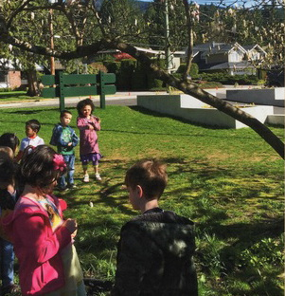

Slide 27
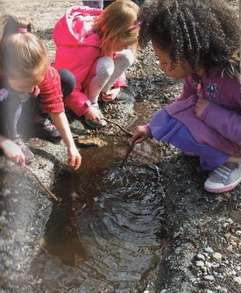

Slide 28
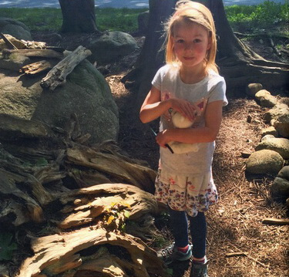

Slide 29
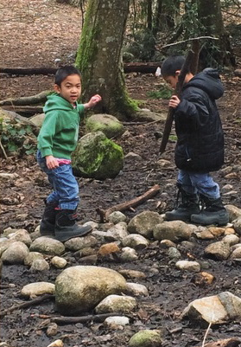

Slide 30
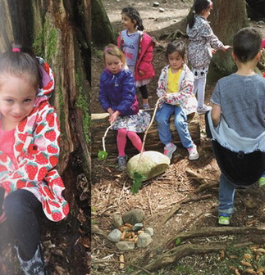

Slide 31
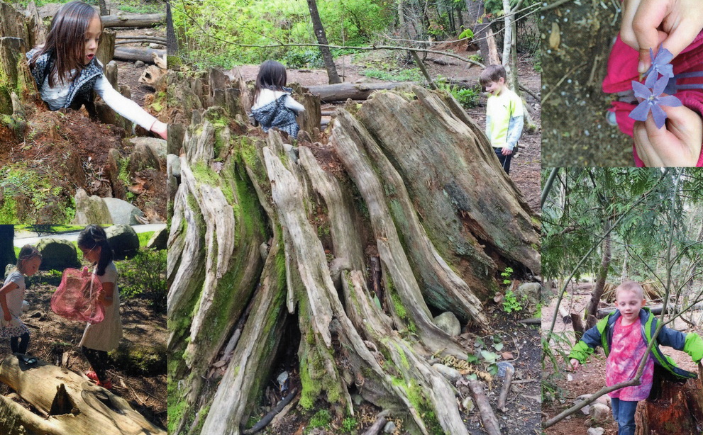

Slide 32
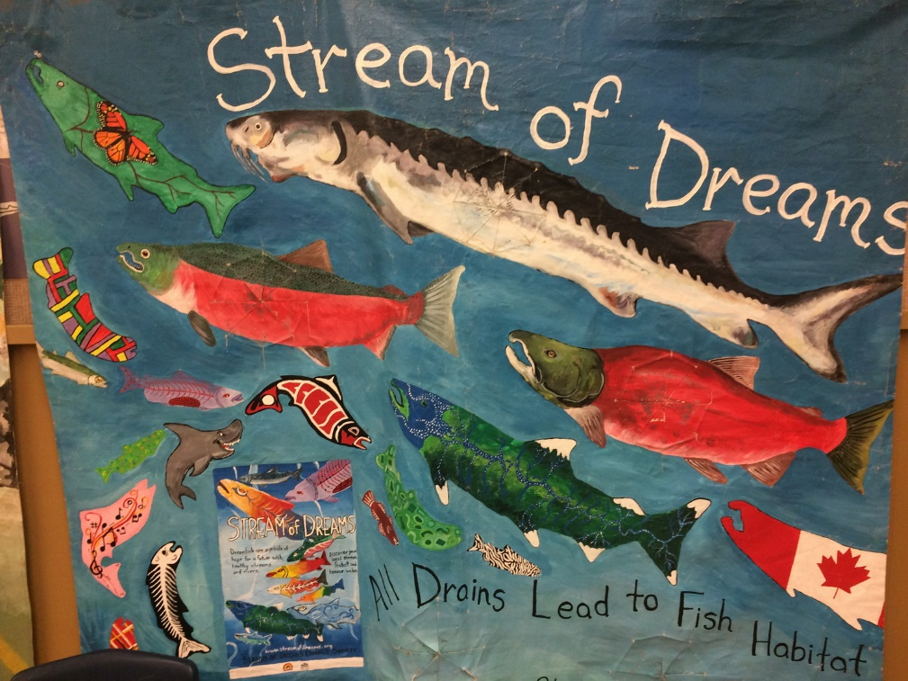

Slide 33
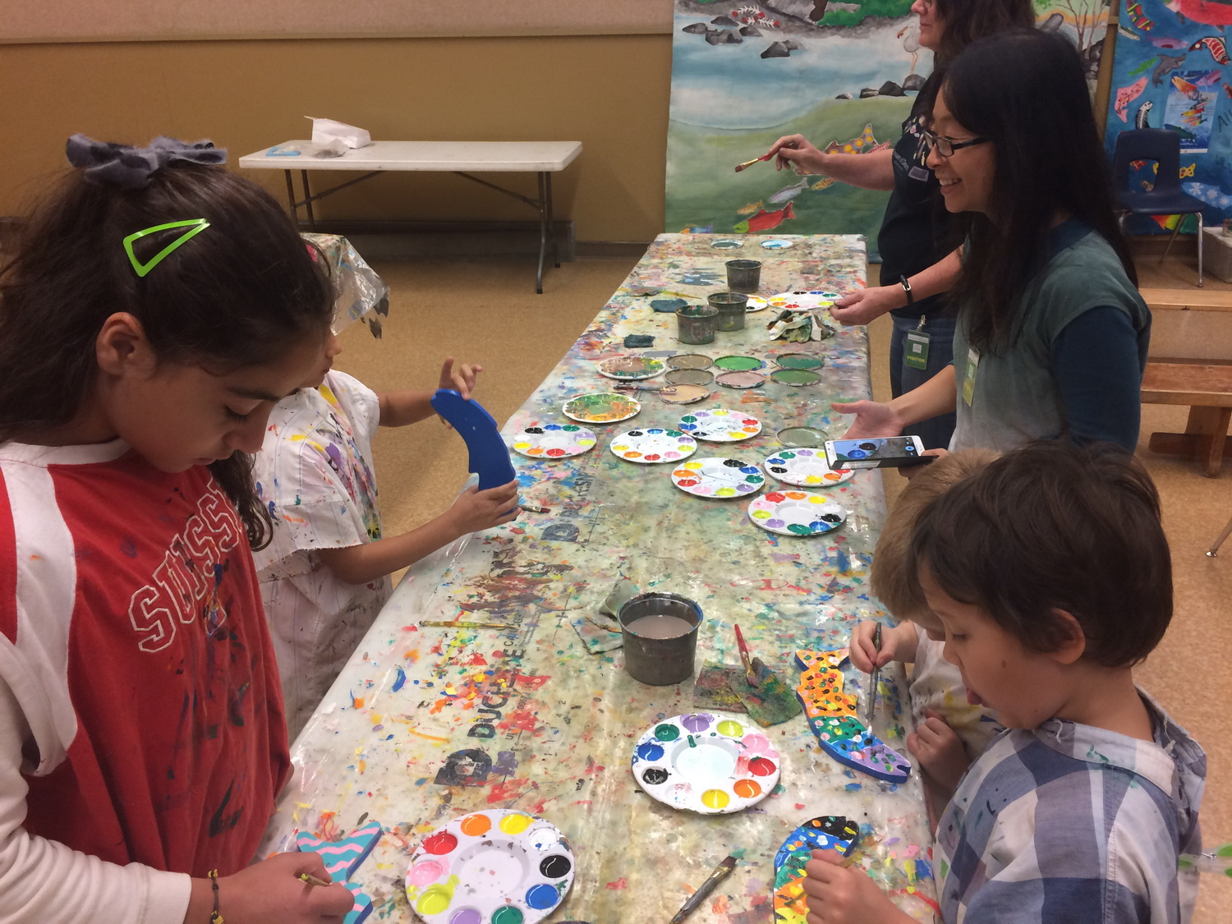

Slide 34
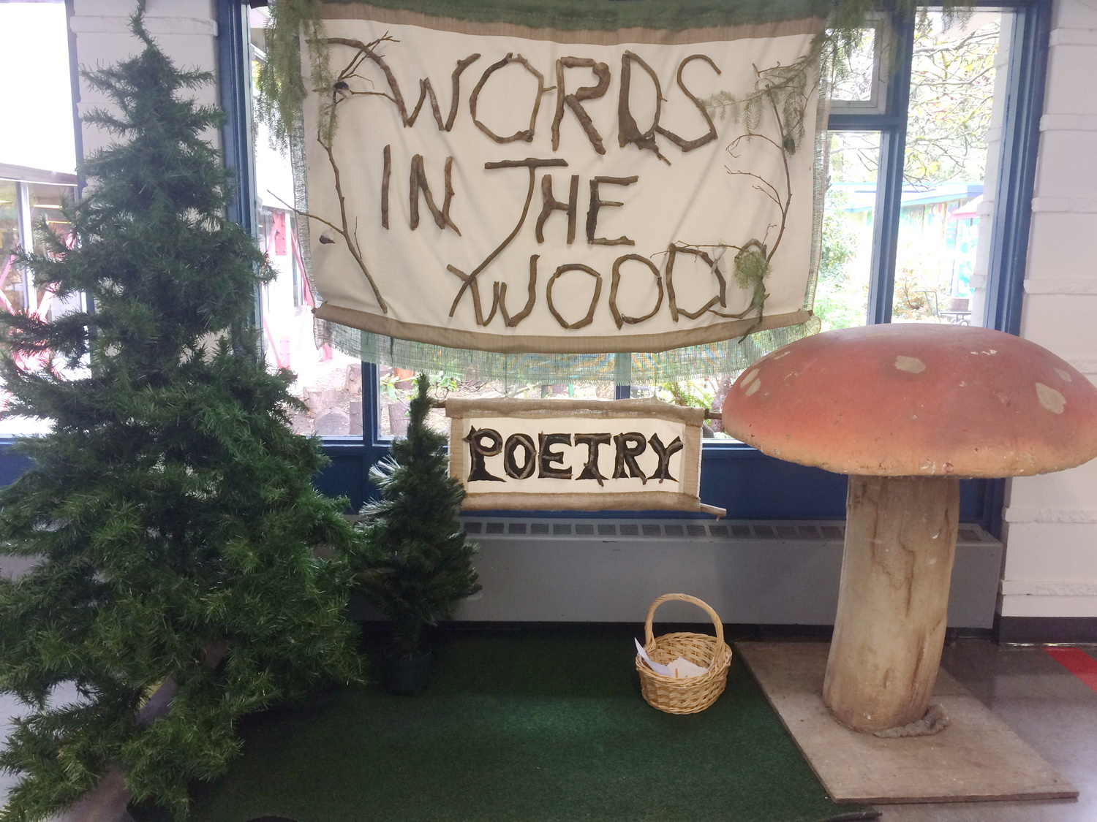

Slide 35
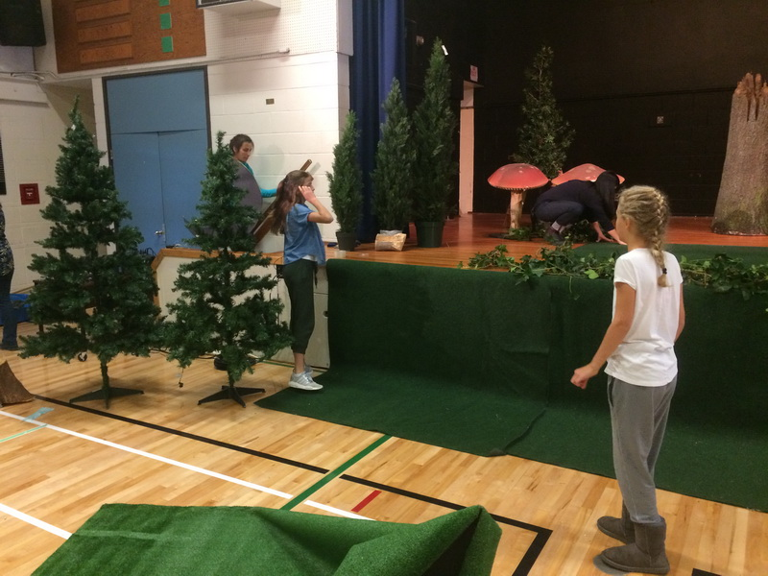

Slide 36
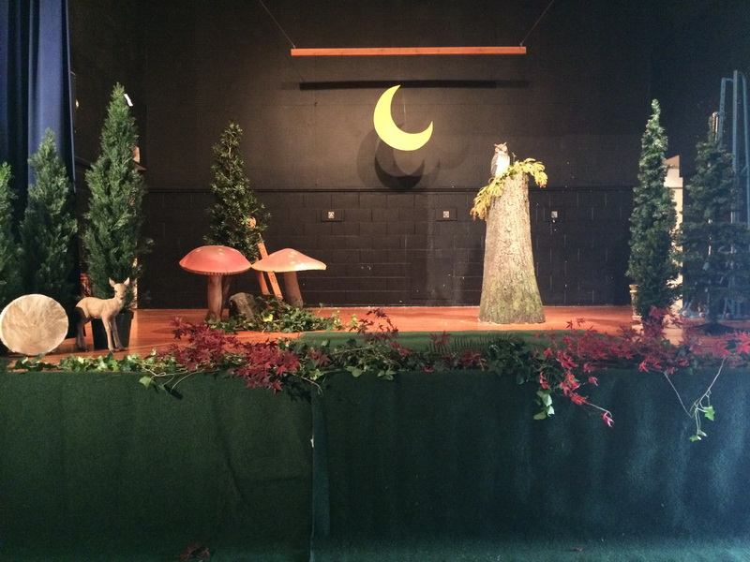

Slide 37
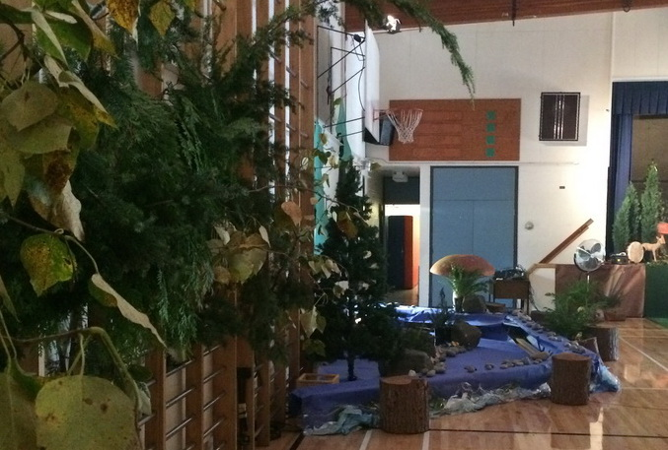

Slide 38
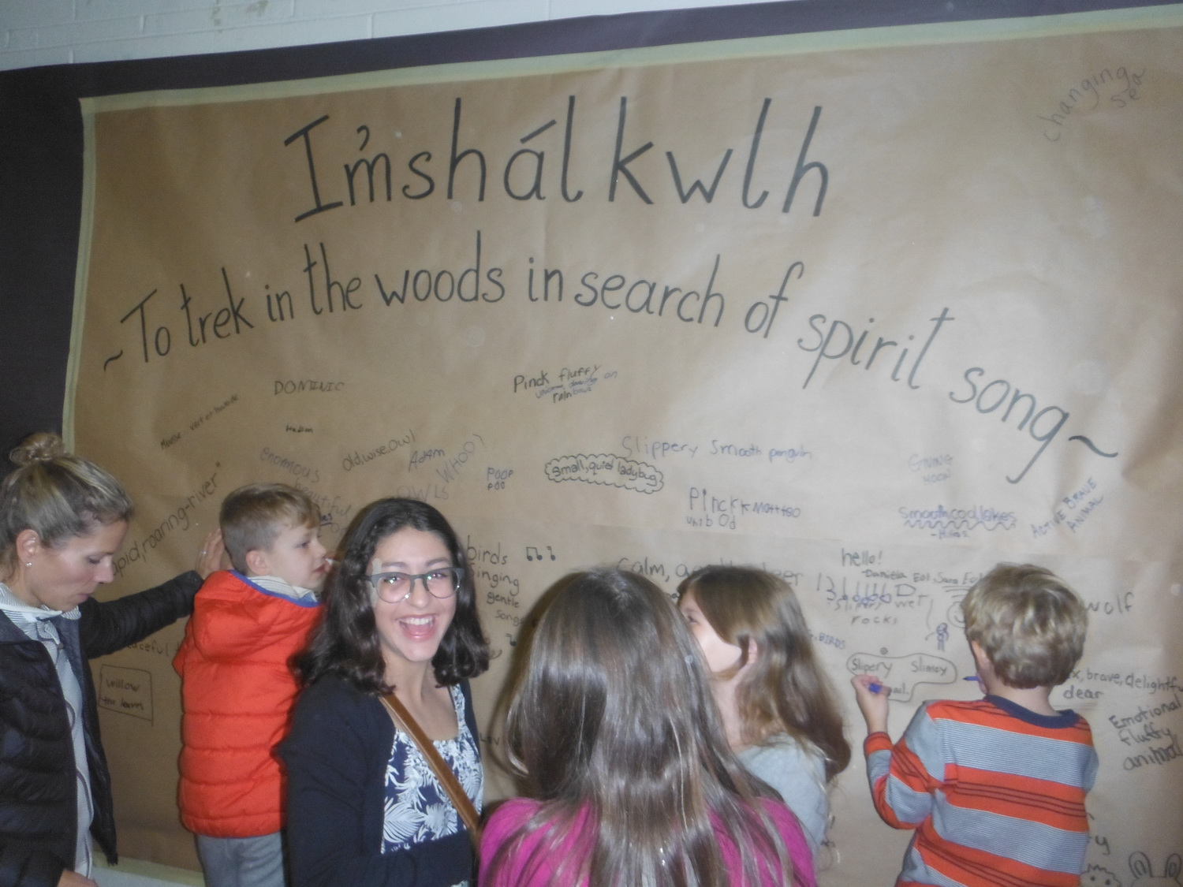

Slide 39
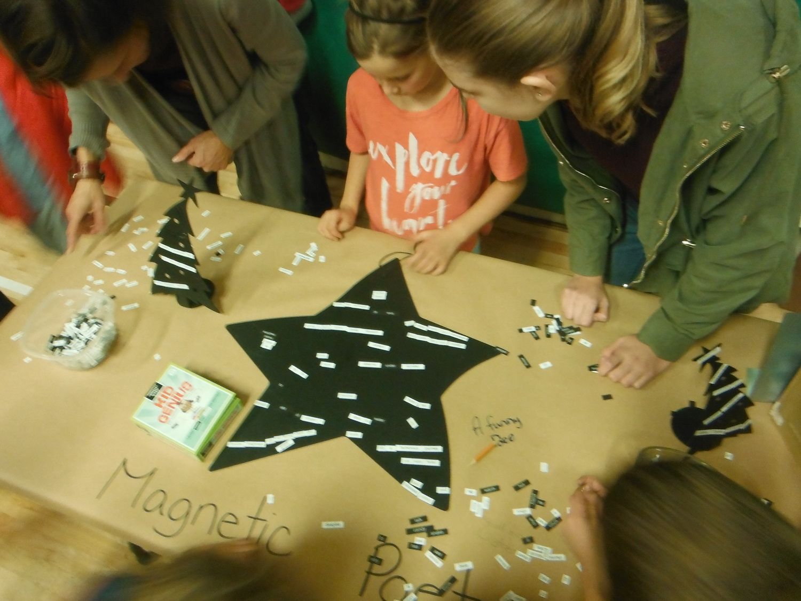

Slide 40
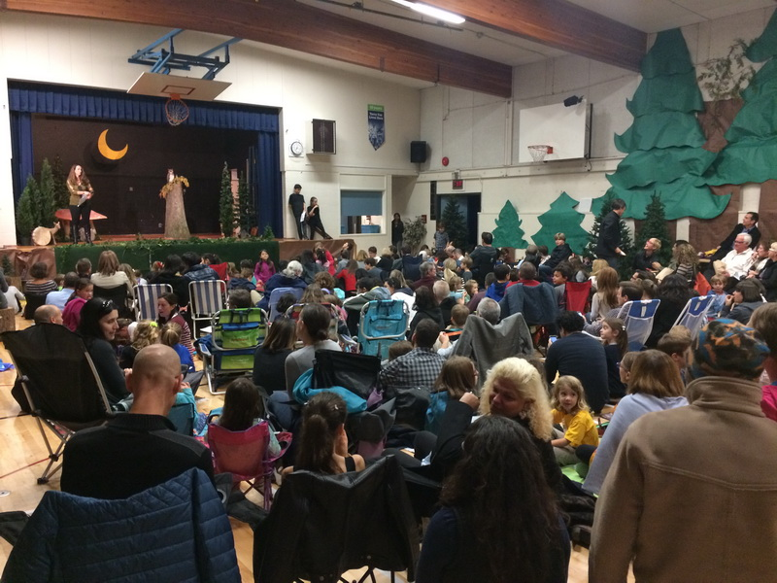

Slide 41
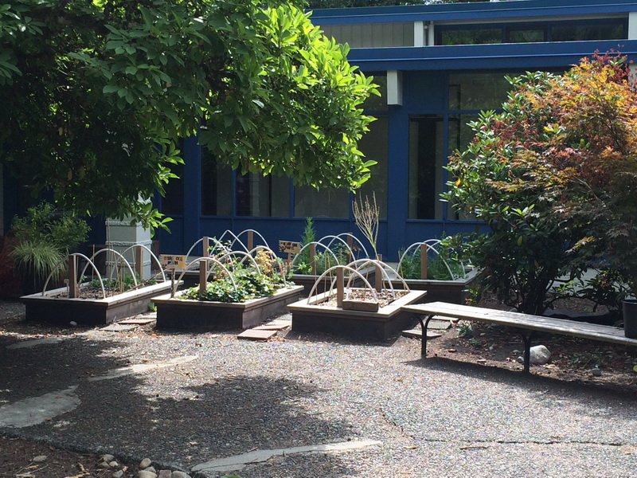

Slide 42
