Slide 1



Grade 11 & 12
Post Secondary Parent Information Evening
Thurs, Oct 16, 2025

Slide 2



Welcome
At Windsor, we acknowledge and honour the history and culture of the Coast Salish people, upon whose traditional territory the North Vancouver School District resides.
We express our gratitude to the Tsleil-Waututh and Squamish Nation and we value the opportunity to learn, live and share educational experiences on this traditional territory.

Slide 3
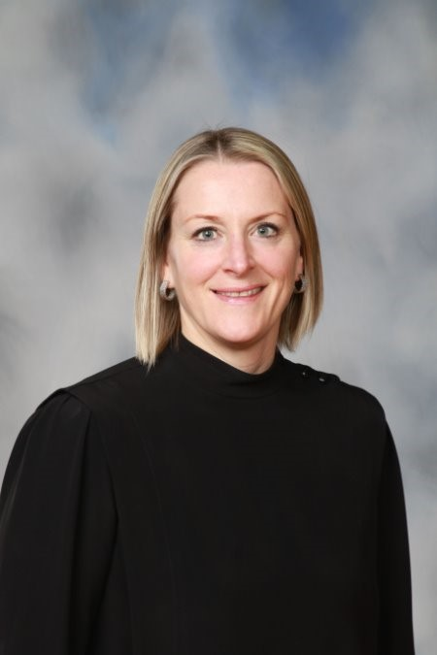
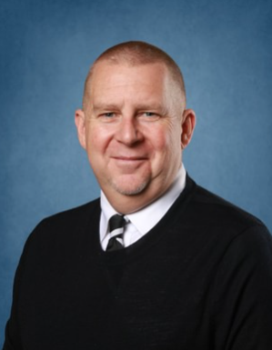
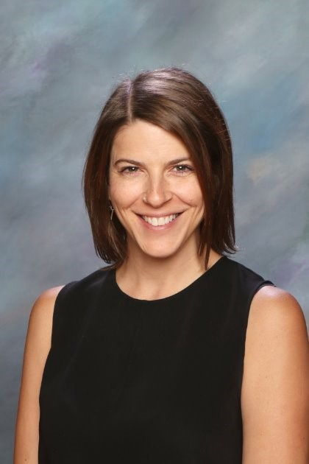
Ms. Caren Hall, Principal
Gr. 12
Mr. Greg Hockley, Vice-Principal
Gr. 9 & 11
Ms. Jennifer Tieche, Vice-Principal Gr. 8 & 10
Windsor Admin. Team

Slide 4
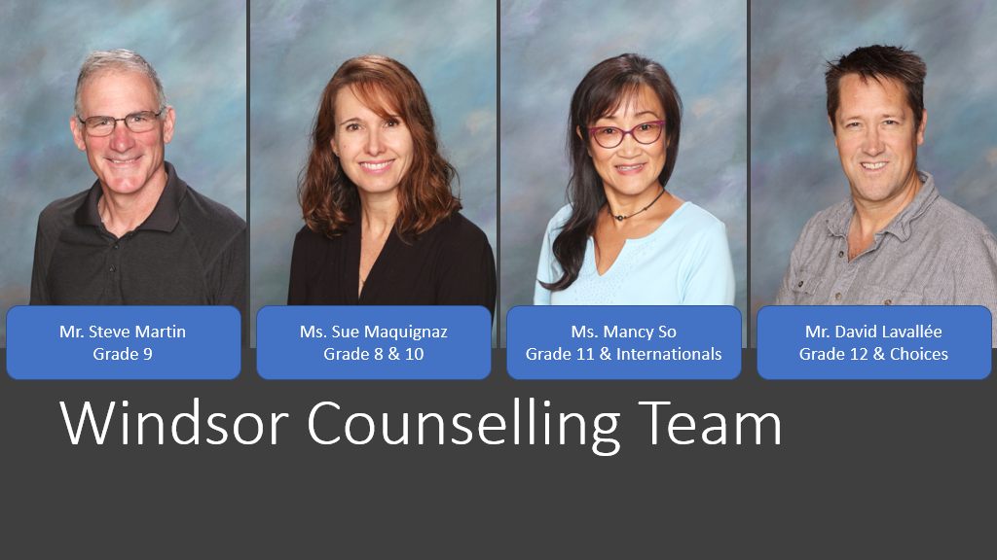
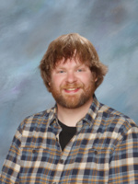
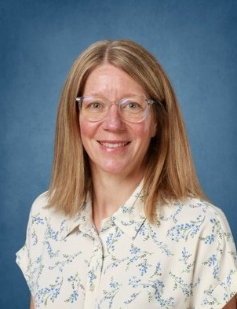
Ms. Sue Maquignaz Gr. 10 & Choices
Mr. Chris Barnes
Gr. 12
Ms. Mancy So
Gr. 11 & Internationals
Ms. Megan Brady
Gr. 8 & 9
Windsor Counselling Team

Slide 5
Key Contacts
Grade 12:
Ms. Caren Hall – Principal, chall@sd44.ca
Mr. Chris Barnes – Grade 12 Counsellor, chrisbarnes@sd44.ca
Ms. Connie Misceo– Careers Life Connection 12 Teacher cmisceo@sd44.ca
Grade 11:
Ms. Jennifer Tieche– Vice Principal (for Grade 11), jtieche@sd44.ca
Ms. Mancy So – Grade 11 Counsellor, mso@sd44.ca

Slide 6
Presentation Overview
Grad Events​
Grade 12 Morning Meetings & Career Life Connection Course​
Post-Secondary Information & FAQ​
General Scholarship & Bursary Information

Slide 7
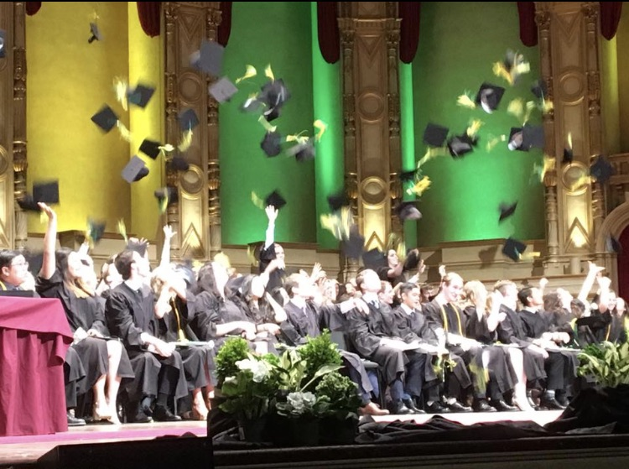
Grad Events
z

Slide 8
Individual Grad Photo Sessions
  Sittings: Dec. 4, 5, & 8-10th , 2025 at Windsor
  On-line Appointment: www.gradsbc.com/school/wsr
  After the above dates, students run risk of not being in the yearbook and/or the grad composite
  Group photos require a separate appointment on a separate day (Dec 11)

Slide 9
Grad Ceremony
Gown measurements: form sent to grads last week on Teams
Orpheum Theatre (Vancouver)
Graduation Ceremony:
    Tuesday, June 2nd, 2026
    7 pm (grads there at 6:15)

Slide 10

Grad Semi - Formal
Date: Mon., Feb 9th , 2026 @ 6pm
Venue: Seymour Golf and Country Club

Slide 11

Grad Banquet
Date: Saturday, June 20, 2026
Venue: Vancouver Convention Centre

Slide 12
Non-School Sponsored Grad Events
Gotcha
Car Rallies
Ski Trips
Boat Cruises
After-Grad Parties
All house parties
WE DON'T KNOW ABOUT THESE!!!
Please do not assume an event is school sponsored, or that events will be chaperoned.

Slide 13

Career Life Connections 12 (CLC 12)
Summary of Wed., September 24, 2025, Mandatory Meeting

Slide 14
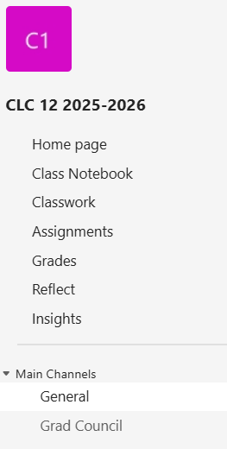
Course Access in TEAMS:
CLC 12 2025-2026
Home Page
Resources
Class schedule
Teacher contact info
Classwork
Unit overviews,
readings &
assignments
Grades
Check if assignments
are returned with
feedback & mark
General
messages, updates,
reminders
Grad Council channel
Required by the BC Ministry of Education for Graduation

Slide 15
Career Life Connections 12​
There are 8 units in total:
    (Activation assignment)
    ▪ Unit 1: Who Am I
    ▪ Unit 2: Capstone Proposal
    ▪ Unit 3: Career Exploration
    ▪ Unit 4: Post Secondary Plans (create a BCeID account to access transcripts)
    ▪ Unit 5: Resilience
    ▪ Unit 6: Financial Literacy
    ▪ Unit 7: Networking & Relationships / Work Experience
    (Career Life Confirmation 30 hours of volunteer or paid work from Grade 10-12)
    ▪ Unit 8: Final Capstone Product & Presentation (Presentations May 6th and 7th )
To date, the following assignments should be complete:
Activation Quiz
1.1 Who Am I
1.2 Core Competencies
2.1 Capstone Proposal
All assignments must be submitted electronically in the CLC 12 TEAMS class
  Assignments need to be completed in the proper platform, submitted on time, and meet criteria
  Assignments will not be remarked

Slide 16

Capstone
  A project that allows one to demonstrate learning from both school & life experiences through an area of personal interest.
  An individual passion project based on one's own personal choice and reflects one's interests, curiosity, values, goals, strengths, and aspirations.
  Independent from any other project previously completed or to be completed for any other class.
  Should show thoughtful planning, depth, and meaningful effort over time.
    Proposal was due on Oct. 15th
    1 Journal per month starting Nov. - Apr.
    Final product due on April 22nd
(Unit 2 Capstone Overview Booklet)

Slide 17
Capstone Components
z
Proposal (was due Wed. Oct. 15th)
- Students state their area of interest, strand, and topic
- Include a detailed timeline and how the final product will be showcased
2) Execution
- Work on researching / developing / creating the product
- Document everything
3) Journals
- Complete one per month to show progress, must include evidence:
    Journal 1 due: Wed., November 19th
    Journal 2 due: Wed., December 17th
    Journal 3 due: Wed., January 14th
    Journal 4 due: Wed., February 11th
    Journal 5 due: Wed., March 11th
    Journal 6 due: Wed., April 8th
4) Presentation (May 6th & 7th)
- Celebrate and showcase ones learning journey and Capstone product
5) Reflection

Slide 18
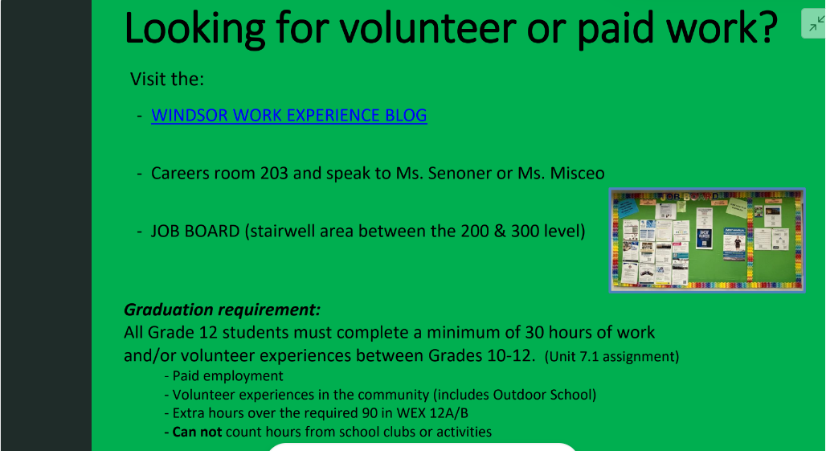

Slide 19

CLC 12 updates will be emailed once a month
For questions, contact Connie Misceo at
cmisceo@sd44.ca
REMINDER
3 Mandatory Meetings in the Multipurpose Room at 8:30am:
  Wednesday, November 26th
  Wednesday, February 4th
  Wednesday, April 8th

Slide 20
How To Get There From Here
z

Slide 21

Graduation Requirements
In order to graduate, the BC Ministry of Education requires students to complete the following:
    52 credits “Required” courses, including CLC 12, and Indigenous Grad Credit
    28 credits “Elective” courses
    Completion of CLC 12
      Capstone Presentation
      30 hours work/volunteer experience

Slide 22

New Path to Graduation
  Current Grade 12 Students MUST write:
  Literacy 12 Assessment
  French Literacy 12 Assessment (if French Immersion Student)
  You should have written in Grade 10:
  Literacy 10 Assessment AND
  Numeracy 10 Assessment
Contact your counsellor if you believe you're missing either of the grade 10 assessments.
Does NOT affect GPA

Slide 23

Assessments
Literacy 12 Assessment: Nov 4th & 5th, 2025
  Re-write available in January 13 & 14
  Re-write available in April 21 & 22
Will have the opportunity to re-write the Numeracy or Literacy 10 Assessments OR write them for the first time
Written French Literacy 12 – June 9th and 10th, Orals are June 11th -16th

Slide 24
STS
Student Transcript Service

Slide 25
Transcripts & Assessment Results through STS
Transcripts and Assessment results can be accessed through the Ministry of Education web site
      www.studenttranscripts.gov.bc.ca
Student will need to create a BCeID account that will follow you to graduation to order transcripts, so please remember your password!
Counsellors cannot access your account for you

Slide 26
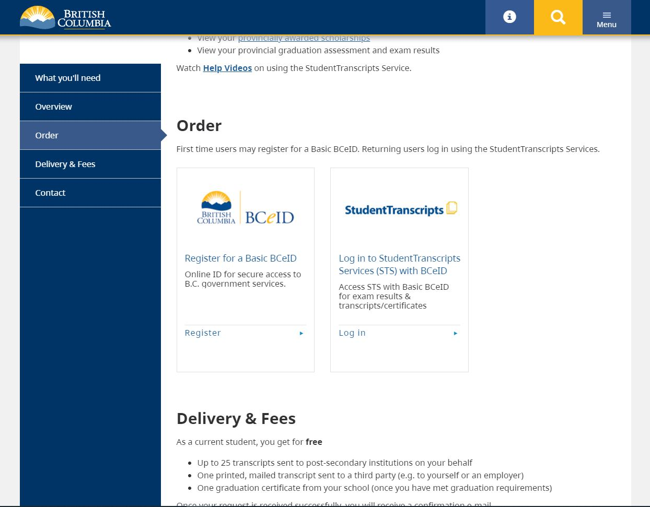
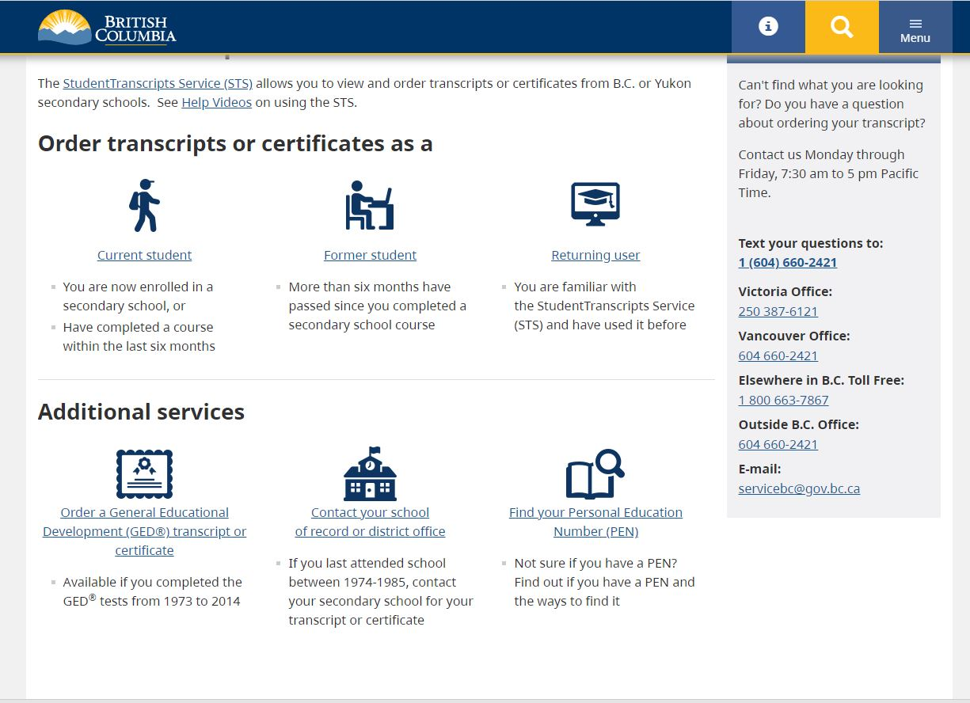
Step 1
Step 2

Slide 27
Marks to Universities
Students must give consent to universities through the STS site
It is an assignment for Unit 4.3 of CLC 12
Final Marks - sent to universities in August ONLY if student has authorized marks to be sent.
Universities may rescind your seat if courses not completed or if marks drop substantially.

Slide 28
Transcripts for other purposes:
For PSI's which do not appear on STS site, see your counsellor
Students can download unofficial transcripts directly from STS site themselves
If you need a transcript with interim marks for scholarships, please see your counsellor, but universities CAN SEE your interim marks through the STS

Slide 29
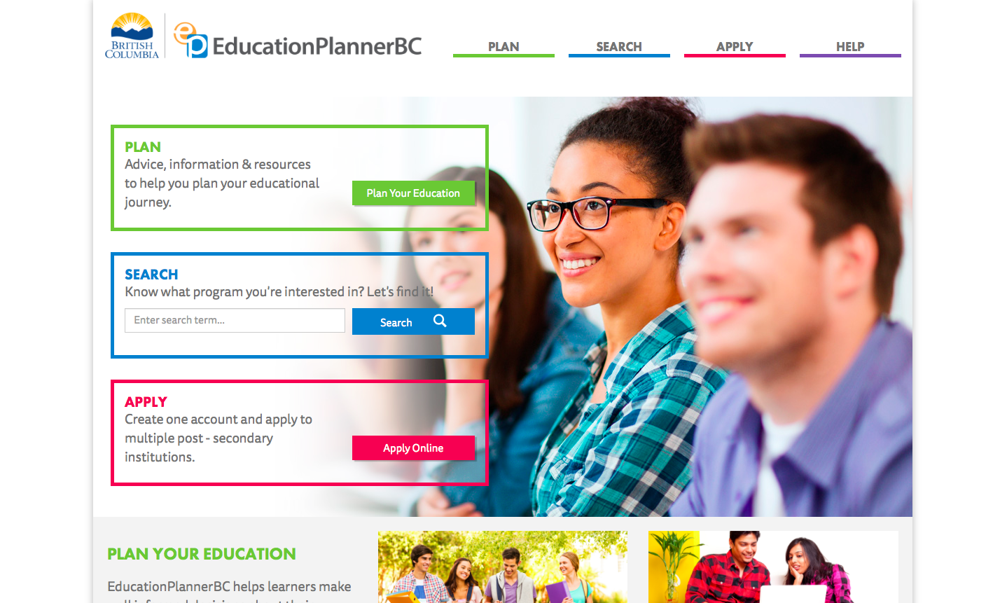
Not Sure Where to Start…
www.educationplanner.bc.ca

Slide 30
Explore the EducationPlannerBC.ca site:
1. www.EducationPlannerbc.ca – “Plan” page → “Work” → to “Career Assessments” to find Career Finder quizzes
2. Go to “Search” to find programs offered
3. Click under “Apply” as central hub for BC PSI’s.

Slide 31
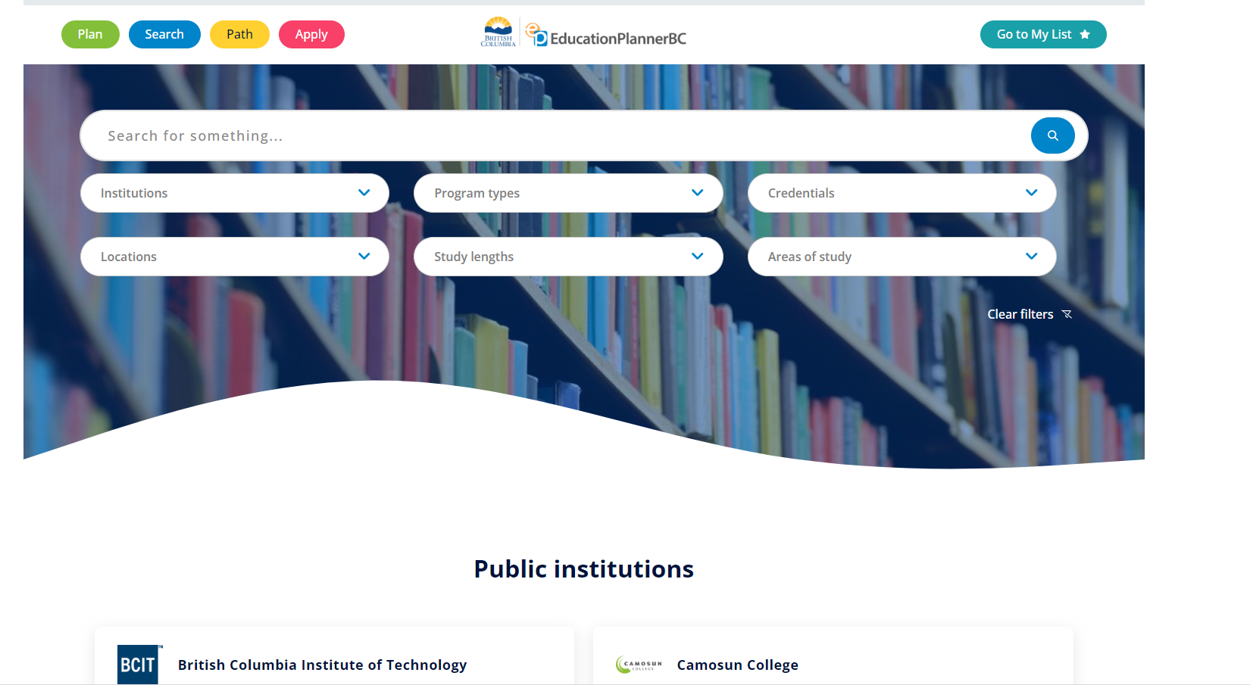

Slide 32
Options to Consider ...
Certificate programs (1-2 year)
Diploma programs (3-4 years)
Associate Degrees (half degree, intended for university transfer)
Direct entry Bachelor degrees (4 years)
Trades/Tech programs (i.e. BCIT, VCC)
Military, Coast Guard, etc.
Upgrade high school courses
Gap years – work, travel

Slide 33
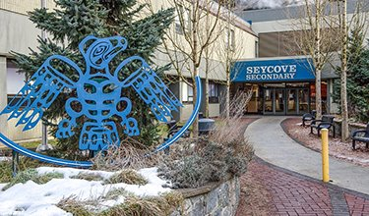
BC Post Secondary Institute Night
Representatives from universities / institutes in BC. Thursday. Oct 30th 6 pm at Seycove
Over 30 Universities and Post-Secondary Institutions from all over BC will be available for questions
Hear the representatives from each school
Ask questions!

Slide 34
Post Secondary Visits noted on Counselling website…
Visiting PSI and contact | Date/Time | Location
Acadia U.- Regan Cyr | Mon Oct 6th 3 pm | Windsor Conf. room 412
BCIT Open House | Oct 8th 4 pm | BCIT Campus
SchoolFinder Student Education Fair * should pre-register online | Sat Oct 18 1-5 pm, | Pinnacle Hotel Vancouver
U. of Calgary – Jamie Bradshaw | Tues Oct 21st | Windsor Conf. room 412
Capilano University – Gabriel Leony Primo | Wed Nov 5th | Windsor Conf. room 412
National Portfolio Day *should pre-register online | Sat Nov 8th, 11:00 – 3 | Emily Carr
Capilano University | Sat Nov 29, 10:30 – 2:30 | Cap U Campus, NV

Slide 35
Post-Secondary
Application Process
COMPILE
REVIEW & VERIFY
CREATE
Begin PSI applications
List of potential Post-Secondary Institutions to which you want to apply and compile important info
Review and verify accuracy and completeness of Transcript Verification Report
Create a BCeID account to access & consent to release of your transcript to PSI
APPLY

Slide 36

Applying to Post-Secondary Institutes (PSI)
BC – use educationplanner.ca
Prairies – directly to PSI website
Ontario – use www.ouac.on.ca
Quebec – directly to PSI website
Maritimes – directly to PSI website
United States – www.commonapp.org

Slide 37

Scholastic Aptitude Test (SAT)
Needed for:
  American Universities (not mandatory now)
  Canadian Universities with NCAA athletics
  Minimum score 840 on SAT to qualify for NCAA eligibility (www.elegibilitycenter.org)
Recommended to write SAT prior to November of gr 12 year, may write more than once
Registration & more info at www.collegeboard.com

Slide 38

Applying To Post Secondary Institutions (PSI)
In BC, generally:
  PSI application process begins:
    October – online application portals open
  Application deadlines vary:
    usually December – March,
    best to check the specific PSI websites
    earlier for major entrance awards
  Decision of acceptance:
    usually around April/May
    later for Ontario
  September 2026 course registration:
    begins in June
  Note deadline to apply for Housing!

Slide 39
Broad Based Admission
Some schools ask for a wider application (not just grades)
Tips sheet available from counselling suite
Students may be asked to submit a personal profile which may include:
    Written submission
    Letter of intent
    List of accomplishments
    Personal References
    Portfolio
    *Remember your digital footprint!
Focus on demonstrating reflective and engaged learning.
Notes:
(leadership, school & community service)

Slide 40
English Language Requirement
English language requirement -
  required for students for whom English is not their first language or
  received their education in a language other than English and have not studied in a Canadian high school for less than a minimum number of years (usually between 2-4 years)
You may need to write an English proficiency exam - the TOEFL / IELTS exam… see counsellor for information
Notes:
(leadership, school & community service)

Slide 41

Trades and Apprenticeship
Wages for certified trades are highly desirable
Employment is often guaranteed at the end of the program
Wages can be earned while student completes program
Government Grants/Incentives

Slide 42
Admission Requirements
Different schools and programs require different courses – you must check specifically
Requirements for similar programs at different schools are NOT always the same
  UBC, SFU, UVIC, CAP can all have different course and GPA requirements for the same program
Important for you to look at admission requirements at all the programs to which you are applying
Some programs need more grade 12 courses than others
Also check language requirements, some schools do not need a language to get accepted but need one to graduate

Slide 43
University Admissions Requirements
General Admission Requirements
Faculty Requirements
Calculation of GPA
Successful Admission!

Slide 44
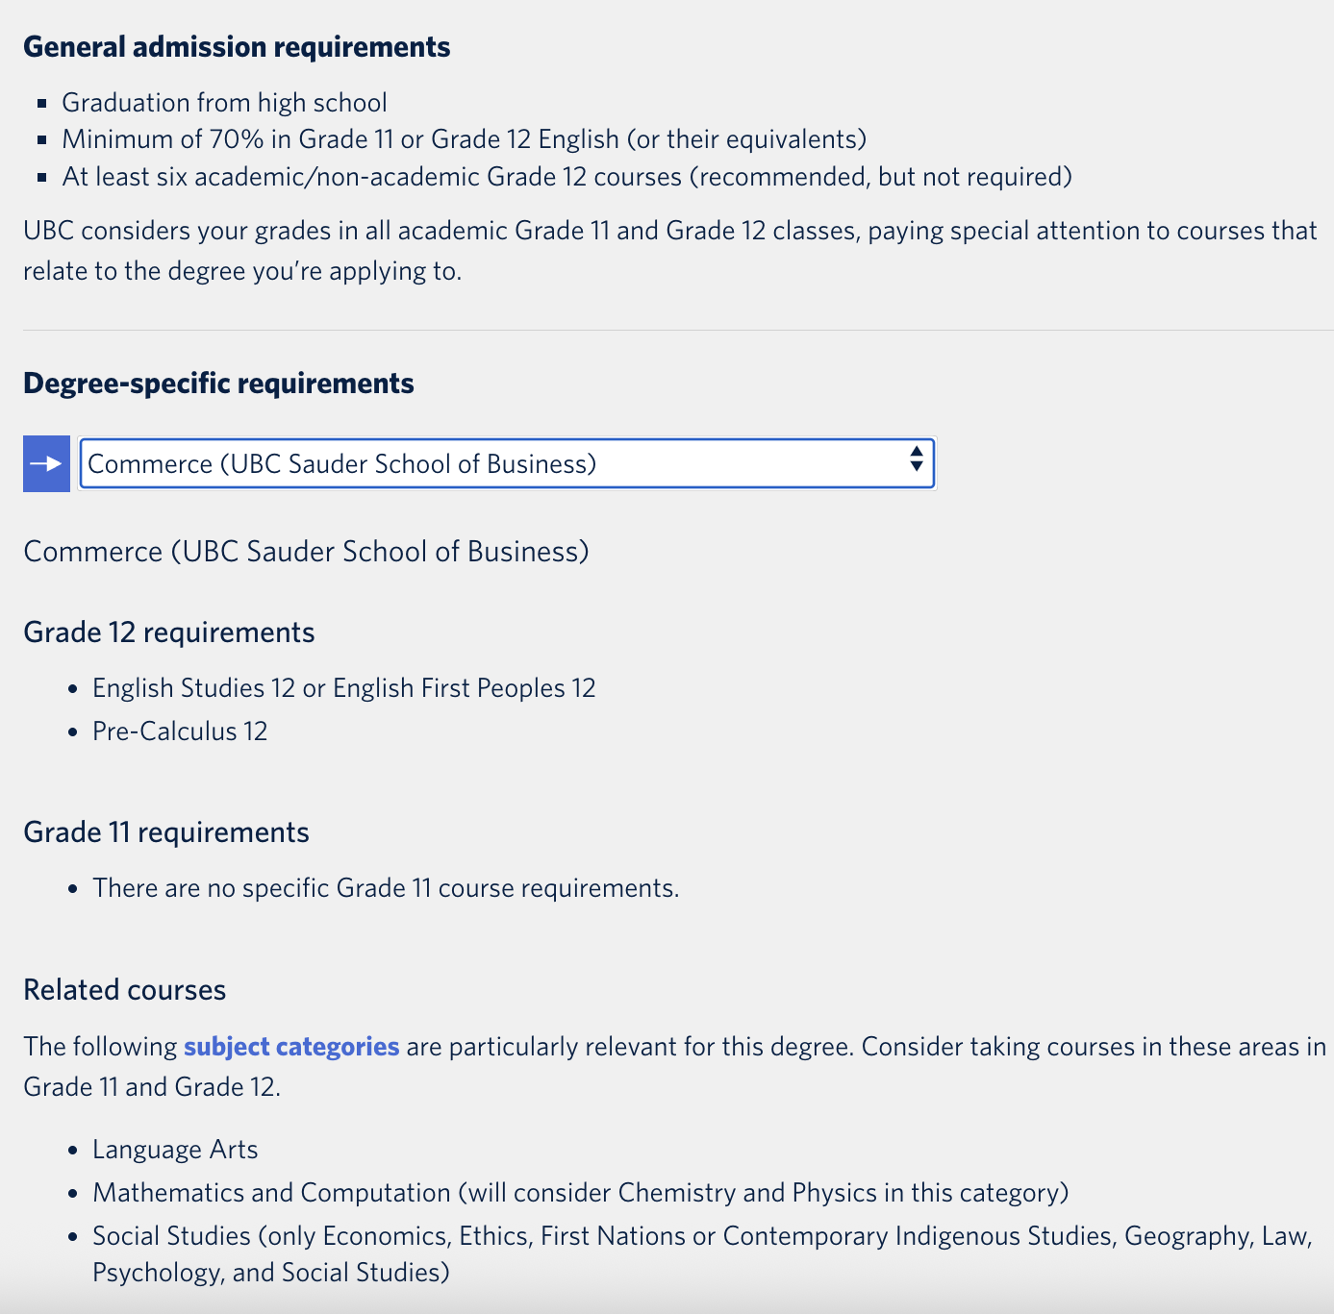
UBC

Slide 45
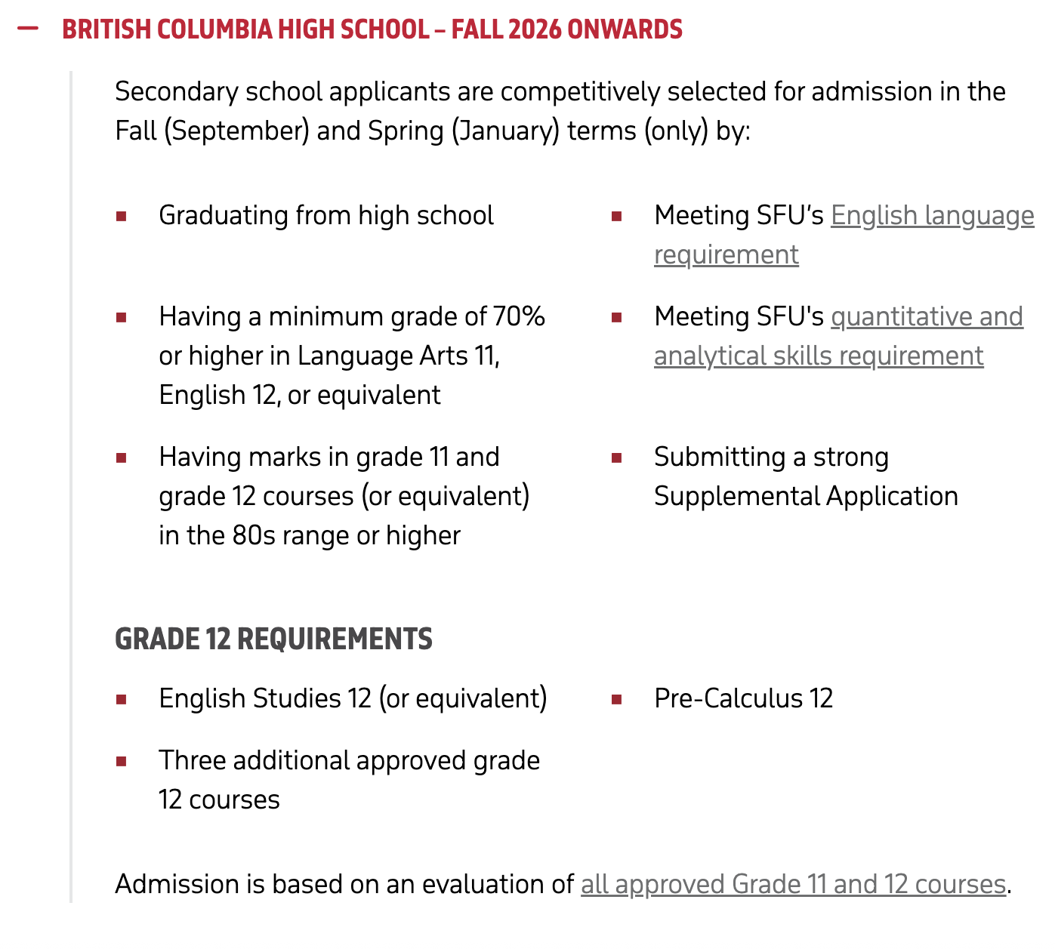
SFU

Slide 46
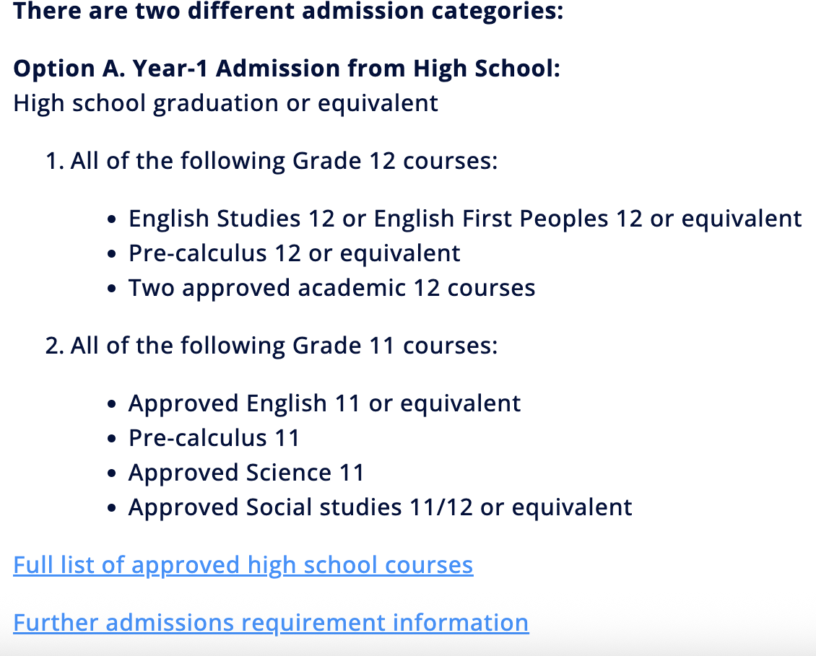
UVIC

Slide 47
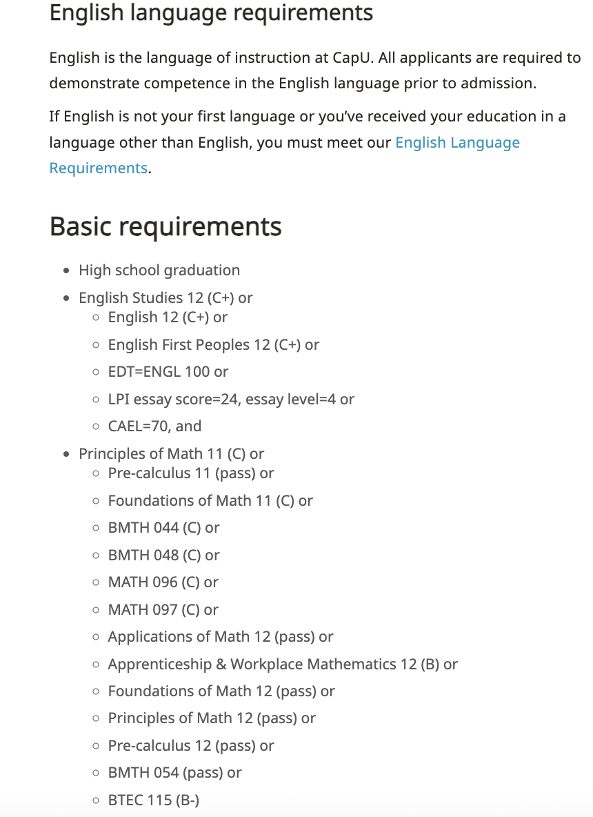
CAP

Slide 48


Thinking of a Gap Year?
You should still apply to PSI this year
As long as you do not take courses at another institution, most universities will grant you a deferral
For options – talk to your counsellor or check out the Counselling website

Slide 49
FINANCING YOUR FUTURE
z

Slide 50

Scholarships and Awards
Bursaries, Scholarships
& Awards
Entrance Awards
Internal (Windsor)
and External

Slide 51

Windsor Internal Scholarships (more than 35)
Digital application form – Due Thurs. Dec. 4th
  Will be posted on Teams Nov 7th
  General criteria includes:
    Academic standing
    Volunteer service
    Citizenship
    Extracurricular involvement
Specific Criteria – depends on scholarship or bursary
    Vocational interest * may not need above criteria
    Financial need * requires interview with counsellor
Decided by Windsor’s Scholarship Committee on behalf of donors

Slide 52

External Scholarships
www.scholarshipscanada.com
www.studentawards.com
www.studentscholarships.org
PSI Entrance scholarships
Employer scholarships (i.e. CUPE)
Many require detailed application - save your essay!
May require reference letter – give 2 weeks, give outline of scholarship criteria and follow up with thank you letter!
More "External Scholarships" on Windsor Counselling Website, listed by month of due date

Slide 53
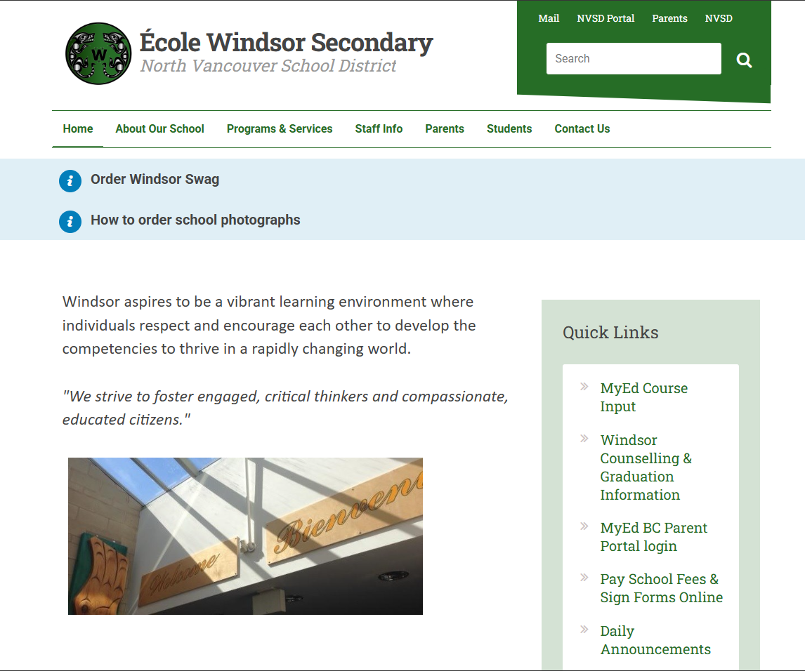
How to access this information

Slide 54
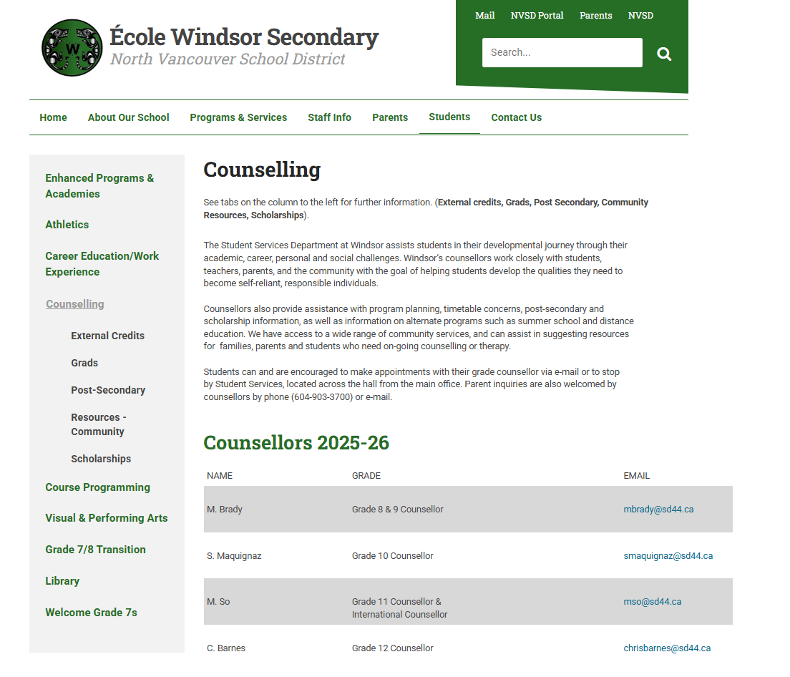
External Awards (Scholarships & Bursaries)

Slide 55
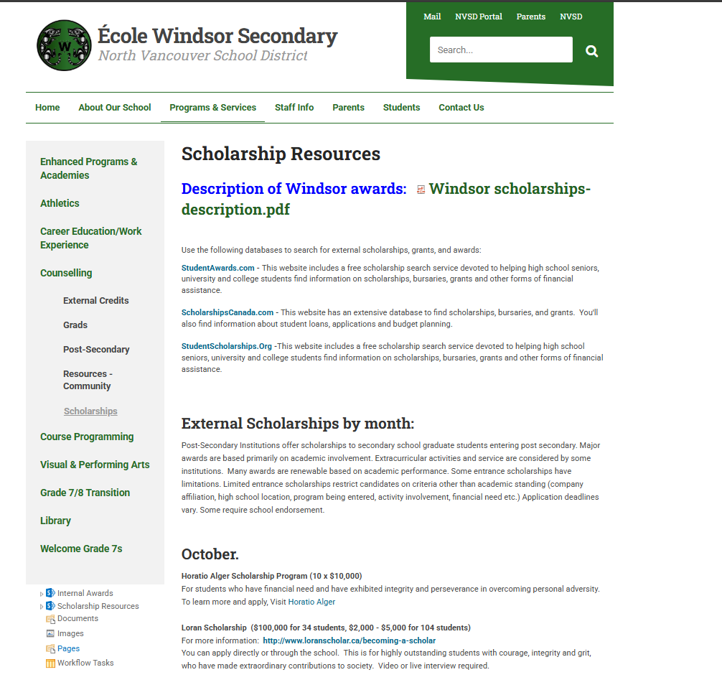

Slide 56

Bursaries
  For students in financial need
  Must indicate ‘need’ on your application and have interview with counsellor
  Non-repayable financial award

Slide 57

Student Loans
Usually, you apply in September of your post-secondary year
Websites:
    www.studentaidbc.ca
    www.canlearn.ca

Slide 58
FINALLY…
It's all about balance!
Academic
Future Plans
Social

Slide 59
Feeling Overwhelmed?
1. Explore www.EducationPlannerbc.ca for all post- secondary and training/careers information.
2. Read and keep the Student Services E Bulletins that come out the middle of each month by email.
3. Talk to one of us, by appointment.

Slide 60
More questions…please contact…
Grade 10 Counsellor – Sue Maquignaz smaquignaz@sd44.ca
International Student and Gr 11 Counsellor – Mancy So mso@sd44.ca
Grade 12 Counsellor – Chris Barnes chrisbarnes@sd44.ca
Connie Misceo– Careers Life Connection 12 Teacher cmisceo@sd44.ca

Slide 61
Thank you for listening!
Have a Great Year!

