Slide 1
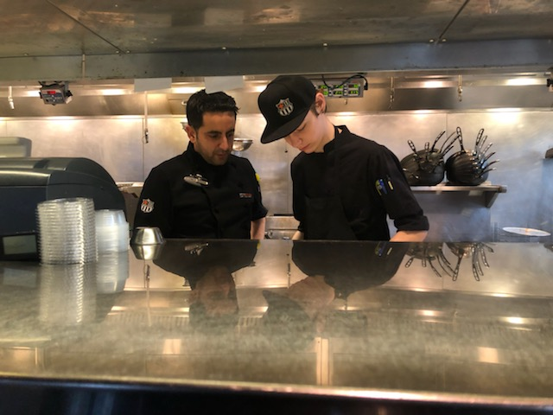
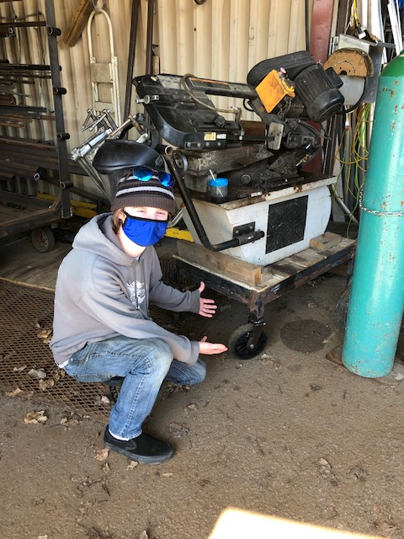
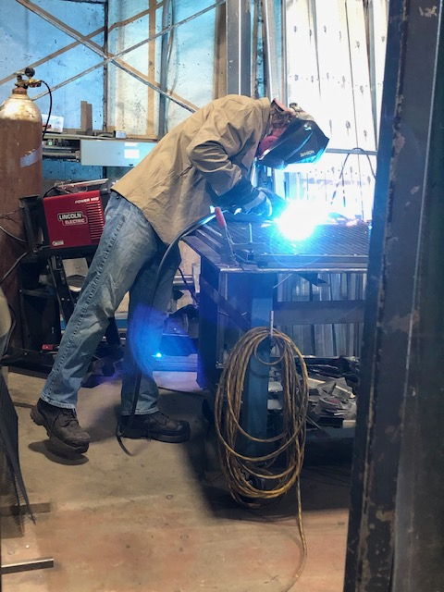
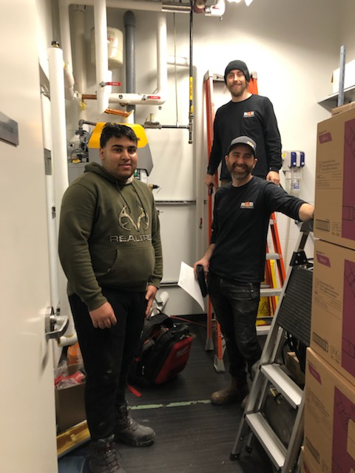
Lunch and Learn
Exploring the Trades
Jennifer Kinakin
District Career Coordinator

Slide 2
This session….
Finding out about you and your interests☺
Why go into skilled trades and what is an apprentice
Overview of what the district offers and process
Resources

Slide 3
Finding out about you and your interests
How many of you are working? Where?
Why are you interested in the trades? Which ones?
Question: How many Red Seal Trades are there?
What do you hope to learn today?

Slide 4
Why Consider a Career in the Trades?

Slide 5
What is an Apprenticeship?

Slide 7
What program do you earn as you learn?

Slide 8
If you are ready EXPLORE PROGRAM OPTIONS!

Slide 9
Skilled Trades BC - Youth

Slide 10
Things to consider….
Work in Trade Program/WEX:
Consult your school counsellor to ensure your school schedule can support your choice
Are you the person that an employer wants?
Trades generally work until 4pm so where/when will you work? Will you give up pro-d and school holiday time to gain the necessary hours?
Train in Trade Program
Consult your school counsellor to ensure you have graduation requirements before you attend a PSI (English 12, Capstone, CLC)
Do you have the necessary requirements to pursue an Apprenticeship Program? Do some research☺
Are you willing to go to another school or take online HS courses (linear)?
Are you leaving space in your course selections for other career options?

Slide 11
On board?
Talk to your parents
See Ms. Yeo (Work Experience Teacher) ayeo@sd44.ca
Or your counsellor
Get your application filled in! Reminder that there are usually no more that 2 HS seats available at any particular PSI/intake session

Slide 12
QUESTIONS?

