Slide 1

Seycove Parent Sports Night

Slide 2
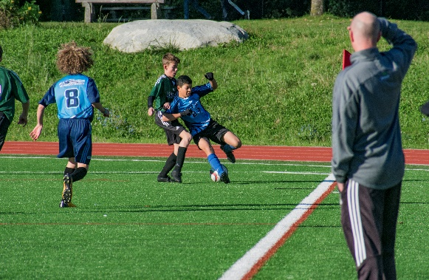
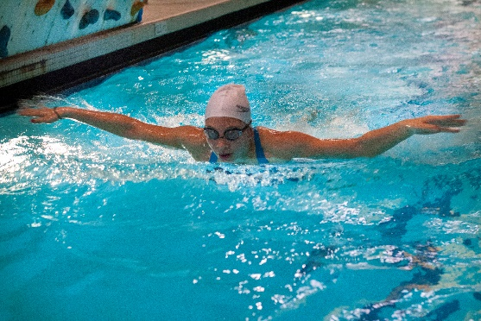
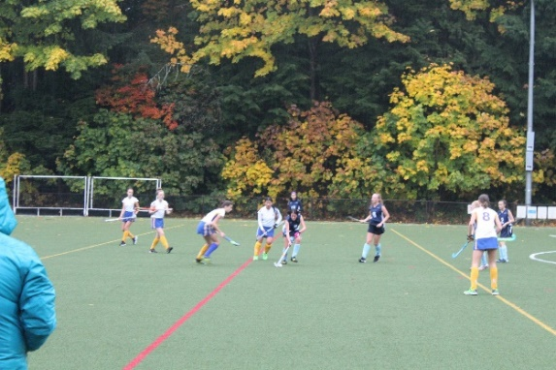
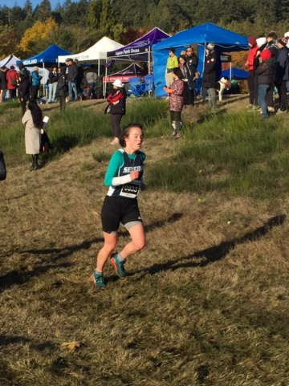
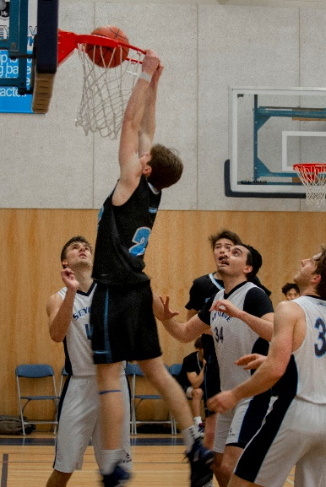
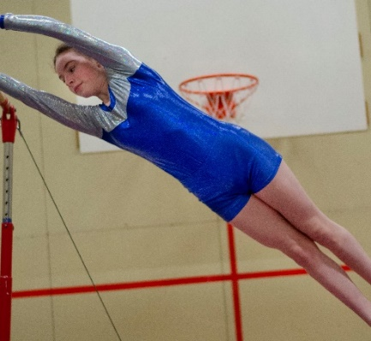
Seasons
Fall: Cross Country, Boys and Girls Volleyball, Swimming, Field Hockey, Boys Soccer
Winter: Basketball, Skiing, Gymnastics
Spring: Track & Field, Badminton, Grade 8 Boys Volleyball, Girls soccer, Boys ice hockey, Mountain Biking, Boys Rugby
Sports we have had in the past
but no longer support:
Ultimate, Wrestling

Slide 3
Values and Goals of Athletics Department
To have as many students as possible involved in sports
Support growth of student athletes in classroom and in sport
To compete at as high a level as possible without sacrificing development.
Grade 8 & 9 Full Participation and Equal Playing Time
Grade 10 Transition
Grade 11 & 12 Playing to Win and unequal playing time

Slide 4
Names for Age Groups
Grade 8 -- Bantam
Grade 9 – Juvenile
Grade10 – Junior
Grade 11 – Senior
Grade 12 – Senior
At the Senior age group, level of Competition is determined by population of school. We are AA school.
Bantam, Juvenile and Junior are not ranked by school size
Gender: Acceptance of fluid gender but one declared gender per season

Slide 5
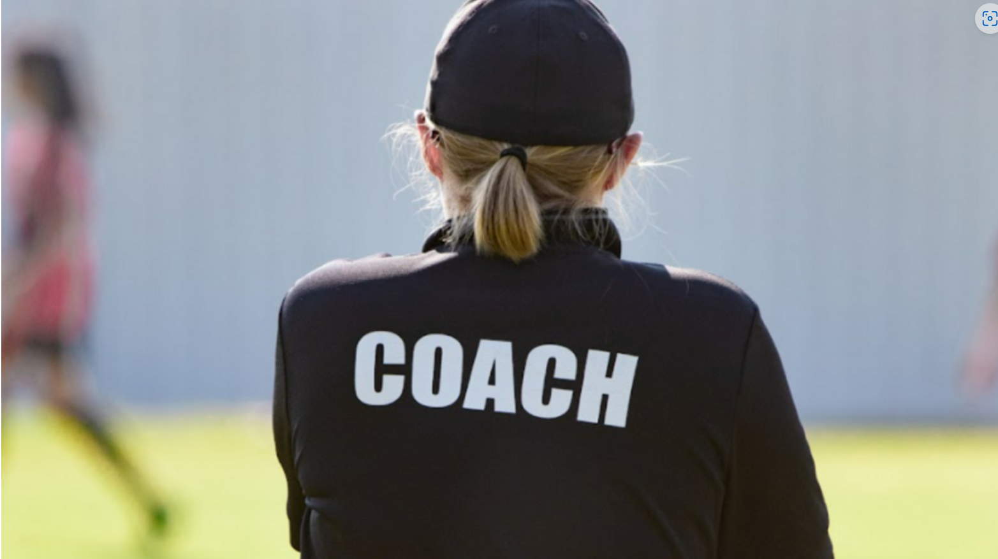
Coaches
Volunteers: Either Teachers or members of the community.
How does someone become a coach? Volunteer– we always need people
Issues with a coach? Speak to the coach—not after a game, reach out by email. If it isn’t resolved you speak to me.
Coaches have to have an up to date CRC and Concussion Training.

Slide 6
Student Responsibilities
Listen to the announcements for practices
Check TV monitors in school for sports announcements
Inform coach that they are interested in participating
Attend practices and games. Inform coaches if they can’t make it.
Student Athlete Contract
Option to attend open gyms, lunch time, Parkgate, Academies

Slide 7
Budget for sports
Each sport is expected to cover its own costs
Fees vary from sport to sport: $35 - $500
Why? Tournaments, Travel, BC Championships, Different referee fees
Example: Volleyball needs 1 ref 2 scorekeepers, Basketball needs two refs and three scorekeepers
If there is an overnight trip we have to have a meeting
Seycove Athletic Fee: Minor Sport- $35, Major sport $60
If there are any problems covering costs, we can help
School Cash Online: Make sure you use an up to date email with notifications turned on.

Slide 8
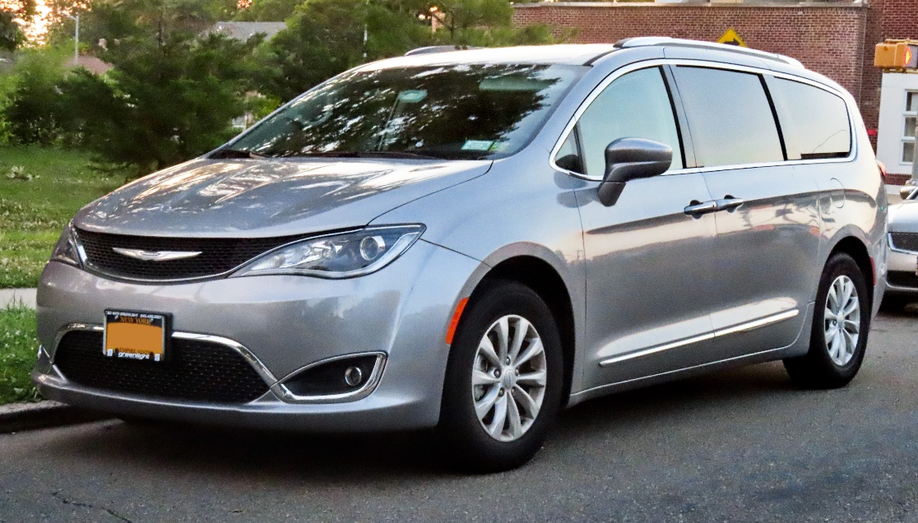
Parent Responsibilities
Fill in forms
Driving
If Driving other kids you have to get a Drivers Abstract and CRC
Appropriate behaviour at games
Pay fees

Slide 9
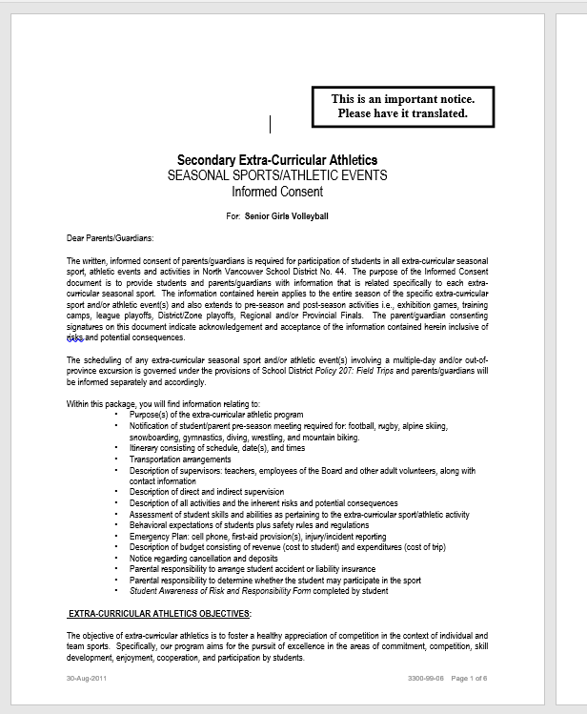
Forms

Slide 10
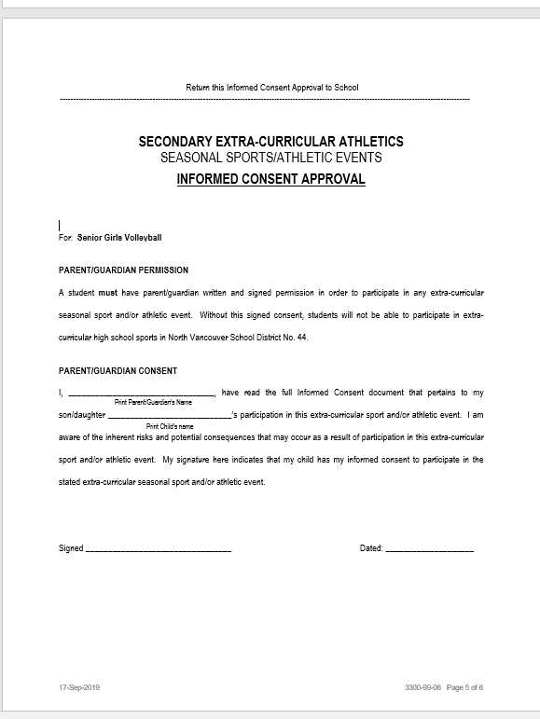
Informed Consent

Slide 11
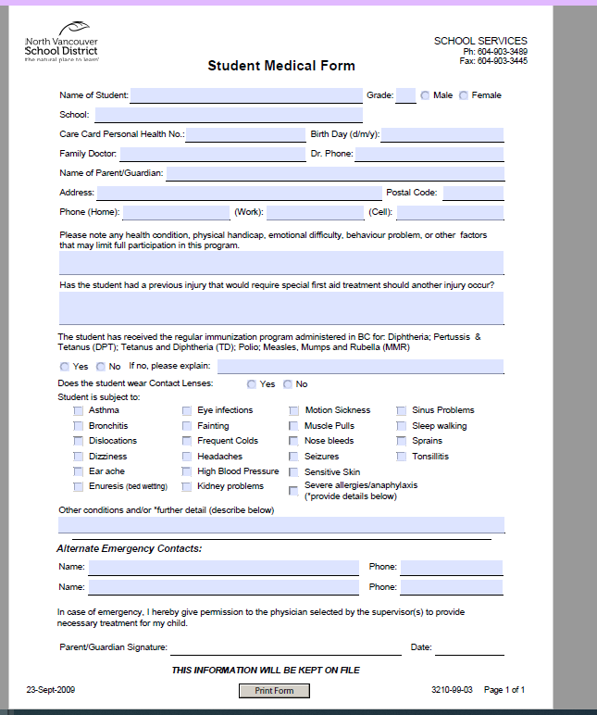
Student
Medical Form in
Electronic version is saveable

Slide 12
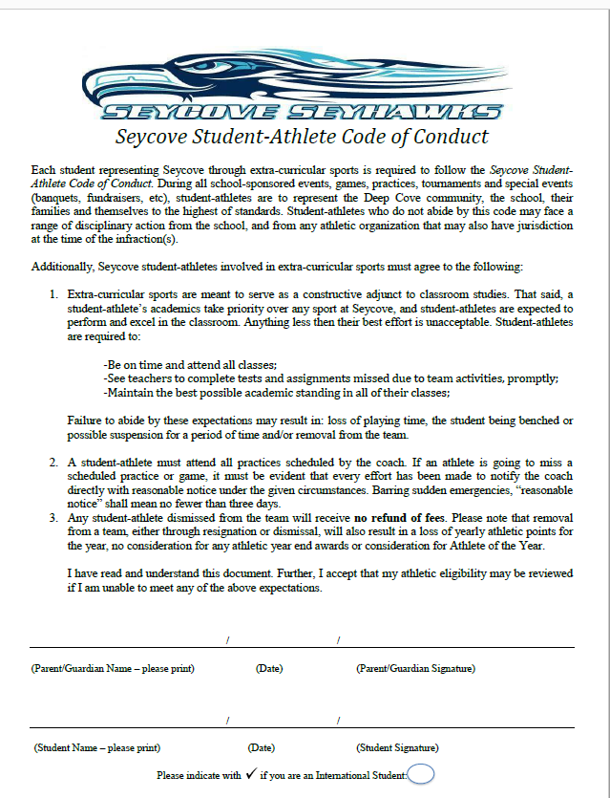
Student
Athlete
Contract
A Parent signs here
and the
Student signs here

Slide 13
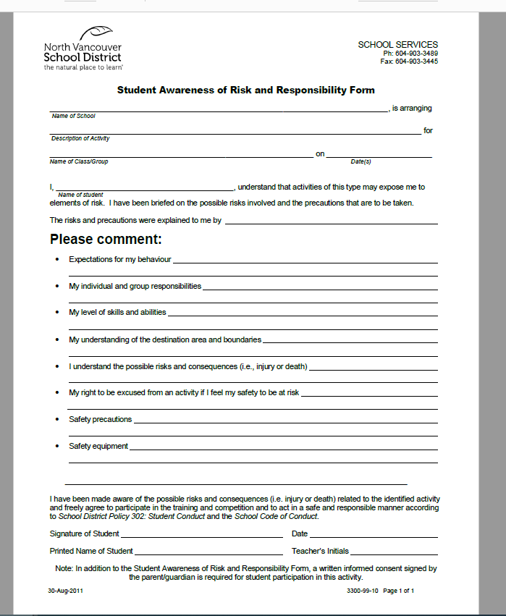
Student Awareness of Risk and Responsibility
Students fill this in to acknowledge there a risks this activity

Slide 15
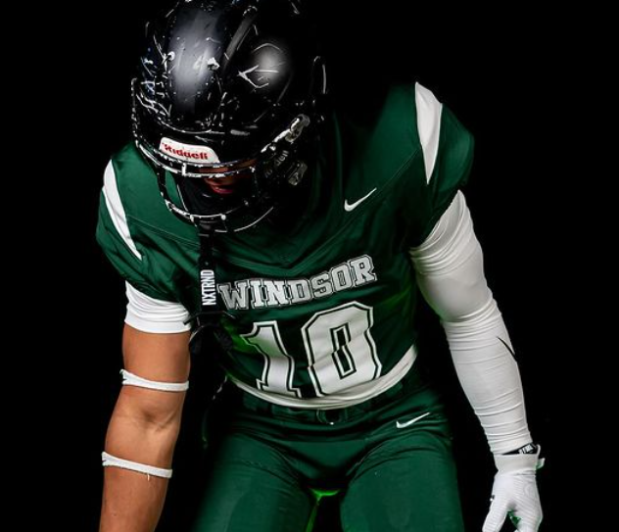
What about Football and Transfers?
We will never have a football team
If one of our athletes plays with a football team at another school, BC School Sports adds our numbers together, which puts Windsor in the more competitive AAA Division
Students can transfer before the first day of Grade 9 without penalty.
If they transfer after Grade 9, they are not allowed to play in any school sports that they played the year before.

