Slide 1

Kindergarten Orientation
Capilano Elementary School

Slide 2


Slide 3
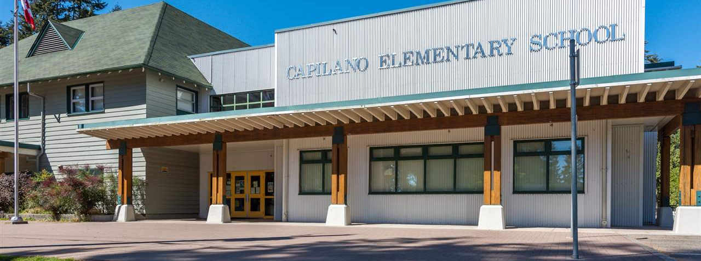
Welcome to Capilano!
We are so happy you are here!
Welcome to Kindgarten 20232024 (2) (1).mp4 (sharepoint.com)

Slide 4

Capilano Elementary
International Baccalaureate (IB) Primary Years Program (PYP) School
Approximately 430 students projected for next school year
Welcoming approximately 55 new Kindergarten Students

Slide 5

School Staff Intro & Information
Principal / Vice Principal
Office Staff
Kindy Teachers
Specialist Teachers
  LST,
  SLP,
  Psychologist,
  Counsellor
  SBRT / ESBRT
Music Teacher
Teacher Librarian
Notes:
Staff composition – SBRT

Slide 6

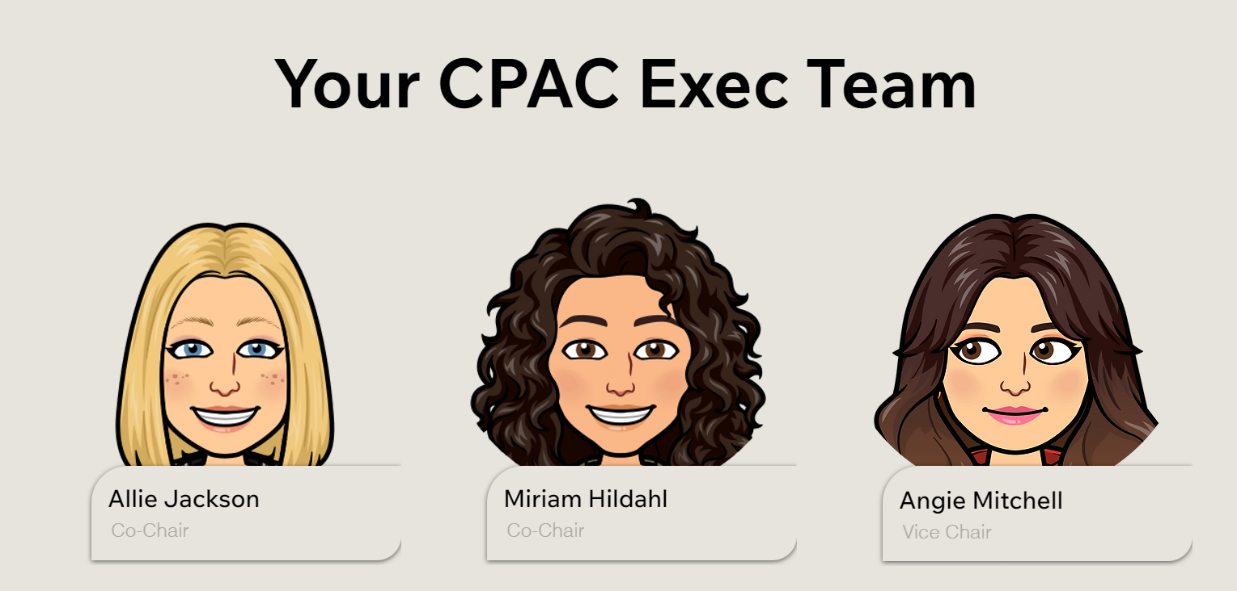
Home | Capilano PAC

Slide 7
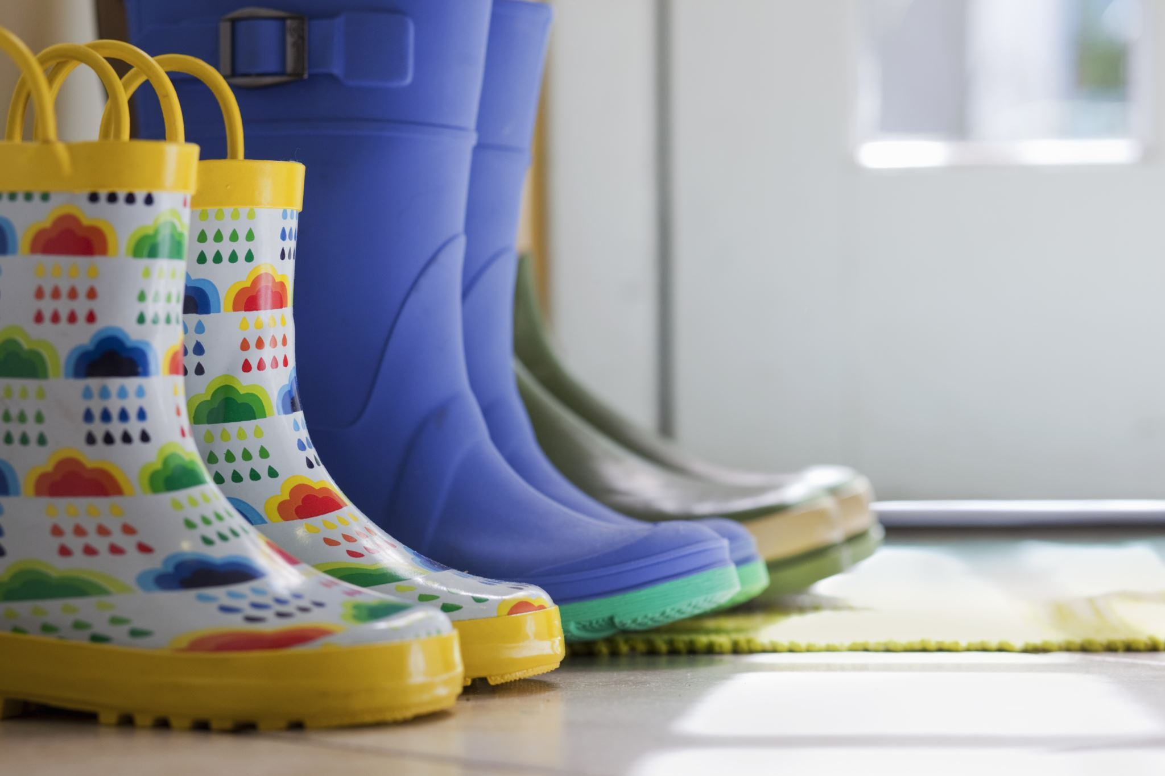
Kindergarten Readiness
Develop and follow bedtime and morning routines
Practice self-management skills
  Putting on and taking off shoes
  Zipping/buttoning jackets
  Opening and closing backpacks, lunch kits, water bottles and containers
  Putting on rain pants/muddy buddies
Teach independent toileting and hand washing procedures

Slide 8
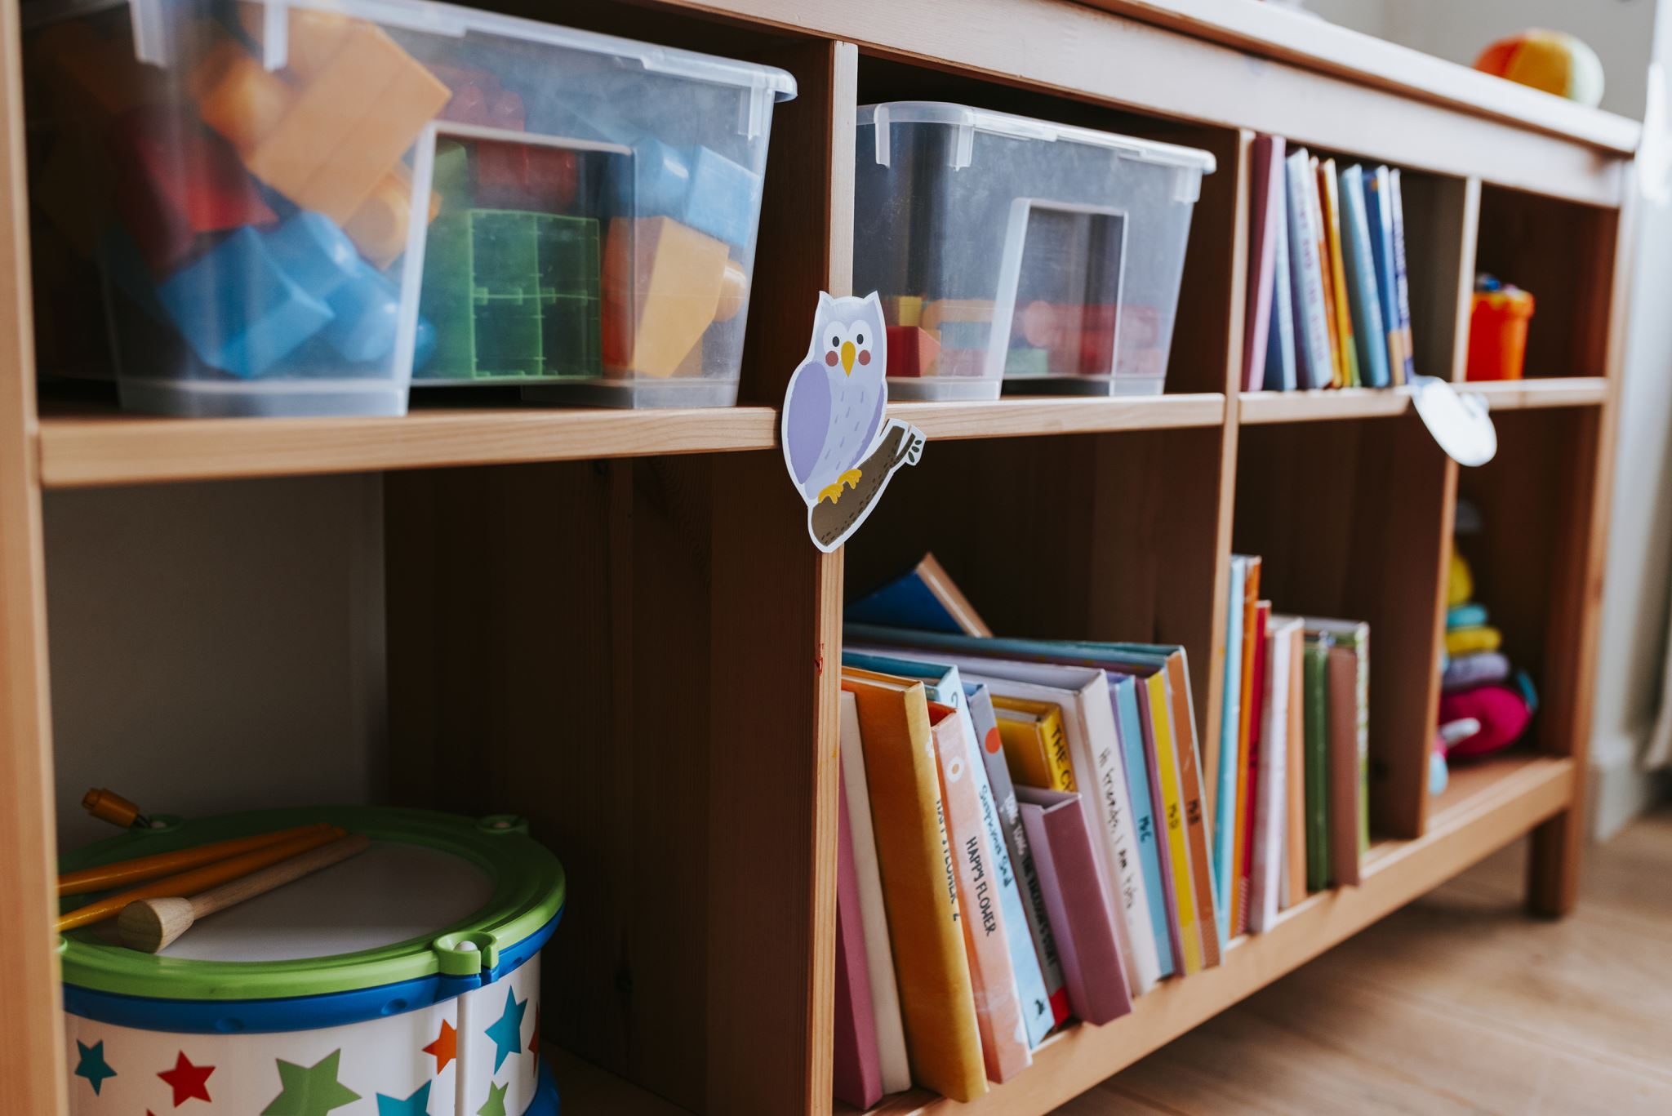
Kindergarten Readiness
Play games together that require turn taking
Explore local parks and playgrounds, including the one here at Capilano
Set up play-dates with similar-aged peers
Read books, sing songs, and recite poems together
Provide responsibilities (tidying up toys, making the bed, helping to set the table)
Practice being a self-advocate and asking adults for help
Create and practice quick goodbye rituals

Slide 9
For September...
Forms, forms and more forms
School supply fee
Gradual Entry
Extra clothes and extra snacks

Slide 10

Beginning September 4, 2024
  Kindergarten students do not attend on September 3
7/8 Partial days
  One hour, two hours, half days
Four groups – A, B, C, D
Sample Schedule:
  Day 1 - Group A, Group B
  Day 2 - Group C, Group D
  Day 3 - Group A&B, Group C&D
  Day 4 – Group B&D, Group A&C
  Day 5 – Group A&D
  Day 6 – Group B&C
  Day 7 – Group A&B – Full Day
  Day 8 – Group C&D – Full Day
First Full day in third week of September
Gradual Entry
Notes:
Day 1 & 2 – 90 minutes – 9:30 – 11:00 and 1:15 – 2:45
Day 2 & 3 – 150 minutes – 8:50 – 11:20 and 12:40 – 3:00
Day 4 & 5 – 270 minutes 8:50 – 1:20
Gradual Entry is designed to ensure that each child has a successful start to their new routine.
to help each child become familiar with everyday classroom routines such as washing hands, using the bathroom, eating snacks and lunch, and dressing for outdoor play.
your child is engaging in their first school experience led by a Kindergarten teacher and a team of teachers, Learning Services Teachers (aka, LST), English Language Learner Teacher (ELL) and itinerant teachers are observing peer interactions – this informs our groupings for gradual entry
Class placement – their "forever" class is determined by Kindergarten teachers observations in these first two weeks.

Slide 11


Slide 12
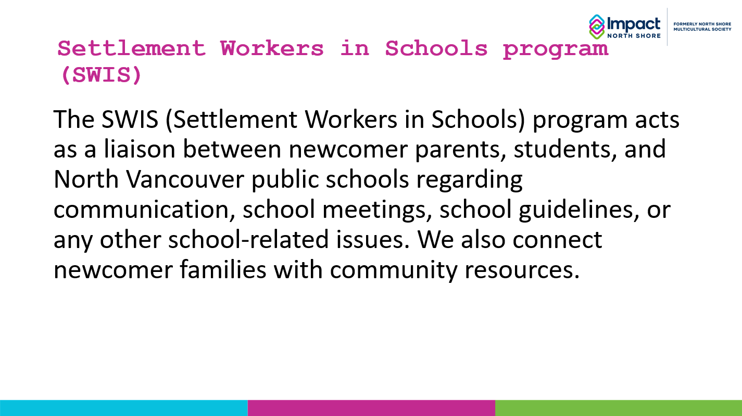

Slide 13
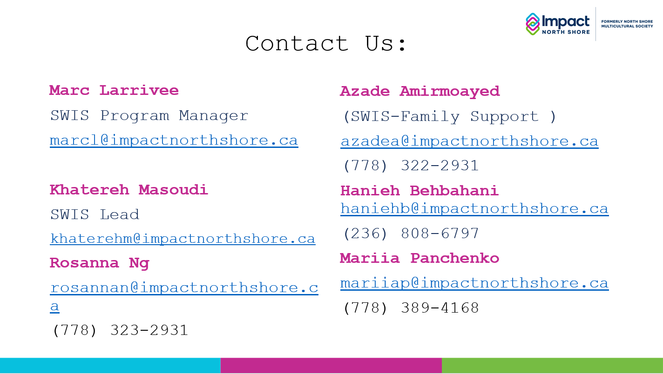

Slide 14
Questions?

