Slide 1
Memory • History • Story
Issues of Indian Residential Schools in Canada
Notes:
Why is it necessary to learn about and understand the Aboriginal people’s history and stories?
To create a new relationship between the Aboriginal people and other Canadians based on:
Mutual recognition (awareness)
Mutual respect
Mutual responsibility
Sharing
All Canadians can help the reconciliation process by learning about and understanding the truths about the history and legacy of Indian Residential Schools

Slide 2
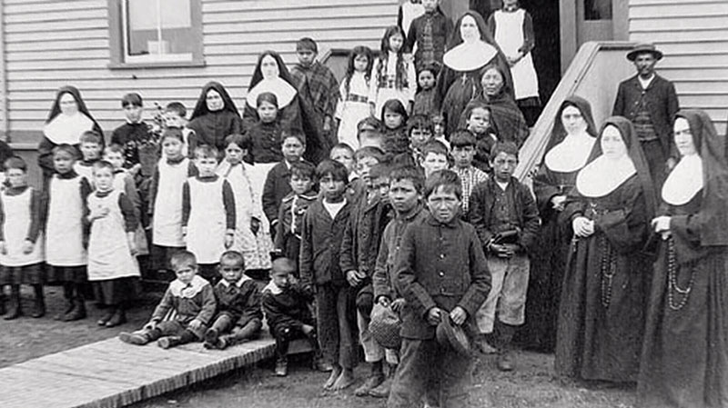
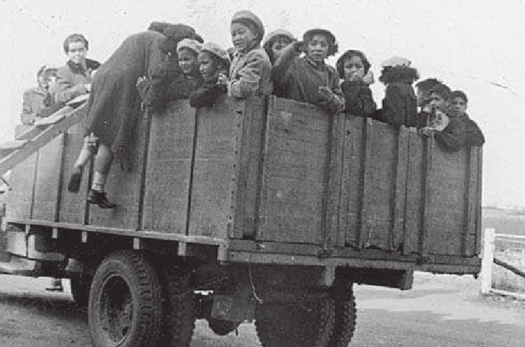
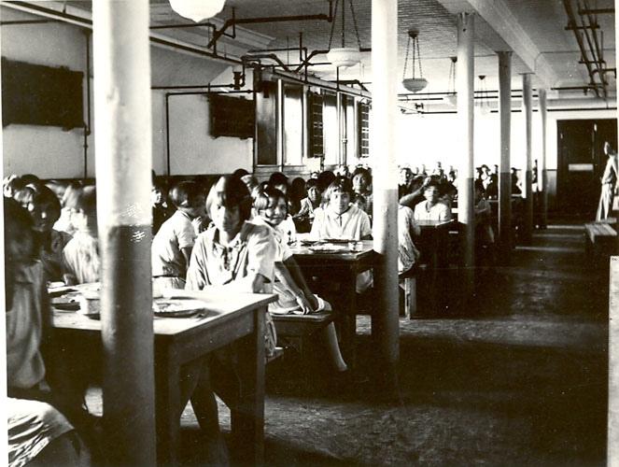
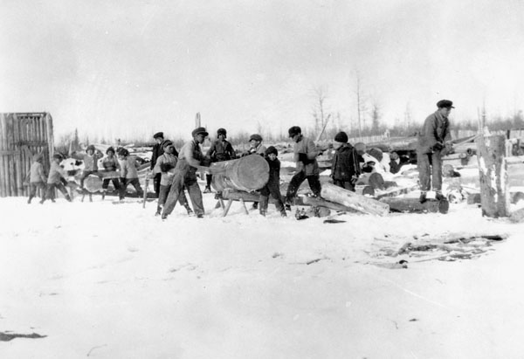
A group of nuns with Aboriginal students.
Girls at Gordon’s school in Saskatchewan being transported to church by truck in 1953.
Children’s dining room, Indian Residential School, Edmonton, Alberta. Between 1925-1936.
Work and Play. Indian Residential School, [Fort] Resolution, N.W.T.
Notes:
Colonialism created an unbalanced and unjust relationship between Aboriginal and non-Aboriginal people.
Indigenous people were treated as wards (responsibility) of the government
Loss of land and language, and the banning of cultural practice.
Residential schools were implementing the dominant culture with the goal of “civilizing and Christianizing” the indigenous people.
Both church and the state used Indian residential schools to promote their goals to destroy traditional culture and assimilate First Nations people into Western culture (European Culture).
The impact of destruction on the First Nation people is Inter-generational.
Image credits, clockwise starting at top left:
“A group of nuns with Aboriginal students.”
Credit: H.J. Woodside / Library and Archives Canada / PA-123707.
Restrictions on use: Nil.
Copyright: Expired.
http://collectionscanada.gc.ca/ourl/res.php?url_ver=Z39.88-2004&url_tim=2019-05-13T19%3A02%3A10Z&url_ctx_fmt=info%3Aofi%2Ffmt%3Akev%3Amtx%3Actx&rft_dat=3193392&rfr_id=info%3Asid%2Fcollectionscanada.gc.ca%3Apam&lang=eng
“Girls at the Gordon’s school in Saskatchewan being transported to church by truck in 1953”
The General Synod Archives, Anglican Church of Canada, M2008-10.
Courtesy / Truth and Reconciliation Commission (P14)
https://www.scribd.com/document/181484814/Arrival-Now-you-are-no-longer-an-Indian
“Children’s dining room, Indian Residential School, Edmonton, Alberta. Between 1925-1936”
United Church Archives, Toronto, From Mission to Partnership Collection.
https://indigenousfoundations.arts.ubc.ca/the_residential_school_system/
“Work and Play. Indian Residential School, [Fort] Resolution, N.W.T.”
Credit: Canada. Dept. of Interior / Library and Archives Canada / PA-048021
Restrictions on use: Nil
Copyright: Expired.
http://collectionscanada.gc.ca/ourl/res.php?url_ver=Z39.88-2004&url_tim=2019-05-13T18%3A29%3A30Z&url_ctx_fmt=info%3Aofi%2Ffmt%3Akev%3Amtx%3Actx&rft_dat=3381307&rfr_id=info%3Asid%2Fcollectionscanada.gc.ca%3Apam&lang=eng

Slide 3
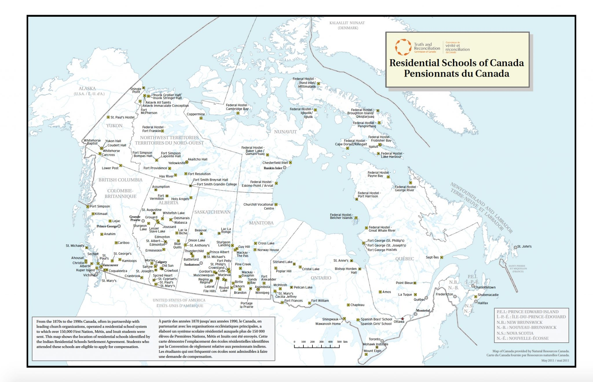
Notes:
The establishment of Indian Residential schools started in the late 1870s (i.e. the establishment of Mohawk Institute Residential School dates back to 1828). There were 139 number of residential schools in Canada with more than 17,000 enrolled students. The last residential school operated by the Canadian government, the Gordon Indian Residential School in Saskatchewan, was closed in 1996.
What was the residential school system?
A collaboration between the Government of Canada and the mainstream churches to educate the First Nations children in an environment that removed them from the influences of their families and culture.
Goal: to “civilize and Christianize” the First Nations children.
To teach boys basic trades and to teach girls domestic skills.
Racism: It was emphasized that Euro Canadian society was superior and First Nation people and culture were inferior.
“Cultural genocide”: punishment for practicing their culture and talking their language
The federal government assumed all control of the lives of all First Nations people, including the responsibility for education. The government funded both schools:
Day schools, located on the reserve
Indian Residential schools
Image Credit: http://www3.sd71.bc.ca/School/abed/resources/teacher/Documents/Residential%20School%20Inquiry%20lessons/T%20and%20R%20map%20Nov%202011.pdf

Slide 4
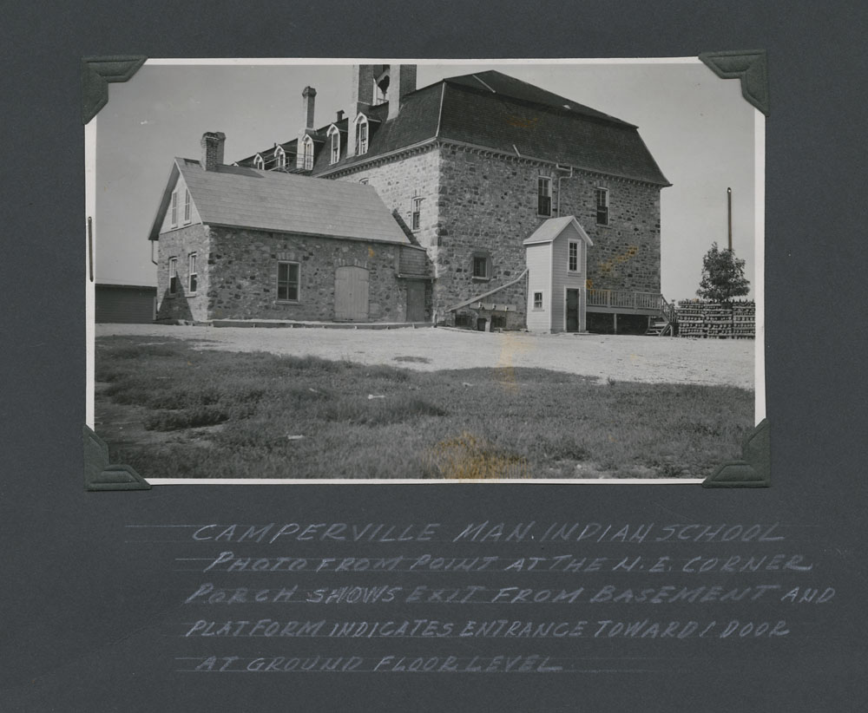
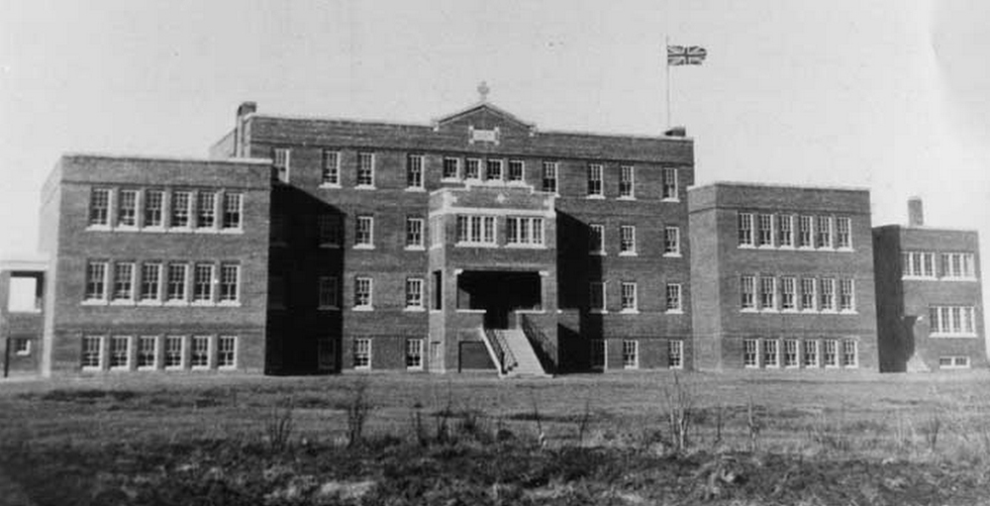
The Old Sun Residential School on the Blackfoot (Sikisika) reserve near Gleichen in southern Alberta.
North-east corner porch of Indian Residential School shows exit from the basement and platform indicates door entrance at floor level, Indian Residential School in Camperville, Manitoba, circa September 1949.
Notes:
School buildings:
• The physical aspects of the Indian Residential Schools emphasized the isolation from family.
• The Indian Residential School buildings created self-contained communities, intended to assimilate First Nations children into Canadian society.
Due to lack of space and school buildings, silos, barns and henhouses were also used as spaces for residential schools.
Image credits, left to right:
“The Old Sun Residential School on the Blackfoot (Sikisika) reserve near Gleichen in southern Alberta.”
https://www.anglican.ca/tr/histories/old-sun/
“North-east corner porch of Indian Residential School shows exit from the basement and platform indicates door entrance at floor level, Indian Residential School in Camperville, Manitoba, circa September 1949.”
Credit: Canada. Dept. Indian and Northern Affairs / Library and Archives Canada / e011080282_s2 ;
Copyright : Expired ; Restrictions on Use : Nil
http://collectionscanada.gc.ca/pam_archives/index.php?fuseaction=genitem.displayItem&rec_nbr=4673957&lang=eng

Slide 5
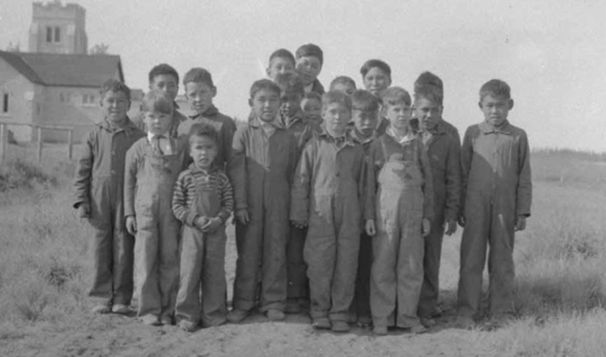
Inuit children who lived too far away and had to stay at school during the summer. Anglican Mission School.
Notes:
In 1920 the Indian Act was amended and Canadian federal legislation made it mandatory for every Indian child to be sent to residential schools upon reaching 7 years of age until 16 years of age. However, despite this legislation over 2000 students were taken before they were even 7. Six generations attended the school, arriving at between 4 and 6 years of age.
The government paid the church to operate the schools
The Indian residential school was Underfunded
Teachers were paid less, compared to the public school
Residential schools operated farms to both feed and subsidize the schools
Residential schools were on the “half day system”: students attended classes for half the day and did labour the other half (operated the farm, in the guise of “industrial training”).
Abuse inherent in the system (emotional, physical and sexual abuse): Removing the children from their communities to “kill the Indian in them”
Image credit:
“Inuit children who lived too far away and had to stay at school during the summer. Anglican Mission School.”
Credit: M. Meikle / Library and Archives Canada / PA-101771
Restrictions on use: Nil
Copyright: Expired
http://collectionscanada.gc.ca/ourl/res.php?url_ver=Z39.88-2004&url_tim=2019-05-13T19%3A37%3A07Z&url_ctx_fmt=info%3Aofi%2Ffmt%3Akev%3Amtx%3Actx&rft_dat=3193915&rfr_id=info%3Asid%2Fcollectionscanada.gc.ca%3Apam&lang=eng

Slide 6
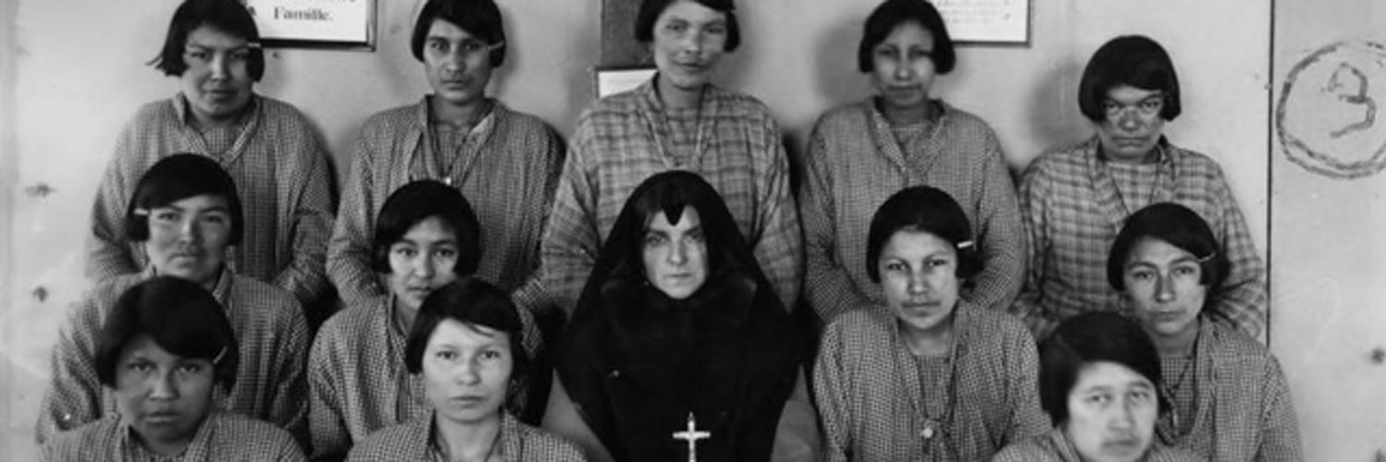
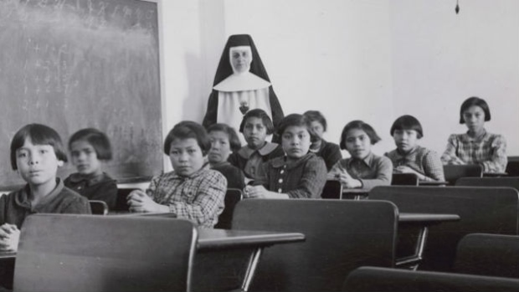
Undated photo from St. Anne’s Indian Residential School.
Group of female students [7th from left Josephine Gillis (nee Hamilton), 8th from left Eleanor Halcrow (nee Ross)] and a nun (Sister Antoine) in a classroom at Cross Lake Indian Residential School, Cross Lake, Manitoba, February 1940.
Notes:
Features of Indian Residential Schools:
Travelling a great distance aboard a cattle truck
Kids were often not allowed to go home and were not permitted to visit other family members in the school.
Removed from a collective culture and put into an institution
Segregation of sexes
Cutting off hair
Regimentation of children’s lives
Forced use of English, punished if using their language(s)
Kids were not allowed to wear their traditional cloths or hold onto any cultural item
Dormitory situation for sleeping
Forced work by children to maintain the institution
Poor food
Loneliness
Image credits, top to bottom:
“Undated photo from St. Anne’s Indian Residential School.”
Courtesy of the National Centre for Truth and Reconciliation.
https://aptnnews.ca/2019/04/12/supreme-court-upholds-residential-school-compensation-for-former-student/
“Group of female students [7th from left Josephine Gillis (nee Hamilton), 8th from left Eleanor Halcrow (nee Ross)] and a nun (Sister Antoine) in a classroom at Cross Lake Indian Residential School, Cross Lake, Manitoba, February 1940.”
Credit: Canada. Dept. Indian and Northern Affairs / Library and Archives Canada / e011080274 ;
Copyright : Expired ;
Restrictions on Use : Nil
http://collectionscanada.gc.ca/ourl/res.php?url_ver=Z39.88-2004&url_tim=2019-05-13T17%3A17%3A11Z&url_ctx_fmt=info%3Aofi%2Ffmt%3Akev%3Amtx%3Actx&rft_dat=4673899&rfr_id=info%3Asid%2Fcollectionscanada.gc.ca%3Apam&lang=eng

Slide 7
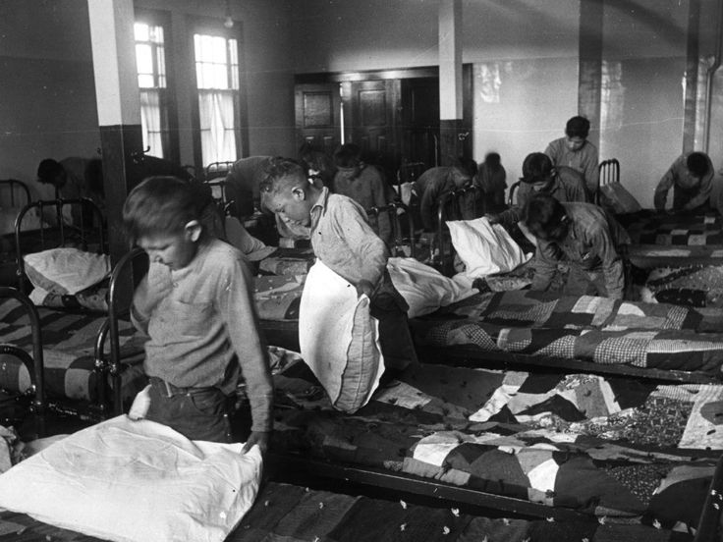
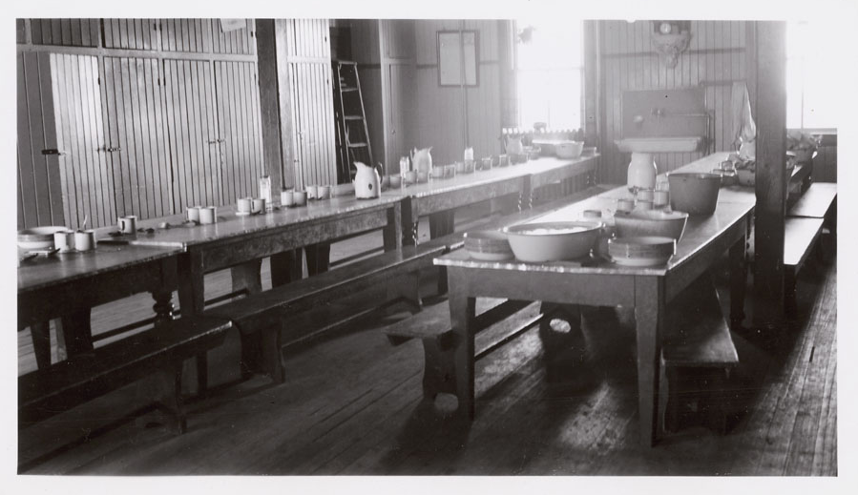
Recreation and dining hall on main floor, looking east, Ermineskin Indian Residential School, Hobbema, Alberta, June 3, 1938.
1950: children in their dormitory at a Canadian boarding school.
Notes:
Food:
The food was notoriously bad in Indian Residential Schools. This was in part due to economics. Schools were always short of funds; however, staff were always fed adequately. This would tend to support the notion that the perception of First Nations being inferior seems to have permitted a lack of empathy on the part of the staff.
As a punishment, food would be taken away from the students.
Sleeping condition:
Students slept on thin, narrow mattresses on single beds. (beds were made out of flour sack, stuffed with straw. Students changed the straw once a year and washed their bed sheets once a month)
Coping and survival:
Students coped with the Indian Residential School experience in different ways.
• When students returned home from Indian Residential Schools, they often felt estranged from their families and communities (a stranger at home).
• In many cases parenting skills were lost because children had no role models to follow; the effects accumulated over generations.
Many students of Indian Residential Schools experienced a sense of inferiority or lack of self confidence.
Some students ran away from the Indian residential school.
There are 6,000 recorded deaths of children at Canadian Residential Schools.
Image credits, left to right:
“1950: children in their dormitory at a Canadian boarding school.”
(Hulton Achives/Getty)
https://www.abc.net.au/radionational/programs/rearvision/6587278
“Recreation and dining hall on main floor, looking east, Ermineskin Indian Residential School, Hobbema, Alberta, June 3, 1938.”
Credit: Canada. Dept. Indian and Northern Affairs / Library and Archives Canada / e011080289
http://knowhistory.ca/dark-tourism-canadian-residential-schools-through-the-european-model/

Slide 8
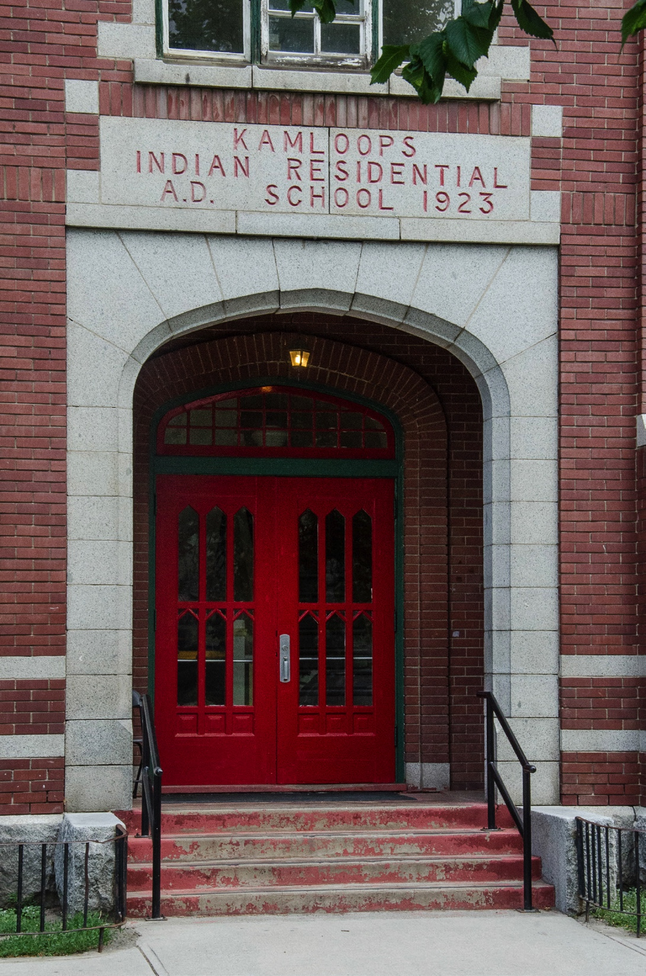
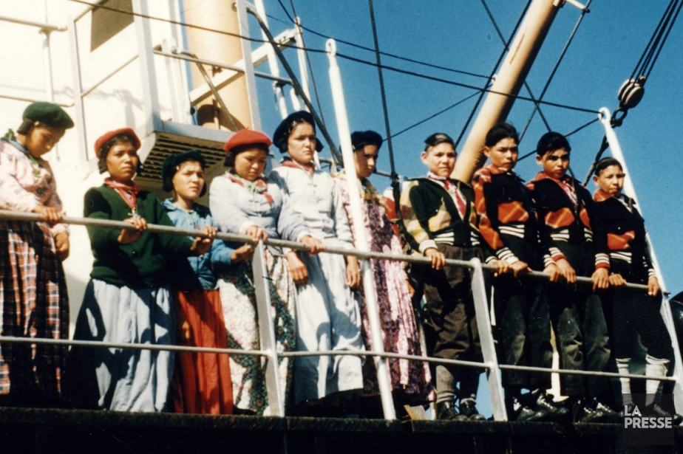
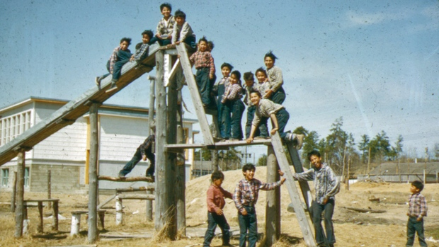
Boys and girls on the SS North Pioneer leaving La Romaine for the Sept-Îles boarding school.
Children at the Cecilia Jeffrey Indian Residential School in Kenora, Ontario.
The Kamloops Indian Residential School closed in 1977. Like many other residential schools in Canada, the conditions were horrific.
Notes:
The last Indian Residential School was closed in 1996 (personalize this date so that students realize that it is pretty recent)
How does all the information provided connect with our local history?
Address St Paul’s Indian residential School in North Vancouver
St Paul’s Indian Residential School (also known as the Squamish Indian Residential School or St. Francis Indian Residential School) was a Canadian Indian residential school and was located in the 500 Block West Keith Road at what is now the site of St. Thomas Aquinas High School in the City of North Vancouver. It was a Roman Catholic school and operated from 1899 to 1958 by the Order of the Oblates of Mary Immaculate. The students of the school were from the adjacent Mission Reserve as well other Squamish and Tsleil-Waututh children.
Image credits, clockwise starting at left:
“The Kamloops Indian Residential School closed in 1977. Like many other residential schools in Canada, the conditions were horrific.”
(FILE PHOTO)
http://truomega.ca/2018/03/21/day-scholar-coordinator-recounts-experiences-in-residential-school/
“Boys and girls on the SS North Pioneer leaving La Romaine for the Sept-Îles boarding school.”
Photo provided by Bibliothèque et Archives nationales du Québec.
https://www.lapresse.ca/actualites/national/201304/24/01-4644115-pensionnats-autochtones-deux-hommes-en-colere.php
"Children at the Cecilia Jeffrey Indian Residential School in Kenora, Ontario.”
Photo from the Presbyterian Church in Canada. (CBC)
https://www.cbc.ca/news/canada/thunder-bay/kenora-secret-path-1.3819304

Slide 9
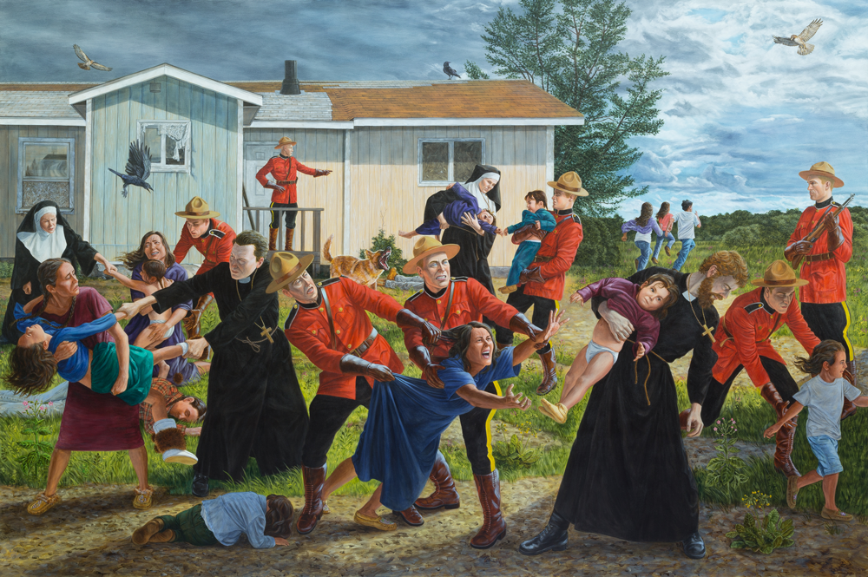
Kent Monkman, The Scream, 2017, acrylic on canvas, 84 x 132 inches
Notes:
The Scream, 2017, acrylic on Canvas, 84 x 132 inches by Kent Monkman
Kent Monkman is a Canadian Aboriginal artist and curator of Cree ancestry. He works with a variety of mediums, including painting, film/video, performance, and installation.
These pieces are chosen from Shame and Prejudice: A Story of Resilience, which is a travelling exhibition for Canada 150. It was organized by the Art Museum at the university of Toronto, opened in Jan, 2017 and will travel to eight Canadian cities through Oct 2020. It portrays a journey through Canada’s history and the treatment of First Peoples.
This exhibition combines historical paintings and artifacts alongside Monkman’s paintings, drawings and sculptural works. As both the artist and curator of the project, he addresses the brutality of 300 years of Canadian history, tying it to the current-day realities for those who live on reservations or the north end of Winnipeg, and the true cost of forging a settler nation. He regards the Canadian confederation (1867) date as a benchmark; he also drifts back to New France, the period 150 years before Confederation, when indigenous peoples were major players in the fur trade that drove the North American economy.

Slide 10
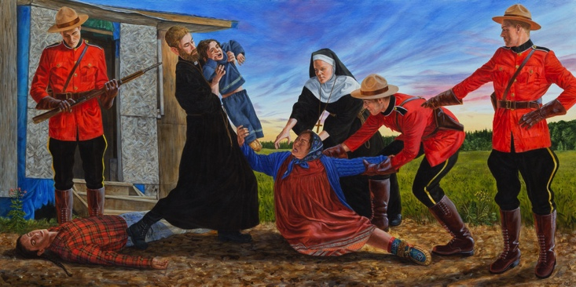
Kent Monkman, A Mother’s Grief, 2017, acrylic on canvas, 36 x 72 inches
Notes:
A Mother’s Grief, 2017, acrylic on canvas, 36 x 72 inches

Slide 11
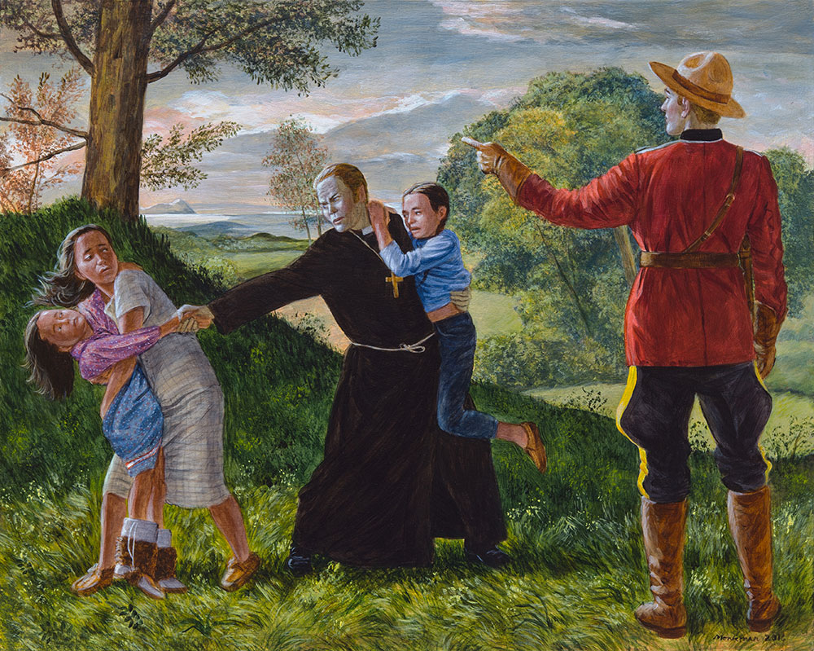
Kent Monkman, Study for The Removal of Children, 2016, acrylic on panel, 18.5 x 23 inches
Notes:
Study for The Removal of Children, 2016 acrylic on panel, 18.5 x 23 inches

Slide 12
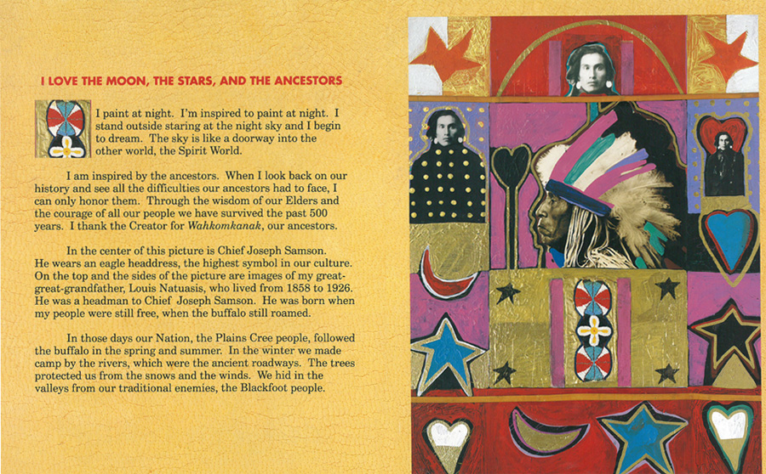
George Littlechild, original artwork from the book This Land is My Land, 1993, Children’s Book Press, pages 4-5
Notes:
George Littlechild was born in 1958 in Edmonton. He is a member of the Plains Cree Nation, which is part of the Cree Nation. He received his Bachelor of Fine Arts degree from the Nova Scotia College of Arts and Design in Halifax, Nova Scotia. He currently lives in Vancouver, BC.
His art is directed to those who do not understand First Nations culture in an attempt to alleviate prejudice and naïveté. Known for creating culturally rich imagery and his use of high-chroma color, George Littlechild is recognized as one of the foremost First Nations artists working in Canada today. He is also the author and illustrator of three children's books.

Slide 13
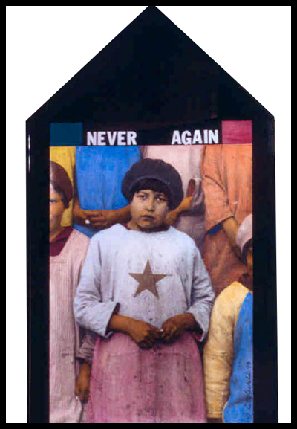
George Littlechild, Never Again, 1993, hand-tinted photograph
Notes:
George Littlechild (B. Edmonton, Alberta, 1958), Never Again (1993), Hand-tinted photograph
Littlechild directly confronts the dark legacy of Canada’s residential school history when he combines a photograph of his mother during her time in the system with direct instruction – Never Again.

Slide 14
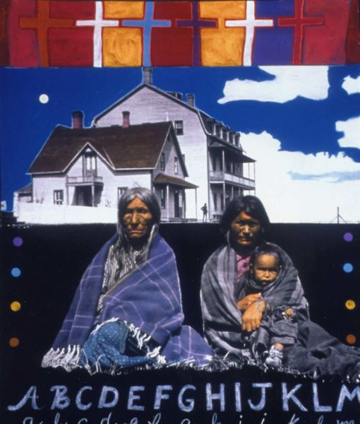
George Littlechild, Ermineskin School Mural – Panel # 4, mixed media,
5 x 4 feet
Notes:
Ermineskin School Mural – Panel # 4, mixed media, 5 x 4 feet by George Littlechild
Address the techniques that Littlechild has used in this piece
Collaging materials: photo
Use of text (alphabets)
Use of symbols
Mark making
Layering
Colour
pattern
Texture

Slide 15
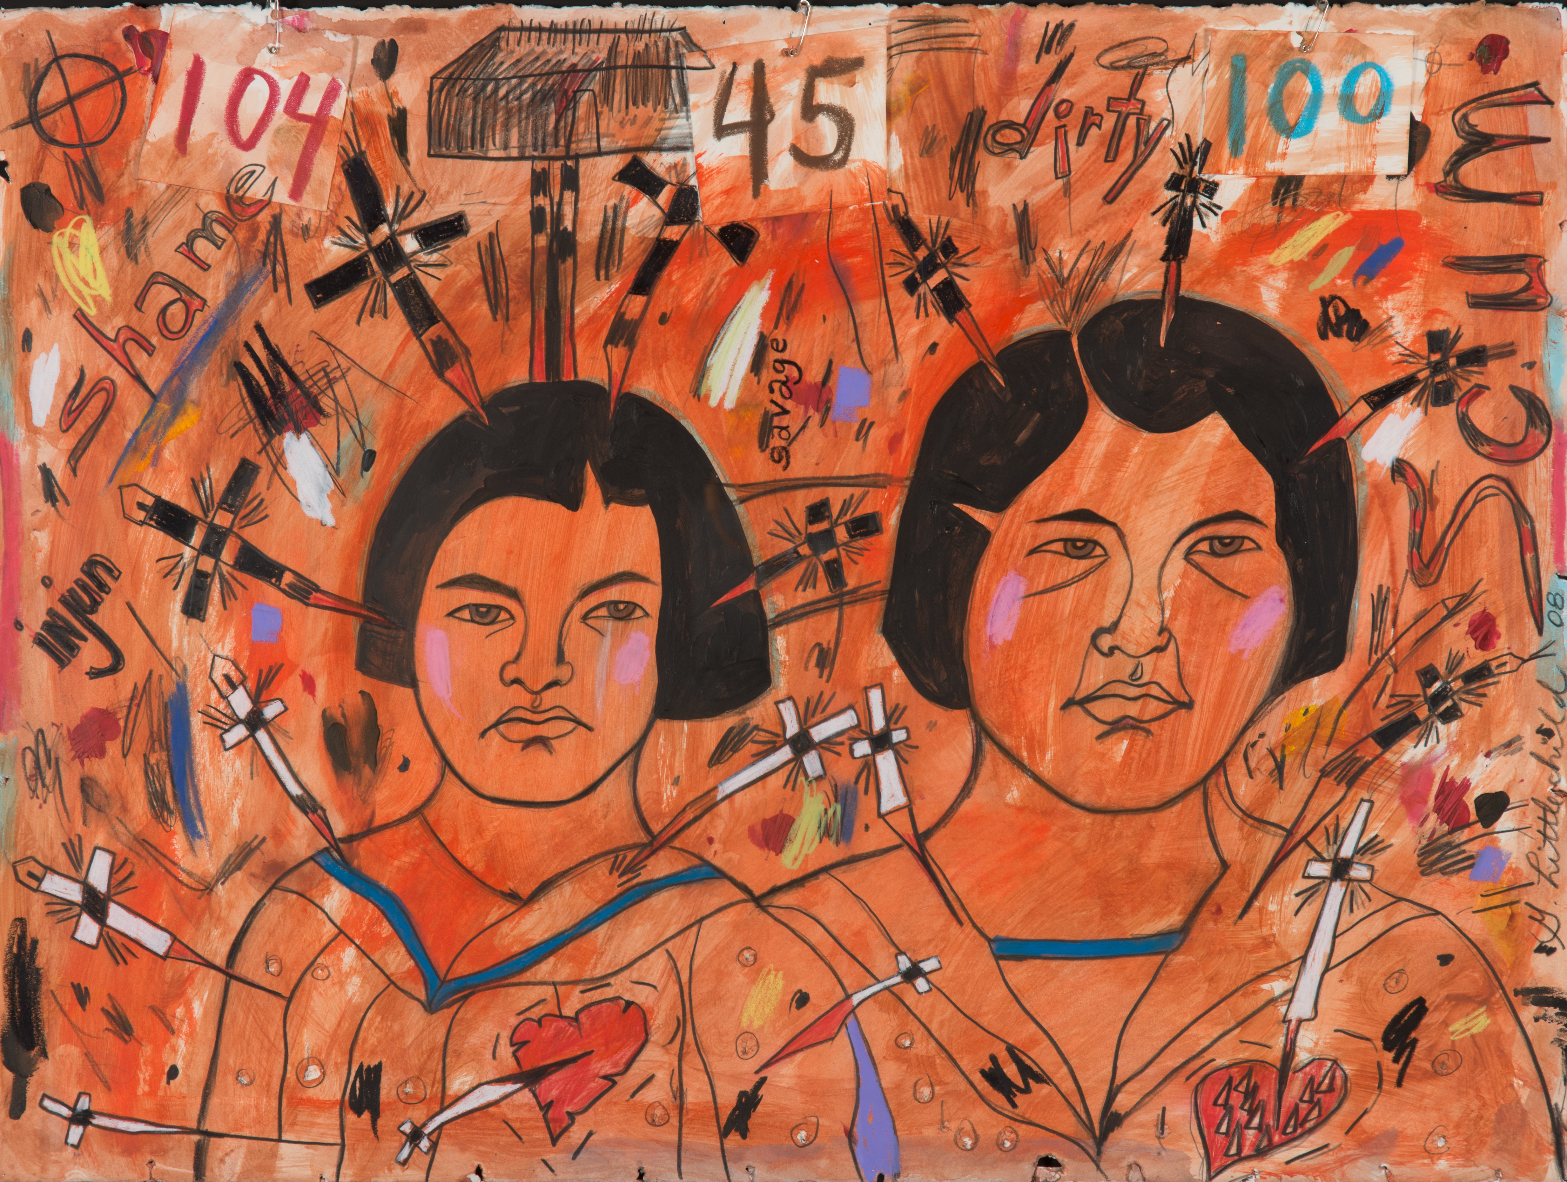
George Littlechild, Numbered Each and Every One, 2008, mixed media and pins on paper, 22 x 30 inches
Notes:
Address the techniques that Littlechild has used in this piece
Use of text
Use of symbols
Use of numbers
Mark making
Layering
Colour
pattern
Texture

Slide 16
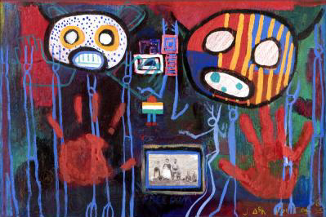
Jane Ash Poitras, Screaming Shaman # 4, mixed media
Notes:
Jane Ash is a Cree artist who was born in Fort Chipewyan in northern Alberta in 1951. She received her Bachelor of Fine Arts Degree in printmaking at the University of Alberta, Edmonton. Poitras’ interest in this medium also took her to Yale University and then to Columbia University, New York, where she completed a Master of Fine Arts Degree in printmaking. She is an internationally acclaimed artist and lives in Edmonton.
Orphaned at six years with the death of her mother from tuberculosis, she was raised in Edmonton by Marguerite Runck, an elderly German lady, at a time when “people did not take too kindly to Indians.” She was also raised in the Catholic church, and with an atmosphere of prayer, dreams, and spirits imparted to her by this woman she affectionately refers to as “Grandma.” Her upbringing had a strong spiritual component, which facilitated the transition to a Native spirituality in the artist’s adult life. Her schooling was not a residential school experience, but rather a conventional school situation with its presentation of a distinctly non-Native perspective coincided with her development as an artist.
Her imagery is narrative in nature and is built upon a combination of symbols of her own and other Native heritages, modern culture and the language of contemporary fine art.
Address the techniques that Jane Ash uses in her art:
Collaging materials: photo
Use of text
Use of symbols
Mark making
Layering
Colour
pattern
Texture
Drawing of human figures: spirit of children who passed away in residential schools
Scribble drawing

Slide 17
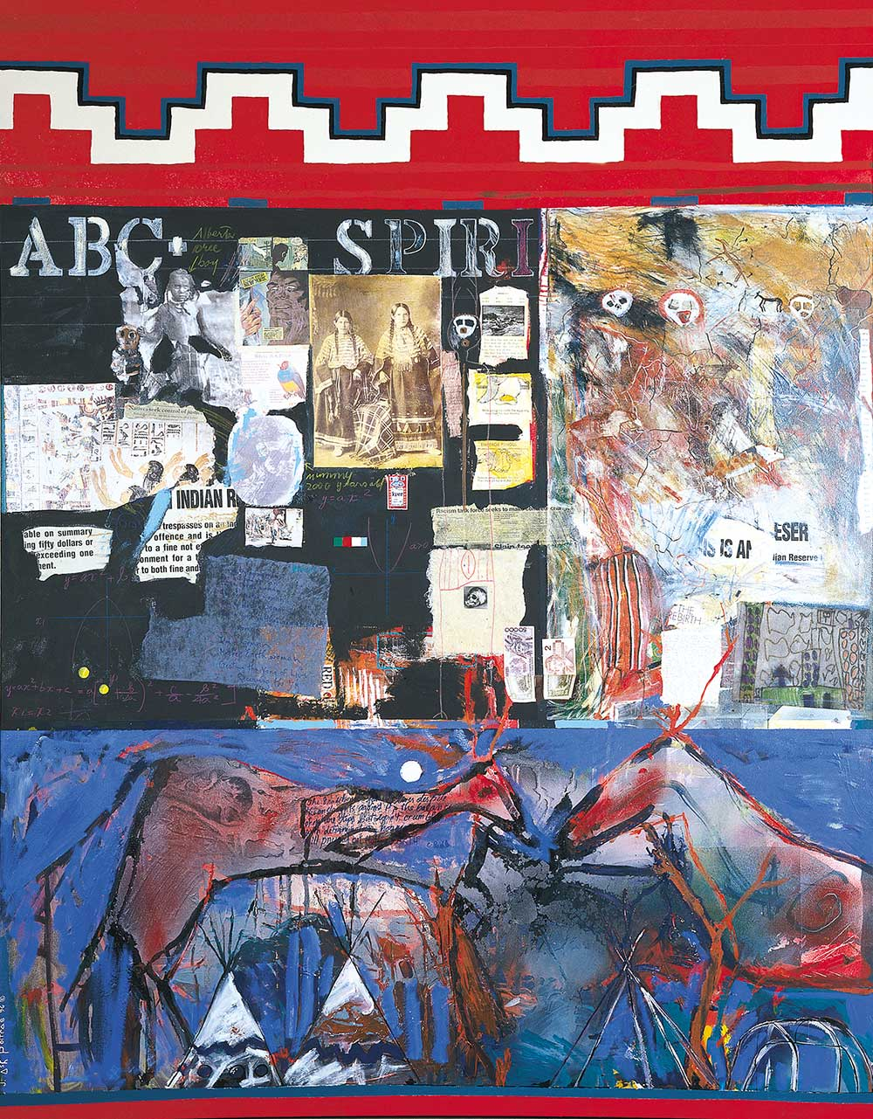
Jane Ash Poitras, Pink Shamans, 1996, Mixed media canvas, 244 x 186.7 cm
Notes:
Address the techniques that Jane Ash uses in her art:
Collaging materials: photo
Use of text
Use of symbols
Mark making
Layering
Colour
pattern
Texture
Drawing of human and animal figures
Scribble drawing (taking paint off with a sharp tool)

Slide 18
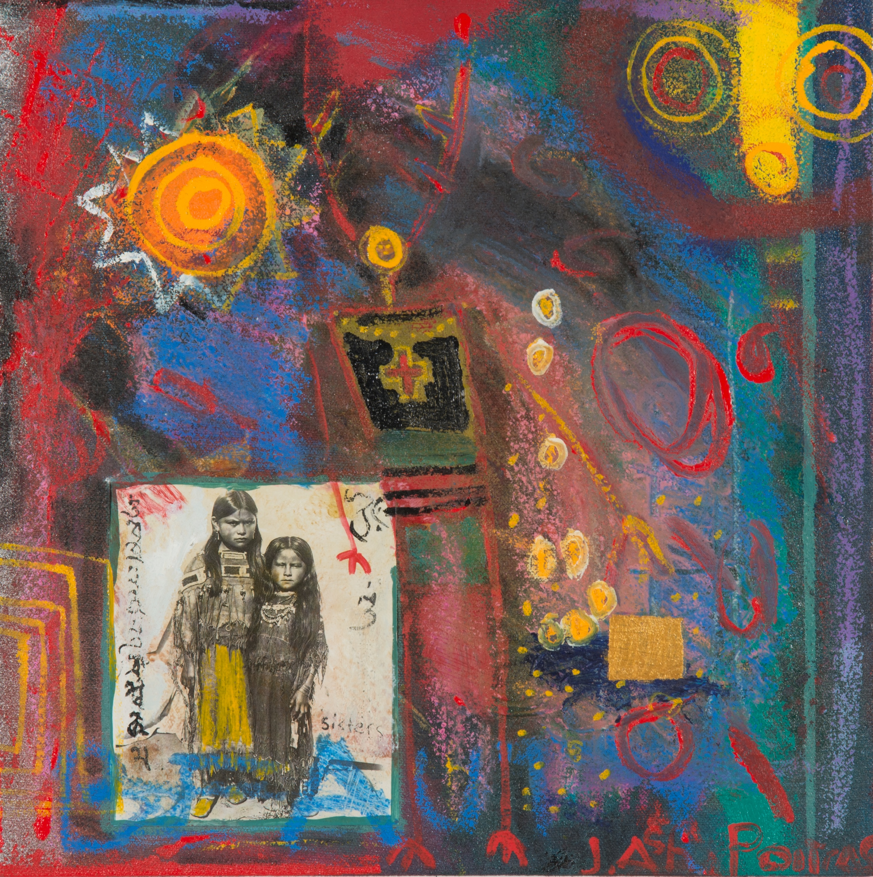
Jane Ash Poitras, Sisters/Storm, 1999, Acrylic on canvas, 12 x 12 inches
Notes:
Address the techniques that Jane Ash uses in her art:
Collaging materials: photo
Hand painting the photo
Use of text
Use of symbols
Mark making
Layering
Colour
pattern
Texture
Scribble drawing

Slide 19
RECONCILIATION POLE INSTALLED AT UBC
http://aboriginal.ubc.ca/2017/04/07/reconciliation-pole-installed-at-ubc/
Notes:
Reconciliation Pole was installed in a traditional Haida manner on Saturday, April 1, 2017 on Main Mall, between Agronomy Road and Thunderbird Boulevard on UBC’s Point Grey Campus, which is located on the traditional, ancestral and unceded territory of the Musqueam First Nation.

Slide 20
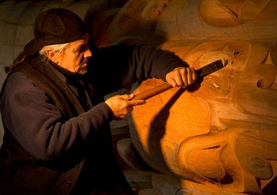
Hart penciling in guidelines (and eating lunch).
James Hart, Haida Master Carver. Reconciliation Pole, UBC.
Notes:
About the artist:
James Hart was born in 1952 into the Eagle Clan at Old Massett, Haida Gwaii. Haida master carver and Hereditary Chief 7idansuu, James Hart, has been carving since 1979. In addition to his monumental sculptures and totem poles, he is a skilled jeweller and printmaker and is considered a leader among Haida artists in the use of bronze casting.
Image credits, left to right:
“Hart penciling in guidelines (and eating lunch).”
Credit: Amanda Siebert, The Georgia Straight
https://www.straight.com/arts/888571/haida-master-carver-james-hart-tells-story-indian-residential-schools-reconciliation
“James Hart, Haida Master Carver. Reconciliation Pole, UBC.”
Credit: UBC/Paul Joseph
http://painterskeys.com/stages-of-the-quest/

Slide 21
Hundreds of people gathered at UBC to watch the Reconciliation Pole being raised on April 1, 2017.
Notes:
What is reconciliation?
Reestablishment of a broken relationship
Creating positive accord where there is discord
Restoring friendship and harmony—resolving differences, accepting the past and working together to build a future
Background:
By 2005, the Government of Canada was facing a large number of court cases seeking restitution from damages suffered by survivors of Indian Residential Schools. That year the survivors and the government reached a negotiated settlement, known as the Indian Residential School Settlement Agreement. It provided financial compensation to survivors and established the Truth and Reconciliation Commission.
What does it include?
Full and active commitment of all parties (Aboriginal and non-Aboriginal)
To acknowledge that It will take time and commitment to reverse the legacy of residential school system
To acknowledge that Residential Schools have affected many generations of students and their families.
To acknowledge that reconciliation involves more than the Indian residential school
It includes reconciling the range of colonial injustices: a fair settlement of land and educate all Canadians on the Indian Residential School System.
It will be a positive step in forging a new relationship between Aboriginal peoples and other Canadians, a relationship based on the knowledge of our shared history, a respect for each other and a desire to move forward together with a renewed understanding that strong families, strong communities and vibrant cultures and traditions will contribute to a stronger Canada for all of us.
Image credit: https://planning.ubc.ca/vancouver/news-events/newsletter/2018-01-09/qa-michael-white-january-2018

Slide 22
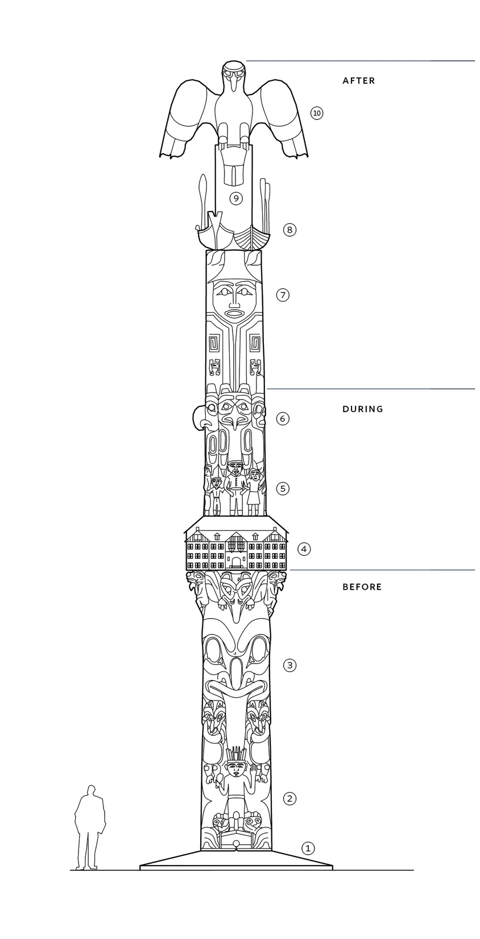
Reconciliation Pole
2015-17, red and yellow cedar, oil paint, copper, abalone
The pole was designed and carved under the direction of master carver and hereditary chief, 7idansuu (Edenshaw), James Hart, Haida of Haida Gwaii, assisted by community members Gwaliga Hart, John Brent Bennett, Jaalen Edenshaw, Derek White, Leon Ridley, Brandon Brown, and late son Carl Hart. Fellow artists from across Canada carved/painted the children— Zacharias Kunuk (Inuit), Shane Perley-Dutcher (Maliseet), Greg Hill (Mohawk), Phil Gray (Cree), Susan Point (Musqueam), Kevin Cranmer (Kwakwa-ka-’wakw), Christian White, Reg Davidson and Corey Bulpitt (Haida), Sven Haakanson (Aleut). Many volunteers young and old nailed in all the copper nails.
The pole, carved from an 800-year-old red cedar log, was installed on April 1, 2017.
Notes:
What Story does the Reconciliation pole tell?
Haida Poles are read from bottom to top.
Surrounding the base of the pole are salmon symbolizing life and its cycle.
Between the legs of Bear Mother is sGaaga (Shaman), who stands on top of salmon House and enacts a ritual to ensure their return
Bear mother holds her two cubs, Raven looks out from between Bear Mother’s Ears.
A Canadian Indian residential school house, a government instituted system designed to assimilate and destroy all indigenous culture across Canada.
The children holding and supporting one another are wearing their school uniforms and numbers by which each child was identified. Their feet are not depicted , as they were not grounded during those times.
Four Spirit Figures: Killer whale—water, bear—land, eagle—air, Thunderbird—the supernatural. They symbolize the ancestries, environment, worldly realm, and the cultures in which they are rooted, that each child came from.
The mother, father and their children symbolize the family unit and are dressed in traditional high-ranking attire symbolizing revitalization and strength of today.
Above the family is the canoe and longboat shown travelling forward, side by side. The canoe represents the First Nations and governances across Canada. The longboat represents Canada’s governances and Canadian people. This symbolism respectfully honors differences, but most importantly displays us traveling forward together side by side.
Four Coppers, coloured to represent the peoples of the world, symbolize and celebrate cultural diversity.
Eagle represents power, togetherness, determination, and speaks to a sustainable direction forward.
Image Credit: http://aboriginal-2.sites.olt.ubc.ca/files/2017/10/UBC_Plaque_2017-Reconciliation_Pole-8-1.pdf

Slide 23
Haida master carver and hereditary chief, James Hart, and his apprentices carved a totem pole as a tribute to Residential School survivors and the thousands who died in the schools. The Reconciliation Pole was raised in 2017 at UBC.
Notes:
The children holding and supporting one another are wearing their school uniforms and numbers by which each child was identified. Their feet are not depicted , as they were not grounded during those times.
A Canadian Indian residential school house, a government instituted system designed to assimilate and destroy all indigenous culture across Canada
Raven looks out from between Bear Mother’s Ears
Image Credit:
”Haida master carver and hereditary chief, James Hart, and his apprentices carved a totem pole as a tribute to residential school survivors and the thousands who died in the schools. The “Reconciliation Pole” was raised Saturday at the UBC.”
Credit: Mike Howell, Vancouver Courier
https://www.vancourier.com/news/hundreds-raise-reconciliation-totem-pole-at-ubc-1.13794494

Slide 24
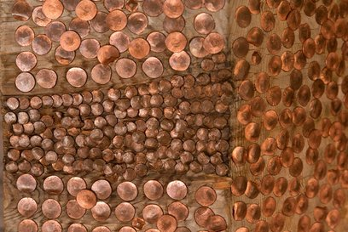
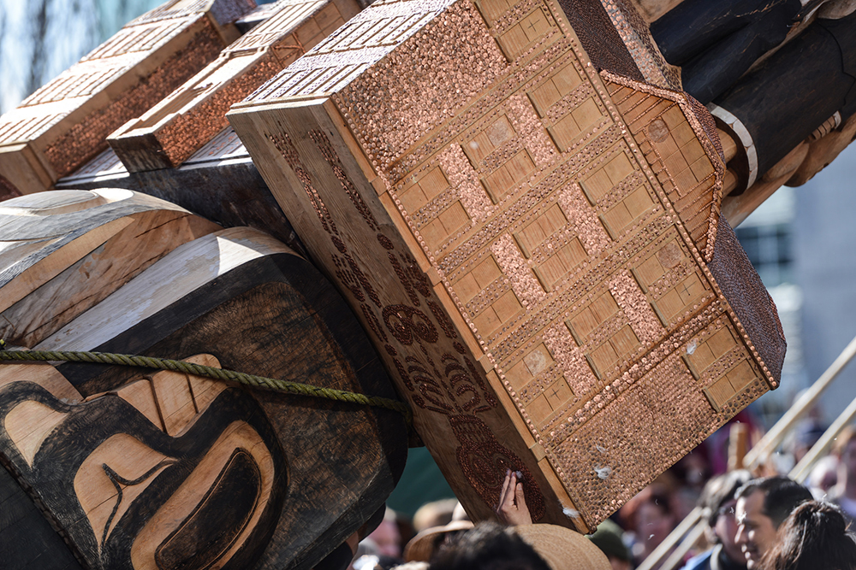
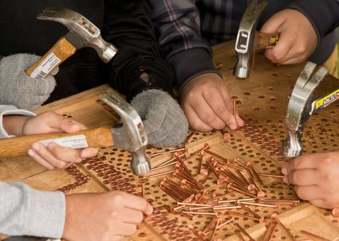
The copper nails represent children who died while at Residential Schools, many of them buried in unmarked graves on the schools’ grounds.
A depiction of the residential school system, with copper nails to represent the chidren who died there, on the new Reconciliation Pole at UBC.
Notes:
The copper nails covering areas of the pole are in remembrance of the many children who died at Canada’s Indian Residential Schools—each nail commemorates one child.
Image credits, clockwise left to right:
“A depiction of the residential school system, with copper nails to represent the chidren who died there, on the new Reconciliation Pole at UBC.”
Credit: Paul Joseph/UBC
https://dailyhive.com/vancouver/reconciliation-pole-ubc-photos-video
“The copper nails represent children who died while at Residential Schools, many of them buried in unmarked graves on the school’s grounds.”
Credit: Sharon Eva Grainger
http://www.dos-polacas.com/copper-nails.html
“The copper nails represent children who died while at Residential Schools, many of them buried in unmarked graves on the school’s grounds.”
Credit: Sharon Eva Grainger
http://www.dos-polacas.com/copper-nails.html

