Slide 1
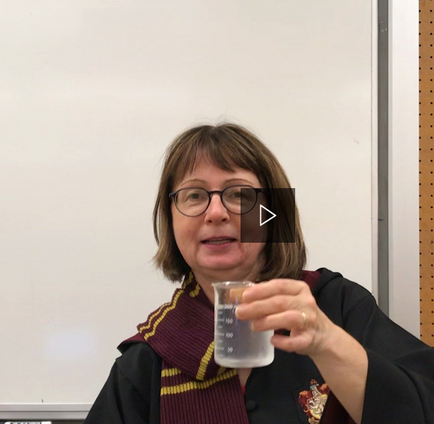
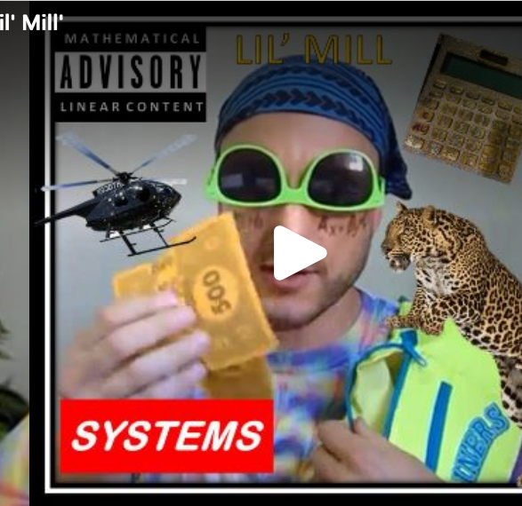
Summer Learning 2021

Slide 2
Vision & Mission
Vision
To provide a platform for students to explore and extend learning opportunities while fulfilling their educational requirements.
Mission
NVSD Summer Learning provides an engaging learning environment where all students can challenge themselves academically and fulfill their personal learning goals through alternative pathways.

Slide 3
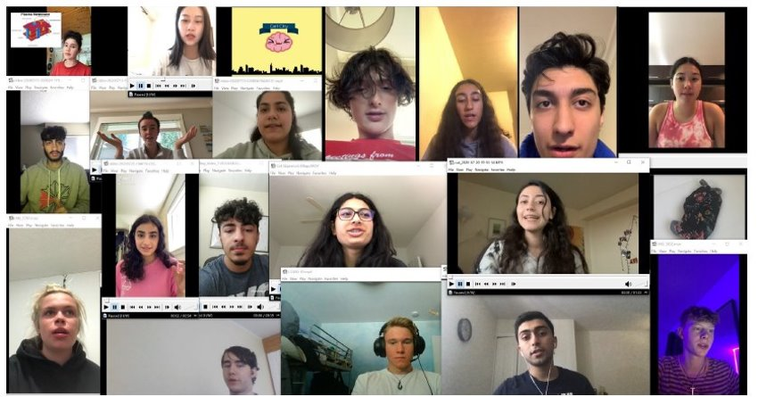
Our Clients
Students with gaps in their learning who aim to enhance their skills
Students who wish to get ahead by taking a full credit academic course

Slide 4
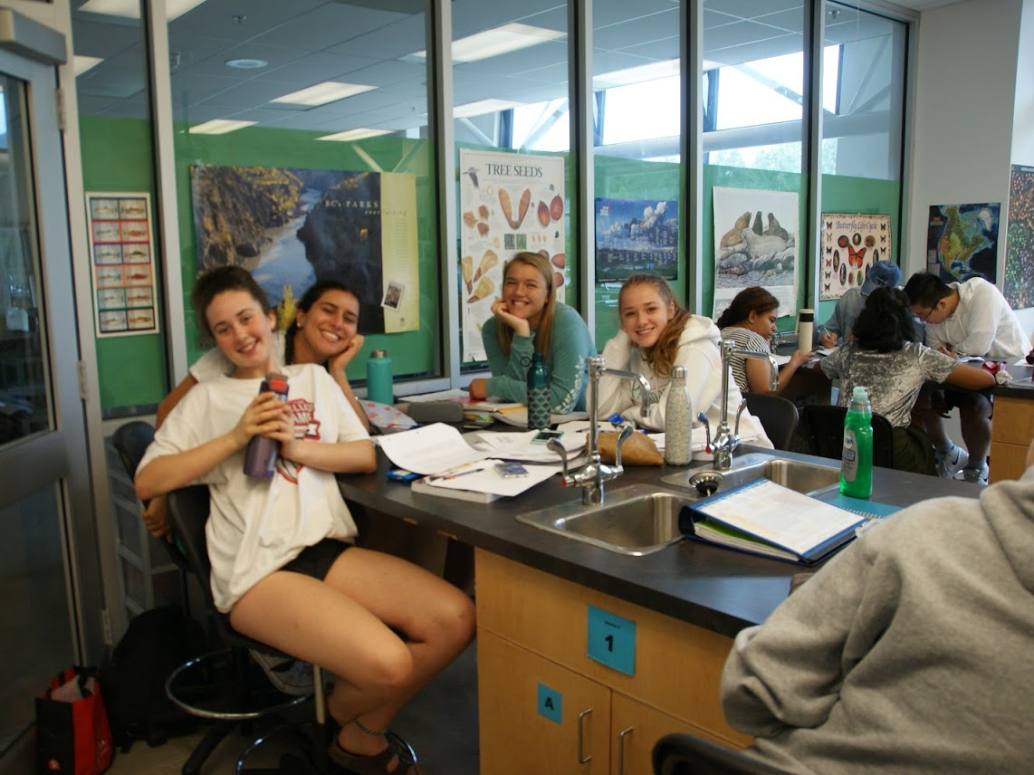
Registration
Online only @ Summer Learning website www.sd44.ca > Schools > Summer Learning
Opens → May 1
Closes → June 24
@ noon

Slide 5
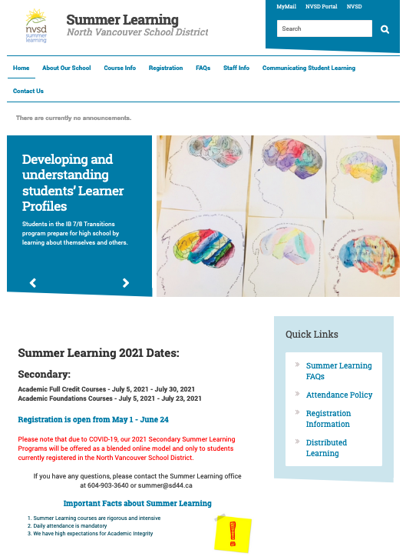
Summer Learning Website

Slide 6
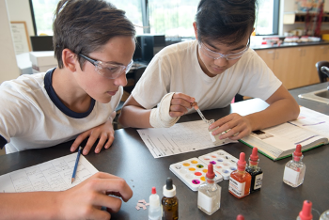
2021 Blended Model Some in person & some online

Slide 7
Summer Learning Details
Programs | Foundations Courses | ​Full Credit Courses
 | ELL Literacy Numeracy | Required courses for Graduation
Locations | Carson Graham Secondary | Carson Graham Secondary
Dates | July 5 - July 23 | July 5 – July 30
Times | 9:00am - 12:00am | 8:30am - 12:30pm

Slide 8
Our Course Offerings
Grade 10 | ​Grade 11 | Grade 12​​
​English Composition & Spoken Word | Chemistry | ​​​​​​Anatomy & Physiology
Foundations of Math & Pre-Calculus | ​Explorations en études sociales | ​​​​Chemistry
​​Physical & Health Education | Explorations in Social Studies | English Studies
Science | Foundations of Math | Physics
Social Studies | Life Sciences | Pre-Calculus
​​ | Literary Studies | ​​​
 | Physics
 | Pre-Calculus​

Slide 9
Good to know...
Summer Learning courses are rigorous & intensive
Daily attendance is mandatory
Academic integrity expectations are high
Celebration of Learning held annually

Slide 10
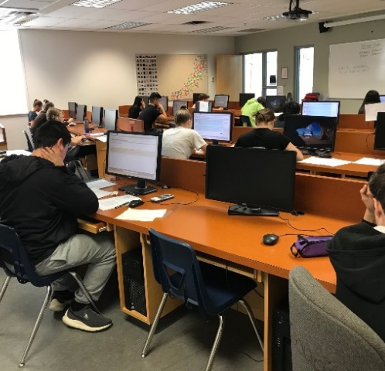
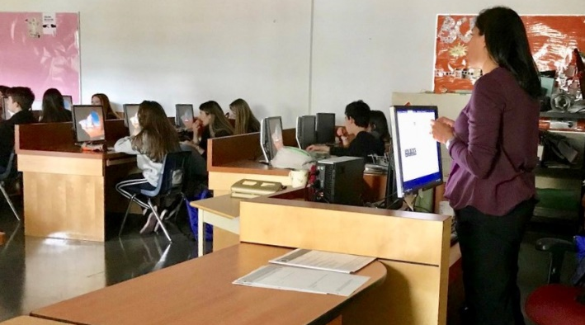
North Vancouver Online Learning (NVOL)

Slide 11
NVOL Vision
To work in partnership with mainstream schools to provide students with flexible, innovative, and personalized pathways to graduation through interactive and engaging online experiences.

Slide 12
About Our School
2,500 + students
youth & adults
graduates upgrading & future graduates
48 courses at the grade 10-12 level & 8 at grade 8-9
8 full time teaching staff
20 part time teaching staff based at SD44 Secondary Schools

Slide 13
What is NVOL?
An alternate way to complete core academic & elective courses at the secondary level
Self-paced
Continuous entry
Online courses with instruction & resources delivered through the Moodle platform
Students engage with teachers as needed through Moodle Messaging, Teams, email, face-to-face, telephone & virtual classroom

Slide 14
Benefits of NVOL
Flexible, self-paced, anytime, anywhere learning
Frees up student timetables
Supports student schedules & part-time work schedules
Prepares students for other online course delivery options like those available at post-secondary, trades & employment training and development programs

Slide 15
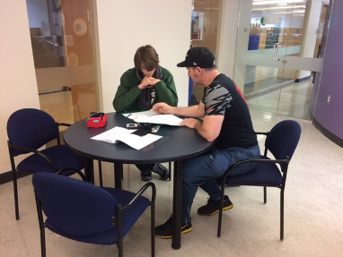
Grade 8 & 9 Course Offerings
English Language Arts 8 & 9
Mathematics 8 & 9
Science 8 & 9
Social Studies 8 & 9
Students in Grades 8 & 9 need permission from their school counsellor to enrol in Online Learning courses.
https://www.sd44.ca/school/onlinelearning

Slide 16
Grade 10 Course Offerings
Career-Life Education 10
Composition 10 (2 credits)
Core French 10
Creative Writing 10 (2 credits)
Education au choix de carrière et de vie 10 (for French Immersion students)
Français langue seconde - Immersion - FRAL 10 (for French Immersion students)
Literary Studies 10 (2 credits)
Mathematics 10 Foundations & Pre-Calculus
New Media 10 (2 credits)
Physical & Health Education 10
Science 10
Sciences naturelles 10 (for French Immersion students) coming March 2021
Social Studies 10
Spoken Language 10 (2 credits)
Workplace Mathematics 10
https://www.sd44.ca/school/onlinelearning

Slide 17
Grade 11 Course Offerings
Chemistry 11
Composition 11
Core French 11
Creative Writing 11
Earth Sciences 11
Explorations en sciences humaines et sociales 11 (for French Immersion students)
Foundations of Mathematics 11
Life Sciences 11
Literary Studies 1
Marketing and Promotion 11
Physics 11
Pre-Calculus 11
Science for Citizens 11
Workplace Mathematics 11
https://www.sd44.ca/school/onlinelearning

Slide 18
Grade 12 Course Offerings
20th Century World History 12
Active Living 12
Anatomy and Physiology 12
Apprenticeship Mathematics 12
Calculus 12
Career-Life Connections 12
Chemistry 12
Core French 12
English Studies 12
Foundations of Mathematics 12
Français langue seconde - Immersion - FRAL 12 (for French Immersion students)
Law Studies 12
Philosophy 12
Photography 12
Physical Geography 12
Physics 12
Pre-Calculus 12
Social Justice 12
https://www.sd44.ca/school/onlinelearning

Slide 19
Student & Parent Support
Virtually through Moodle & MS Teams platforms
Students & parents contact teachers as needs and questions arise
In person at Mountainside Secondary OL Centre room 410
Academic support
Test taking
Tech support
Open daily
Satellite OL Centres (at each Secondary School)
Academic support
Test taking
Tech support
Open as per on-site OL staff schedules

Slide 20
Registration
Step 1:
Meet with your grade counsellor to determine is OL is right for you!
Create your graduation plan/course plan
Step 2:
Complete registration forms, available on the OL website
Submit forms to your grade counsellor for signature
Submit forms to NVOL
Step3:
Receive your Moodle access (students & parents)
Login & get started
Message your OL teacher, update your profile & bio, and set personal timelines
https://www.sd44.ca/school/onlinelearning

Slide 21
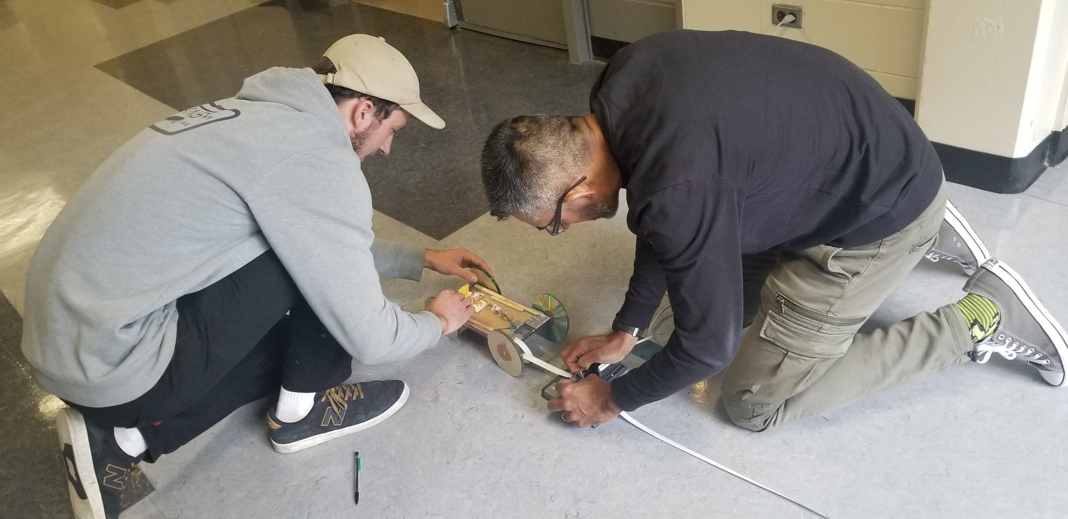
Questions?
https://www.sd44.ca/school/onlinelearning

