Slide 1

Outdoor Place-based
Learning

Slide 2

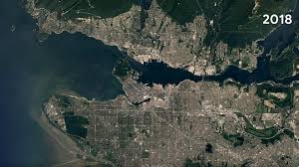
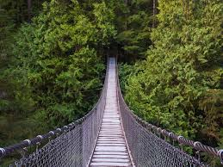
What is Place?
Place is any environment, locality, or context with which people interact to learn, create memory, reflect on history, connect with culture, and establish identity.
From BC Curricular Competency guidelines
Notes:
PADLET Session 1: Place

Slide 3

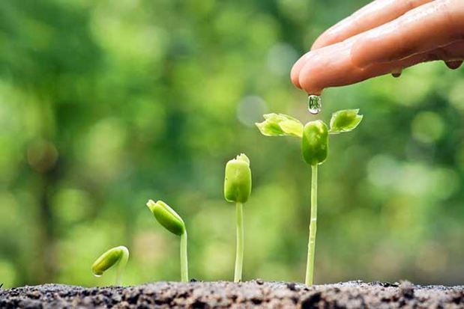
Place-based Learning
“Emphasizing hands-on, real-world learning experiences, this approach to education increases academic achievement, helps students develop stronger ties to their community, enhances students’ appreciation for the natural world, and creates a heightened commitment to serving as active contributing citizens.” (David Sobel, 2004, p. 7).

Slide 4
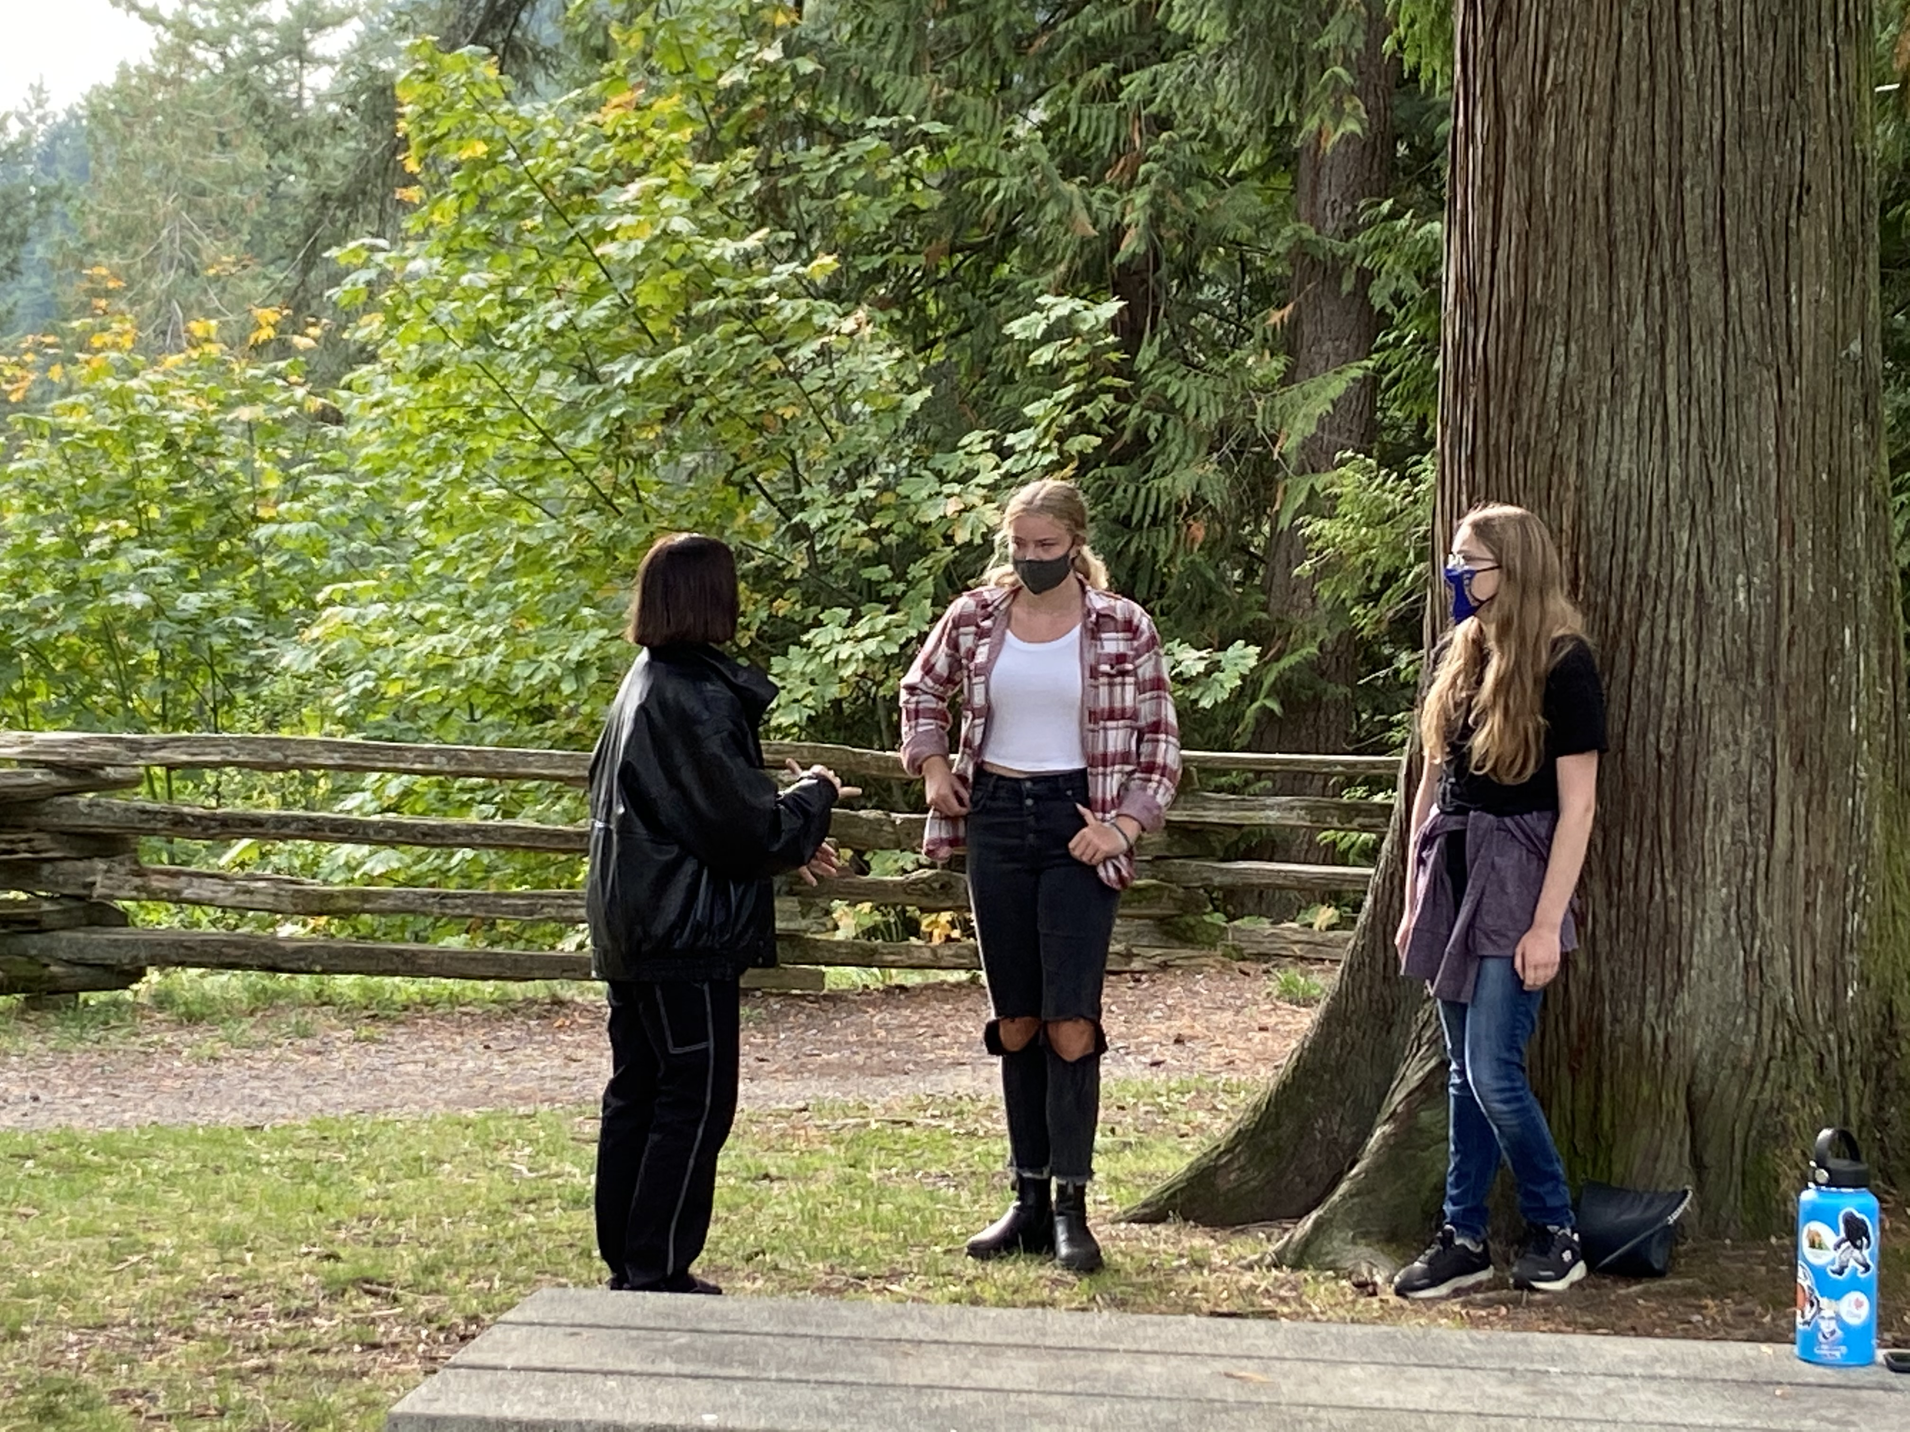
Key Elements
Place-based approaches to education:
increase learner engagement
help learners form stronger ties to their community
enhance learners’ appreciation for the natural world, and
create a heightened commitment to serving as active contributing citizens
Source: Ministry of Education Introduction to Science-from D. Sobel Connecting Classrooms and Communities

Slide 5
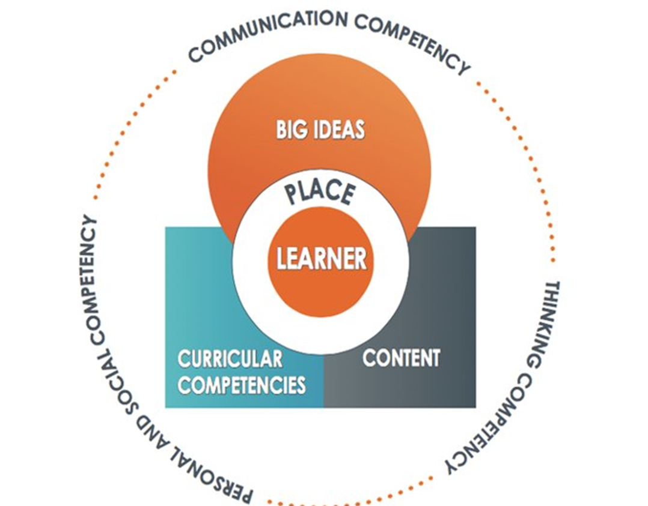
NVSD--the Natural PLACE to Learn
We support outdoor place-based learning that...
is situated in and around the school site, in the local community and environment
focuses on local themes, systems, and content
is student-centred, interdisciplinary and personally relevant to the learner
promotes engagement and connection with the outdoors
contributes to the health of the community and environment
is grounded in and supports the development of a love for one’s place.
Notes:
PBL is learner-centred, cross-curricular, inquiry-driven and grounded in place.
Place-based education embraces personalized, student-centred learning; concepts, topics and issues are relevant to students’ lives and local community.
A place-based approach provides a learning environment that connects the concept-based, competency driven curriculum to the real-world of students’ daily lives.
Place-based learning is embedded in and across the K-12 curriculum and is a core SD44 strategic priority.
With distance/hybrid learning, opportunities exist for educators to connect classrooms to community (virtually and in-person) and begin to explore the students' homes and local neighborhoods as potential learning environments.

Slide 6

PBL & Core Competencies
Place-based environmental learning approaches link strongly to the core competencies, as inquiries connected to place provide opportunities to develop:
Communication and collaboration skills;
Creative, critical and reflective thinking; and
Personal awareness & responsibility, positive personal and cultural identity and social awareness and responsibility.

Slide 7
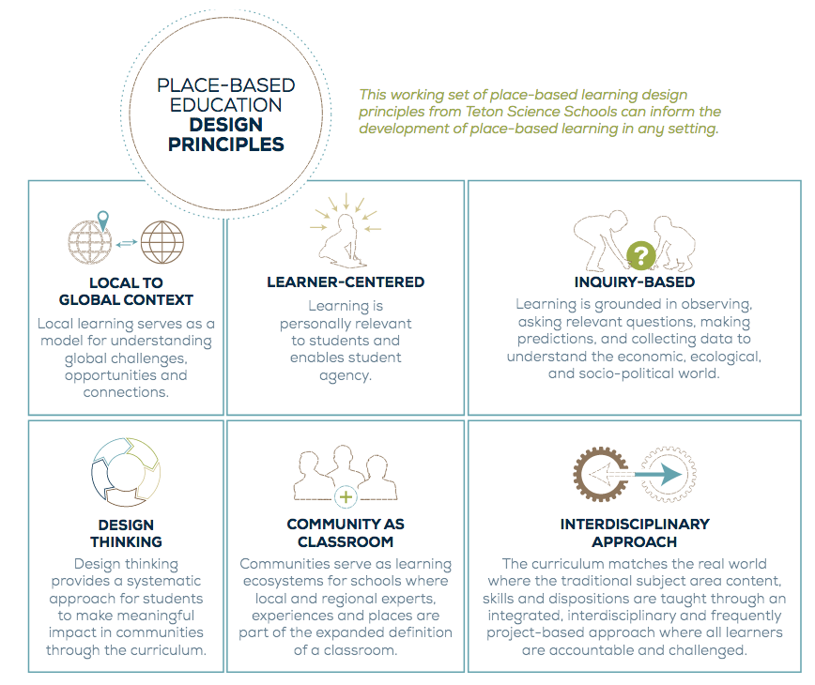
Efbfsbd

Slide 8
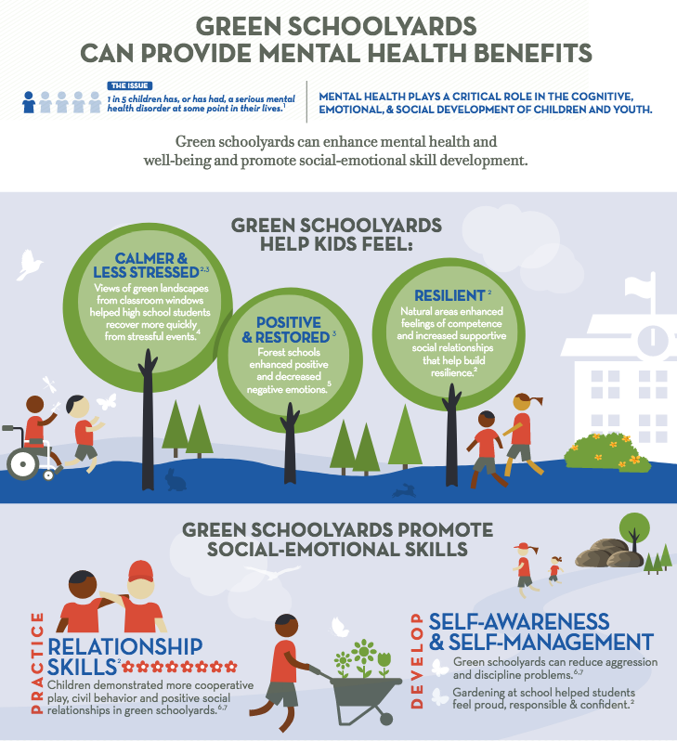
Shifting the Classroom Outdoors & into the Community
Benefits
  Engagement & relevancy
  SEL/Mental health supports
  Physical activity/literacy
  Fresh air & open spaces
  Connecting learning in/with & about place
Considerations
  Supervision
  Managing risk
  Teaching/learning resources
  Transport/access
  Building expectations/routines

Slide 9
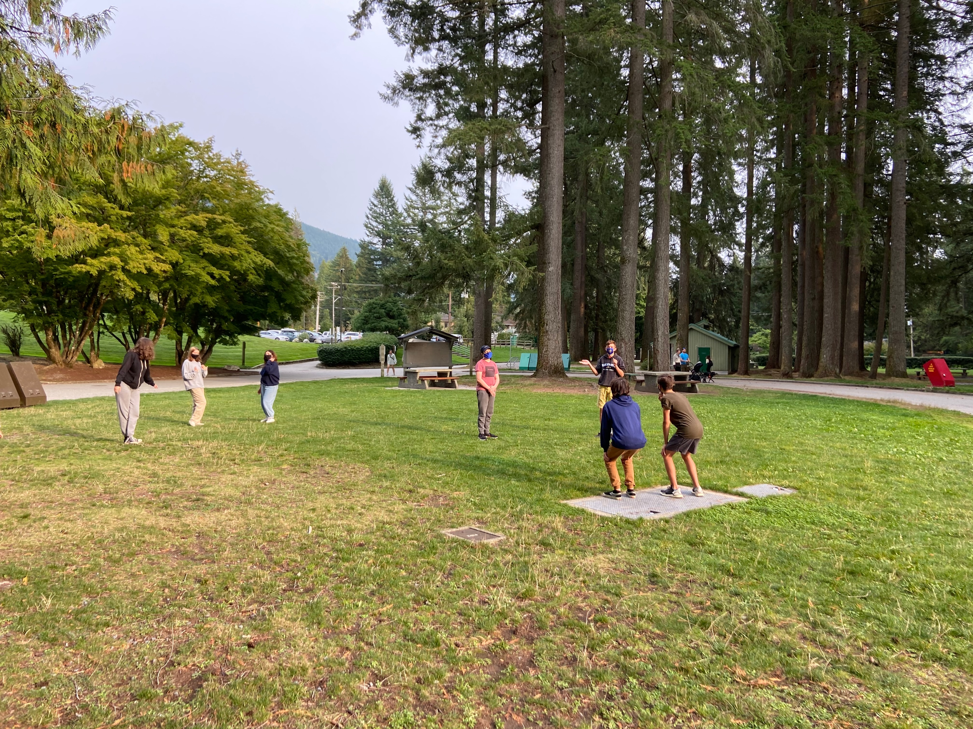
Community Connections
Places: Parks, Art Galleries, Museums, Community Centres, Municipal Facilities,
People: Elders, Business Owners, Govt Representatives, Athletes, Parks Interpreters, Veterans, Volunteers, Student leaders
Organizations: Oceanwise, Edible Garden, Regional Parks, Edible Garden Projects, Farm to School BC, North Shore Neighbourhood House, Community Sports Associations, SAR, Senior Centres, Deep Cove Kayak
HSS Student Leaders at Cleveland Dam
Notes:
PADLET Session 2

Slide 10
NVSD--the Natural PLACE to Learn
      What’s Next?
      As a district, how could we connect, share stories & promising practices, and celebrate successes?
Place-based Learning Network?
      Forum for building place-based learning connections
      Place to share resources, lessons, and PD opportunities
      Identify, promote and broaden community connections
      Build collective capacity

