Slide 1
Welcome Parents and Guardians Handsworth Secondary 2024 - 2025 Grade 8 into 9 Programming Presentation

Slide 2
We thank the Coast Salish Peoples of the SKWXWÚ7MESH and TSLEIL-WAUTUTH NATIONS, upon whose unceded lands the North Vancouver School District resides. We value the opportunities to LEARN, SHARE AND GROW together with the Indigenous keepers of this, their traditional territory.
“If we think of territorial acknowledgments as sites of potential disruption, they can be transformative acts that to some extent undo Indigenous erasure. I believe this is true as long as these acknowledgments discomfit both those speaking and hearing the words. The fact of Indigenous presence should force non-Indigenous peoples to confront their own place on these lands.” – Chelsea Vowel, Métis 5 Steps to Making Respectful Land Acknowledgements - RAVEN (raventrust.com)

Slide 3
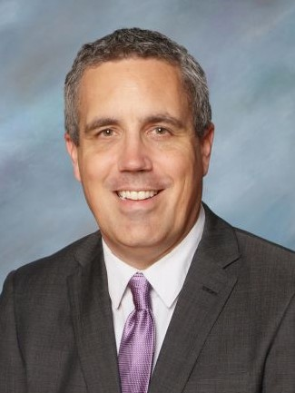
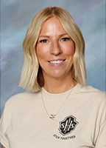
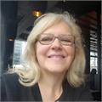
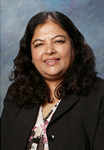
Supporting Students & Families
Cary Hungle, Principal
Grade 12 Administrator
Meghan Downie, VP
Grade 9 & 11 Admin
Marianne Macario
Counsellor, Gr. 9
Jagruti Desai, V.P.
Grade 8 & 10 Admin

Slide 4
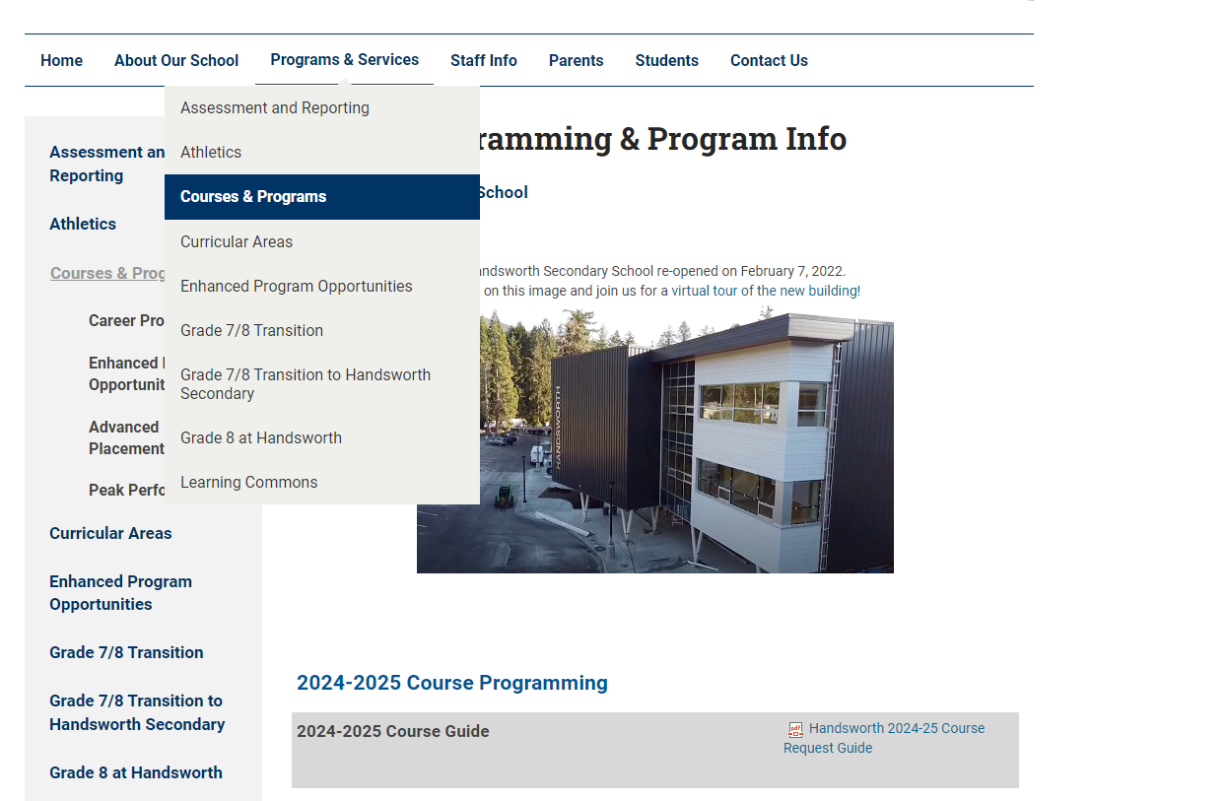
Course Programming Information Page
Course Programming Guide

Slide 5
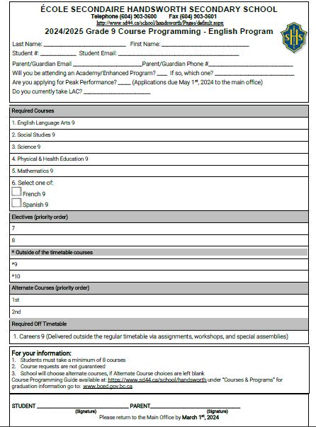
PICK UP YOUR GREEN FORM
TUESDAY

Slide 6
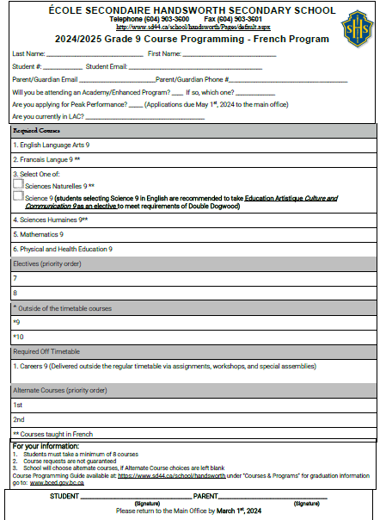
PICK UP YOUR PURPLE FORM
TUESDAY

Slide 8
MyEd Student Course Request Entry
Step 1 – Login to STUDENT MyEd account and reset Password (prior to February 14th)
Student MyEd login username information on labelled Course Request Sheets. Instructions and student passwords will be sent home to families.
Step 2 – From February 14th – February 29th, MyEd Student Course Request Entry window is OPEN. Students enter course request at home.
Step 3 – Hand in Course Request Sheet (completed AND signed to Main Office by March 1st, 2024.
(Students unable to do course request entry at home
can get support at school March 12th)

Slide 9
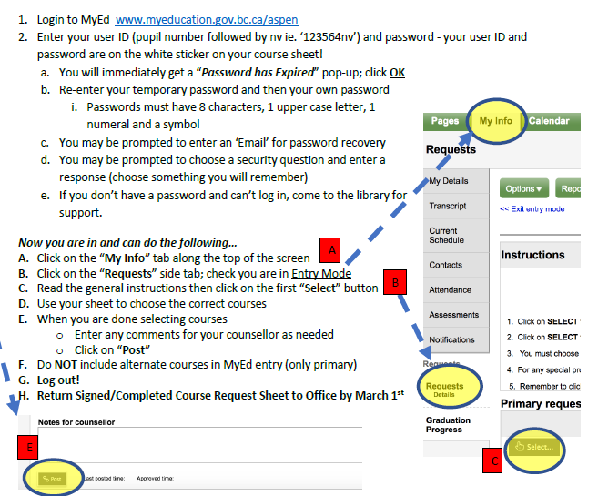
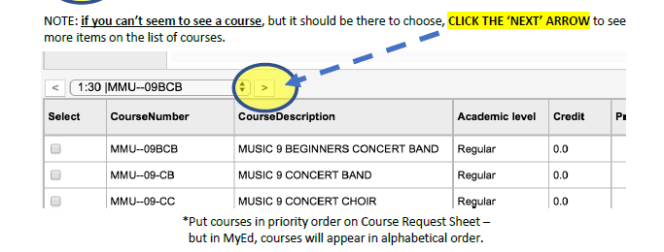
MyEd Student Course Request Entry

Slide 10
MyEd Student Course Request Entry
Temporary Password for reset
Was sent to families Friday Feb 2 and to students with login info Tuesday Feb 6

Slide 11
Electives
Spanish
French
Academies
Visual Art
Drama
Band
Strings
Choir
Woodwork
Power Tech
Drafting
Electronics & Robotics
Drafting
Business Education (entrepreneurship & marketing)
Information & Communication
Food Studies
Textiles
YOUR PREFERENCES

Slide 12
What can I expect to learn in Electives?

Slide 13
Electives – Select your Preferences carefully

Slide 14
Sample Timetable
Semester 1​ or DAY 1 all year | Semester 2​ or DAY 2 all year
‘Tutorial Time | Tutorial Time
1 – Social Studies/ Sciences Humaines | 5 – Math
2 – Elective #1 110 | 6 – PHE
3 – English | 7 – Elective #2
4 – French or Spanish/ FRAL | 8 –Science/ Sciences Naturelles

Slide 15
Sample Timetable: Choir
Semester 1​ or DAY 1 all year | Semester 2 or DAY 2 All year​
Tutorials, some Academies CHOIR & Jazz Band either before classes or after 3:00 pm | Tutorials, some Academies
1 – Social Studies/ Sciences Humaines | 5– Math
2 – Elective #1 : 110 | 6 – PHE
3 – Science/ Sciences Naturelles | 7 – Elective #2
4 – French or Spanish/ FRAL | 8 – English

Slide 16
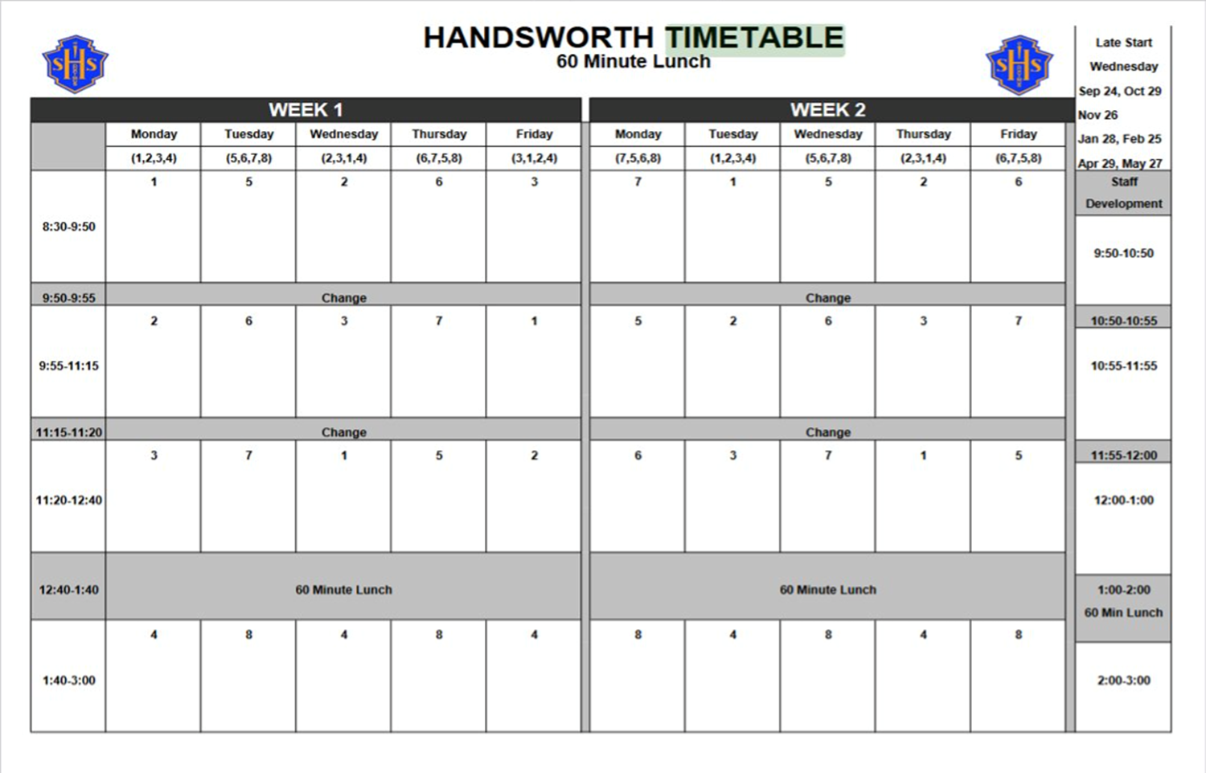
Sample Timetable: Linear

Slide 17
Academies and Enhanced Programs
These programs enhance and enrich the overall learning experience by providing a learning environment that concentrate on a focal skill set.​
Most programs are open to all students grade 8- 12 (some only for grade 10-12) ​
Students receive Ministry of Education course credit and for students in grade 10-12, credits towards graduation​
A variety of athletic and academic programs ​
Students may be required to travel to a different school site ​
Limited financial bursaries are available​

Slide 18
Sample Timetable: Academy PHE
Semester 1​ or DAY 1 all year | Semester 2​ or DAY 2 all year
Tutorial Time | Tutorial Time
1 – Social Studies/ Sciences Humaines | 5 – Math
2 – Elective #1 110 | 6 – English
3 – Science/ Sciences Naturelles | 7 – Elective #2
4 – French or Spanish/ FRAL | 8 – ACADEMY PHE
Notes:
** Linear Academy uses 2 Elective spots.

Slide 19
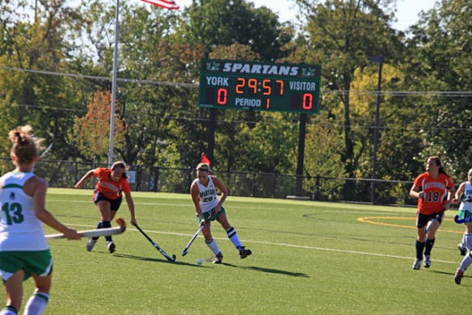
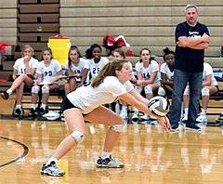
Enhanced PHE9 Programs Academies for Grade 9s
@ Sutherland:
BASKETBALL ACADEMY​
FIELD HOCKEY ACADEMY (SUTHERLAND & RUTLEDGE)
@Windsor secondary:
DANCE
Hockey Skills ​ SOCCER
@ Mountainside school
VOLLEYBALL
@ Seycove:
ROWING
These are DISTRICT PROGRAMS - Apply @sd44.ca before Feb 29, 2024

Slide 20
Enhanced Academy (not PHE related)
Digital Media Lite
Argyle (grade 9s)
Digital Media Academy
Argyle (grade 10-12)
Business & Gaming Entrepreneurship Lab
Handsworth
Robotics, Mechatronic and Digital Fabrication
Carson (grade 10 – 12)

Slide 21
Secondary Enhanced Programs & Academies Night January 31 – 6 to 8pm
5th Floor, Education Services Centre - 2121 Lonsdale Avenue
Students in Grades 7 to 11 and their families (from across the North Shore) are
invited to learn about the various Enhanced Programs and Academies
offered at our Secondary Schools.
This event will include short presentations and booths hosted by
NVSD staff, Academy providers, program facilitators and coaches.
While optional, we would appreciate your RSVP to this event.
www.sd44.ca/school/onlinelearning/Registration
Parking: Limited underground parking will be available. Use the underground parking entrance off West
21st Street and Lonsdale Avenue. Park your vehicle and take the
elevator to the 5th floor.
Note: If you had RSVP'd to attend the session originally scheduled for January 18, 2024, there is no need to RSVP again.

Slide 22
Academies and Enhanced Programs
Registration Jan. 19th – Feb. 29th for initial offers
Ongoing registration & waitlisting after February 29th
For further information or to apply go to NVSD Academies
For questions, contact academies directly at academies@sd44.ca or Justin Wong - jwong@sd44.ca

Slide 23
What is NVOL?
English, French & French Immersion
Online Learning courses in grades 8-12
Taught by NVSD44 teachers
New Brightspace Learning Management System
Anywhere, anytime learning
Self-paced & flexible
Start any time during school year & complete within 1 calendar year

Slide 24
NVOL Course Offerings ​
Arts Education ​
Applied Design, Skills & Technologies (ADST)​
Career Education & Education au Choix de Carrière ​
English Language Arts ​
Français Langue Seconde – Immersion​
Languages (Core French)​
Mathematics​
Science & Sciences Naturelles​
Social Studies & Sciences Humaines et Sociales ​
Physical & Health Education​
https://www.sd44.ca/school/onlinelearning/Pages/default.aspx#/=
Notes:
Currently Grade 9 courses available are Core Courses, English, Math, Science, Social Studies

Slide 25
Grade 9 Japan ‘Exchange’ Program
April 8-22, 2025

Slide 26
Program History
BEGAN IN 1989
SISTER SCHOOL RELATIONSHIP ESTABLISHED WITH INAGE IN 1992
HANDSWORTH HAS VISITED JAPAN ALMOST EVERY YEAR UP TO COVID
TRAVEL RESUMED IN 2023
2018

Slide 27
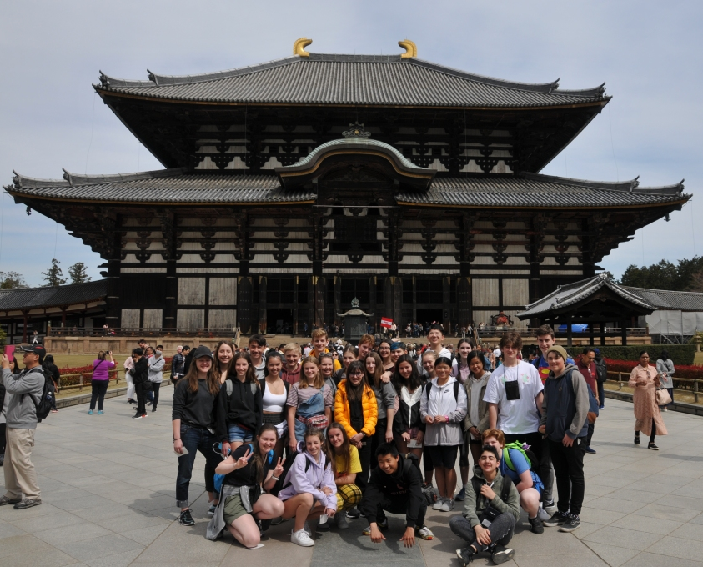
Program Overview
2 weeks spent in japan
First week: travelling through kyoto, nara, osaka, hiroshima & takayama
Exposure to japanese culture through visiting historic and cultural capitals of japan, buddhist temples, shinto shrines, japanese amusement parks, peace memorial park and atomic museum, staying in a traditional japanese ryokan (B&B)
Act as ambassadors for canada and north vancouver
2019

Slide 28
Program Overview Continued
Second Week: Spent visiting Inage, our sister school in Chiba, Japan (near Tokyo)
Cultural immersion: students stay (in pairs) with Japanese families, attend Japanese high school classes, explore Japanese hobbies like Kendo, Judo, Calligraphy & flower arrangement, visit Tokyo
Culminating the students’ role as ambassadors for North Vancouver, students will meet with the mayor of Chiba on behalf of the Mayor of the City of North Vancouver
2023

Slide 29
Dates
Travelling April 8 – 22, 2025
One of the few programs in North Vancouver allowed to travel outside of Spring Break
2018

Slide 30
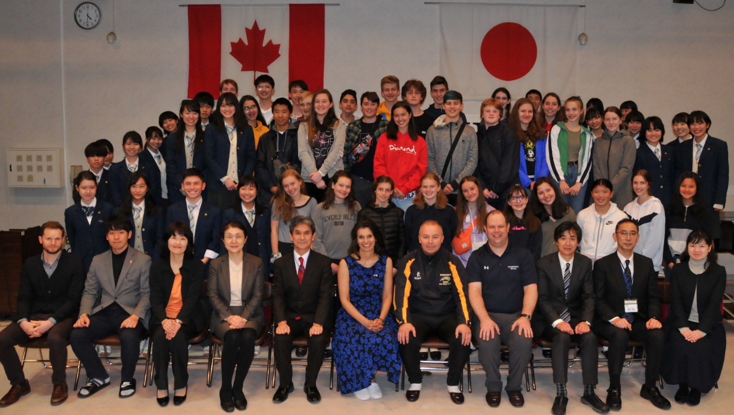
Estimated Costs
2024 $7800 per student (may vary with travel costs)
Includes: flights, hotels, premium travel insurance, ground transportation, entrance fees, some meals
2019

Slide 31
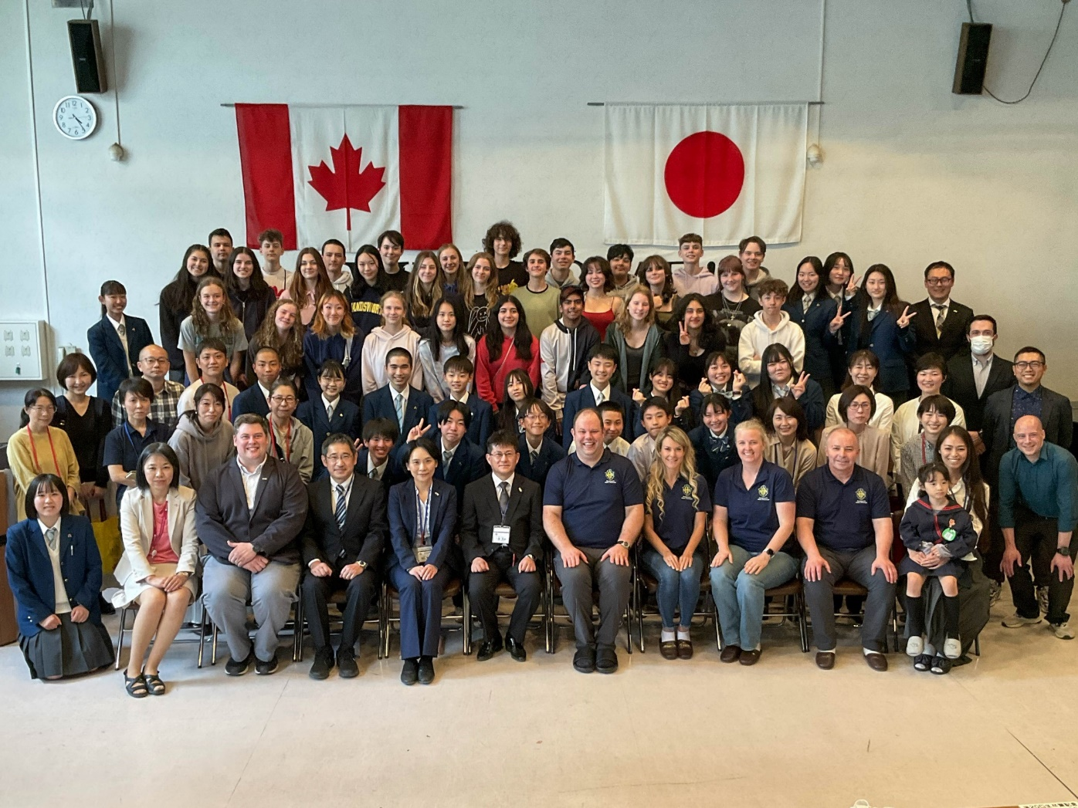
For More Information
Visit the Japan Exchange Page of the Handsworth Website
2023

Slide 32
Questions?
Contact Mr. Forsyth: mforsyth@sd44.ca
Follow this Year’s Grade 9s in April
@Handsworthjapan2024.wordpress.com

Slide 33
Important Dates & Deadlines
February 6
@ 8:30 am
In the Theatre
Course Programming Assembly for all current GRADE 8 students
MANDATORY
February 14 – 29
Student Course Request Entry @ Home using MYED Student Portal
March 1
Completed & Signed Course Request Form
Handed in at main office.

Slide 34
How can Parents Support?
Keep lines of communication open – they need to feel like they are being heard
Validate their perspective: “I can see why you feel that way”, “If that were me, I would probably feel…too”
Ask for their backstory “Can you tell me why you are feeling this way?” “Can you tell me why you did it that way?”
Teach and Practice Problem Solving Skills
Brainstorm responses: “What could you do about it?” Hatch a plan and then circle back: “how did it go?”
Rinse and Repeat
Supports healthy emotional growth and development, reduces stress, increases resiliency
Set the Stage for Keeping them Safe
Talk about bullying, dating, vaping, sex, drugs, alcohol, social media, online communication
Talk about the consequences of poor decision making
Remind them of your expectations and that when they do make a poor choice, they can call on you for help.
Set out a Plan for regular learning at home – Homework Schedule
Develops lifelong learning, responsibility, and increases confidence
Sleep and Food
Notice disturbances and make plans to support good habits. There is no better way to understand the power of food than making your own. Make an appointment with your doc when needed
Responsibility – Choices
Collaborate on a list of what they would like to do to contribute to the household, then ask them to choose 2. Talk about the successes and work out a plan to overcome any roadblock.

Slide 35
Just Before We Go
Semester 2 begins Thursday, February 1
Mandatory Homeroom 9:00 am on Thursday
Students must attend homeroom to get their Semester 2 schedule of classes.
There have been changes!
Learning Updates (report cards) with Final Proficiency Grades and Descriptive Feedback for Semester 1 - Posted to Parent Portal on February 6
Parents please consider:
Review report card comments with your students.
Work together to set goals for success – What are your family rules for success?
TUTORIALS are GOLDEN, HOMEWORK is ADDICTIVE, & READING is EVERYTHING!
Set schedules for must-do tasks like attending tutorials and communicating with teachers in TEAMS.

Slide 36
Questions?
Please feel free to stay for a few minutes & connect with us and each other

