Slide 1
Carson Graham Secondary
Course Programming Year 5
2017/2018

Slide 2
Life in High School…
GET INVOLVED!
Grade 12 and Beyond…
Grade 11
Grade 10
Grade 9
Grade 8

Slide 3
How does the MYP affect course programming?
All students must:
Take a Fine Arts OR a Applied Skills course
Take a Second Language course
Complete the MYP Personal Project
Complete 10 hours of service

Slide 4
Graduation Program

Slide 5
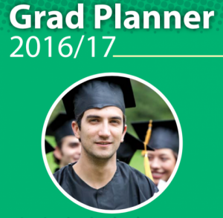
The Grad Planner
Keep up to date with current information from the Ministry of Education
Review of all programming
information in The Grad
Planner 2017/2018

Slide 6
In order to earn a BC Dogwood Graduation Diploma:
Students must have 80 credits
Students begin earning credits in Grade 10

Slide 7
Graduation Program: 80 Credits over Three Years
52 required credits (13 courses)
28 elective credits (7 courses)

Slide 8
Dogwood Graduation Requirements
REQUIRED 52 CREDITS INCLUDING:
English 10
English 11 or Communications 11
English 12 or Communications 12
Social Studies 10
A Social Studies 11 or 12
A Science 11 or 12
A Mathematics 10
A Mathematics 11 or 12
Physical Education 10
A Fine Art or Applied Skill 10, 11 or 12
Planning 10
Graduation Transitions/Careers
28 ELECTIVE CREDITS:
28 credits from courses numbered 10, 11, or 12.
16 Grade 12 credits
(4 Courses)

Slide 9
Dogwood Graduation Requirements
Students must earn a minimum of 80 credits 52 required credits + 28 elective credits
Each course earns 4 credits
English 10
English 11 or Communications 11
English 12 or Communications 12
Social Studies 10
Social Studies 11 or 12
Science 10
A Science 11 or 12
A Mathematics 10
A Mathematics 11 or 12
Planning 10
Physical Education 10
A Fine Art or Applied Skill 10, 11 or 12
Graduation Transitions/Careers 52 CREDITS
REQUIRED
ELECTIVES
28 CREDITS

Slide 10
Dogwood Graduation Requirements
Students must earn a minimum of 80 credits 52 required credits + 28 elective credits
Each course earns 4 credits
English 10
English 11 or Communications 11
English 12 or Communications 12
Social Studies 10
Social Studies 11 or 12
Science 10
A Science 11 or 12
A Mathematics 10
A Mathematics 11 or 12
Planning 10
Physical Education 10
A Fine Art or Applied Skill 10, 11 or 12
Graduation Transitions / Careers 52 CREDITS
REQUIRED
ELECTIVES
28 CREDITS

Slide 11
Dogwood Graduation Requirements
Students must earn a minimum of 80 credits 52 required credits + 28 elective credits
Each course earns 4 credits
English 10
English 11 or Communications 11
English 12 or Communications 12
Social Studies 10
Social Studies 11 or 12
Science 10
A Science 11 or 12
A Mathematics 10
A Mathematics 11 or 12
Planning 10
Physical Education 10
A Fine Art or Applied Skill 10, 11 or 12
Graduation Transitions / Careers 52 CREDITS
REQUIRED
ELECTIVES
28 CREDITS

Slide 12
Dogwood Graduation Requirements
Students must earn a minimum of 80 credits 52 required credits + 28 elective credits
Each course earns 4 credits
English 10
English 11 or Communications 11
English 12 or Communications 12
Social Studies 10
Social Studies 11 or 12
Science 10
A Science 11 or 12
A Mathematics 10
A Mathematics 11 or 12
Planning 10
Physical Education 10
A Fine Art or Applied Skill 10, 11 or 12
Graduation Transitions / Careers 52 CREDITS
REQUIRED
ELECTIVES
28 CREDITS

Slide 13
Dogwood Graduation Requirements
Students must earn a minimum of 80 credits 52 required credits + 28 elective credits
Each course earns 4 credits
English 10
English 11 or Communications 11
English 12 or Communications 12
Social Studies 10
Social Studies 11 or 12
Science 10
A Science 11 or 12
A Mathematics 10
A Mathematics 11 or 12
Planning 10
Physical Education 10
A Fine Art or Applied Skill 10, 11 or 12
Graduation Transitions / Careers 52 CREDITS
REQUIRED
ELECTIVES
28 CREDITS

Slide 14
Dogwood Graduation Requirements
Students must earn a minimum of 80 credits 52 required credits + 28 elective credits
Each course earns 4 credits
English 10
English 11 or Communications 11
English 12 or Communications 12
Social Studies 10
Social Studies 11 or 12
Science 10
A Science 11 or 12
A Mathematics 10
A Mathematics 11 or 12
Planning 10
Physical Education 10
A Fine Art or Applied Skill 10, 11 or 12
Graduation Transitions / Careers 52 CREDITS
REQUIRED
ELECTIVES
28 CREDITS

Slide 15
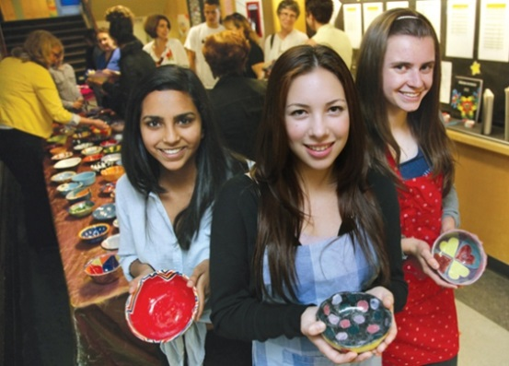
So, what should you take?!
You must consider the following:
Which electives do I want?
Which career directions interests me?
District Programs?
Which Math should I take?
What Work Experience should I get?

Slide 16
North Vancouver District Programs Available to all Grade 10 Students
Artists 4 Kids Art Academy (10-12)
Digital Media Academy (11-12)
Digital Media Lite (Grades 9 – 10)
Dance Academy(8 – 12)
Field Hockey Academy
Hockey Skills Academy
Basketball Academy
Soccer Academy
Volleyball Academy
Work Experience/Apprenticeship (10 – 12)
Distributed Learning (10, 11, 12)
Peak Performance 8-12
More information available on the district website:
https://www.sd44.ca/ProgramsServices/Documents/SecondaryEnhancedPrograms.pdf

Slide 19
Additional Courses
Outside the Timetable
Community Initiatives 10
Beginner Band
Vocal Jazz (must also be taking Concert Choir)
Jazz Band (must also be taking Concert Band)
Work Experience
Improv
Distributed Learning
These courses may be taken in addition to the EIGHT entries on your course selection sheet.

Slide 20
Distributed Learning: What is It?
Alternate way to complete core academic courses and electives at the Grade 10, 11, and 12 levels – online
BC Ministry of Education approved courses
Teacher-student interaction is both online and blended
Continuous entry and self-paced
Learning with a technology focus;
using online tools

Slide 21
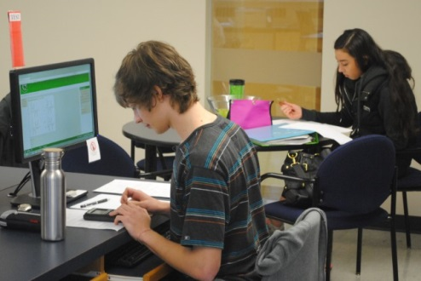
DL Centre Model
The DL Centre is a computer lab, classroom, or work space for students to meet with DL teachers for face to face interaction.
Main DL Centre: Mountainside Secondary
DL Centre opened daily, until 6:00
Test invigilation, tutorial support, tech support
Satellite DL Centres (at each Secondary School)
DL Centre hours posted on school website
Test invigilation, tutorial support, tech support

Slide 22
Distributed Learning: Who is it for?
You are a good candidate for DL if:
You are academically engaged
You are self-motivated
You are organized and have good time management skills
You have the ability to manage stress
You have the willingness to challenge yourself
You have the ability to present ideas and express yourself clearly

Slide 23
Interested in the IB Diploma Programme?
Although you still have a year to decide, it is never too early to consider your options!
https://www.sd44.ca/school/carson/ProgramsServices/IB/diplomaprogramme/Pages/default.aspx
Info session January 19th at 7pm at Carson if you’re interested in learning more!

Slide 24
Course Programming Sheets

Slide 25
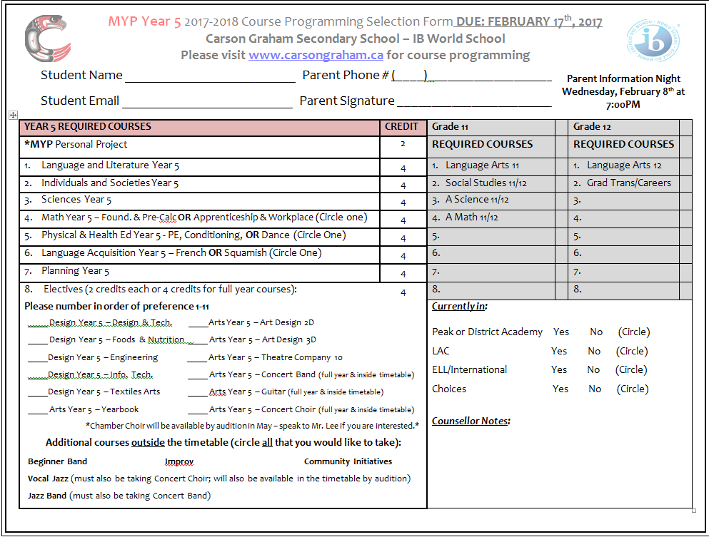

Slide 26
Joe Schmoe
604 555-5555
jschmoe@gmail.com
J. Shmoe
604 555-5555
4
7
8
5
1
2
6
3

Slide 28
Submit your sheets as early as possible.
Where? Counselling
When? ASAP
Deadline to submit sheets: February 17th

Slide 29
Questions?
Visit: http://www.carsongraham.ca
Students
Course Programming
Course Descriptions
Speak with teachers for information and/or recommendations
See your counsellor
Talk to your parents

Slide 30
Current Grade Nine Counsellor Assignments
A-C ……………………… Ms. Gayle Weyell
D-J ………………………… Ms. Julia Cross
K-P, ELL, Int’l ………Ms. Lindsey McDowell
Q-Z,Choices ……………Ms. Jennifer Elkan

Slide 31
Questions?

