Slide 1

Grade 7 Parent Programming Evening
2017 – 2018
“We strive for excellence”

Slide 2

Welcome to Secondary School
Around the corner is a new and exciting time in your child’s life where endless opportunities and pathways are theirs for the taking.
We look forward to embarking on an important partnership with you and your child.

Slide 3

Evening Overview
Introductions
IB MYP Program
Grade 8 Program

Slide 4
Grade 7s Look Forward to:
Having their own locker
More than one teacher
Trying new courses – Fine Arts / Design
Meeting new friends
Playing new sports, joining new clubs
Increased independence
More freedom
Cafeteria

Slide 5
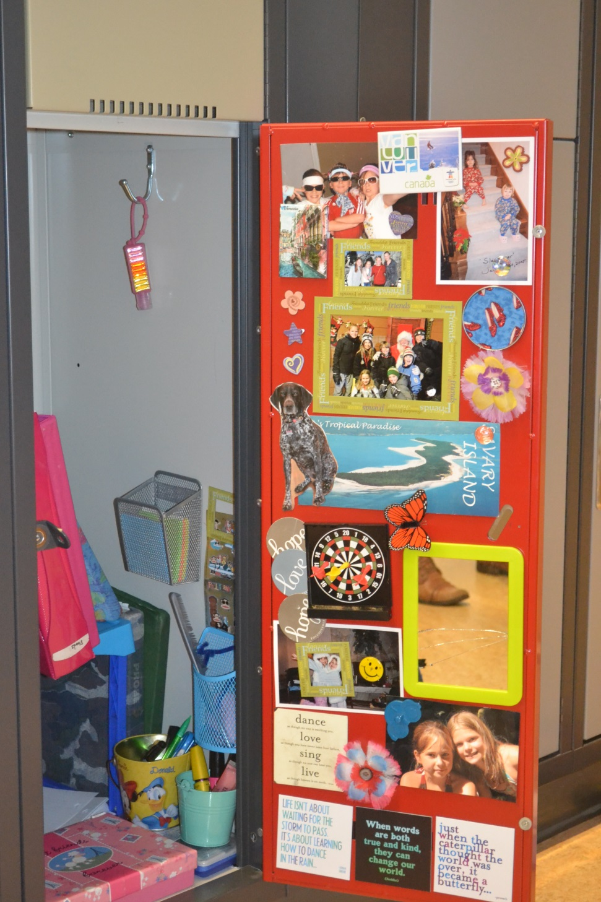
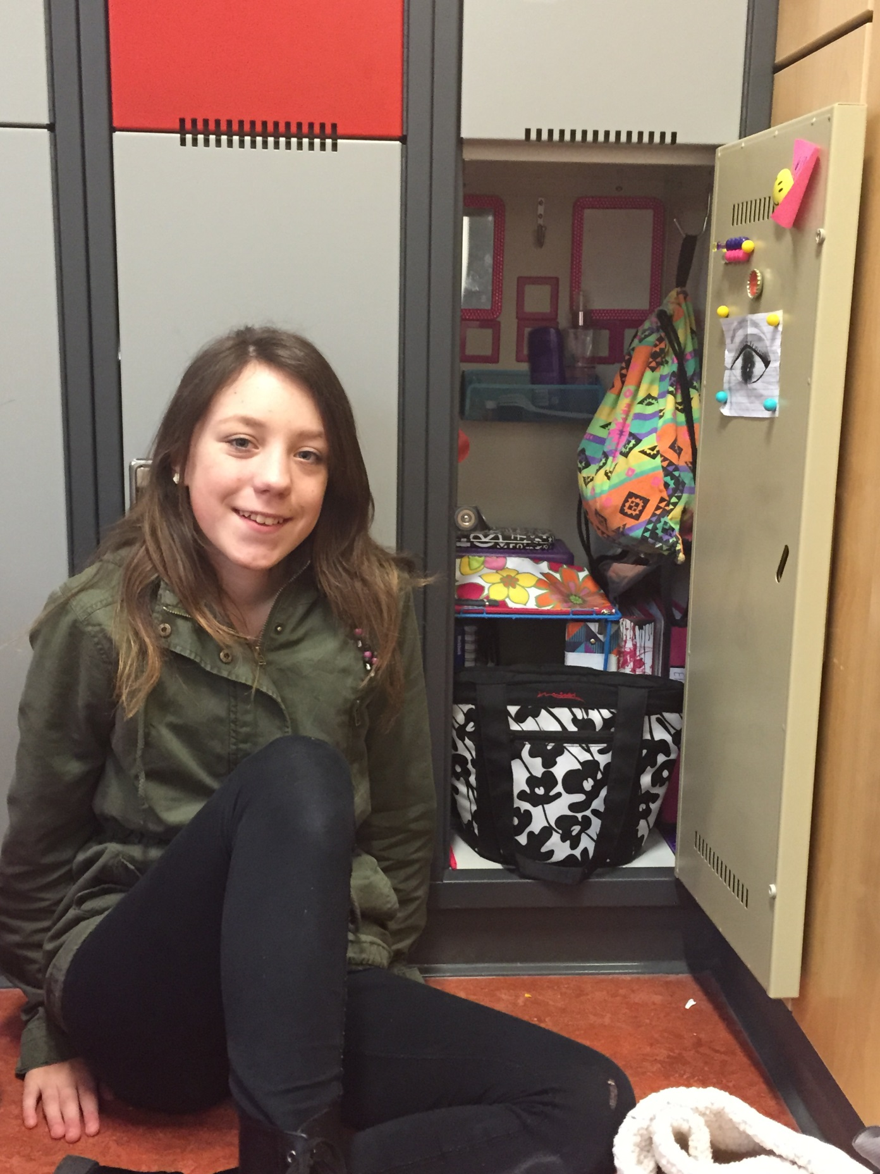

Slide 6
What Grade 7s worry about
Figuring out their timetable
Remembering their lock combination
Finding their classes
Being late for class
Too much homework
Different teachers, different rules
Peer pressure
Friendships changes

Slide 7
What Parents worry about
Making a successful transition
Academic & social success
Will they really know my child’s needs?
Communication with teachers
Who do I go to with questions, concerns?
Autonomy & independence
Opportunities to stay involved
Resistance to peer pressure

Slide 8
Six Important Learning Skills for Success
Responsibility
Organization
Independent work
Collaboration
Initiative
Self-Regulation

Slide 9
How can parents help
Be aware of strengths and weaknesses
Closely monitor attendance
Communicate with teachers regularly
Closely monitor academic progress
Know who to turn to for answers
Key supports in secondary school

Slide 10
Key Support People
Gr. 8 Counsellor
LAC Teachers
Special Ed Teachers
Educational Assistances
Behaviour Support Workers
First Nation Support Teachers
Vice Principals and Principal

Slide 11
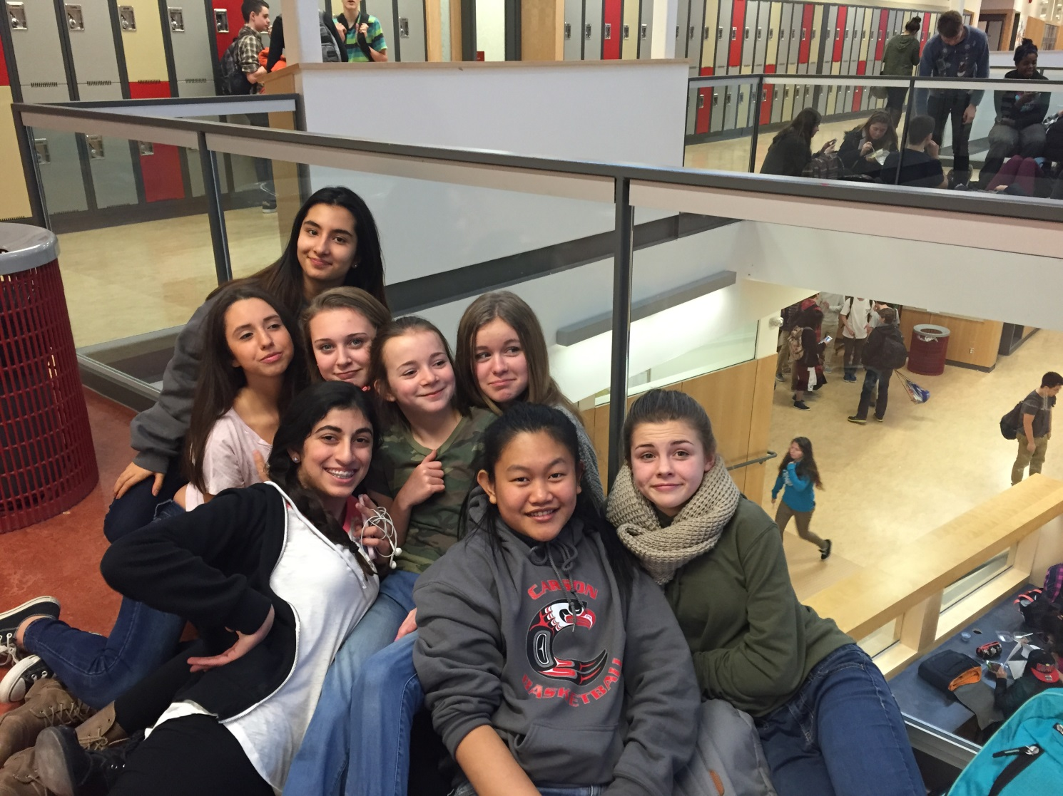
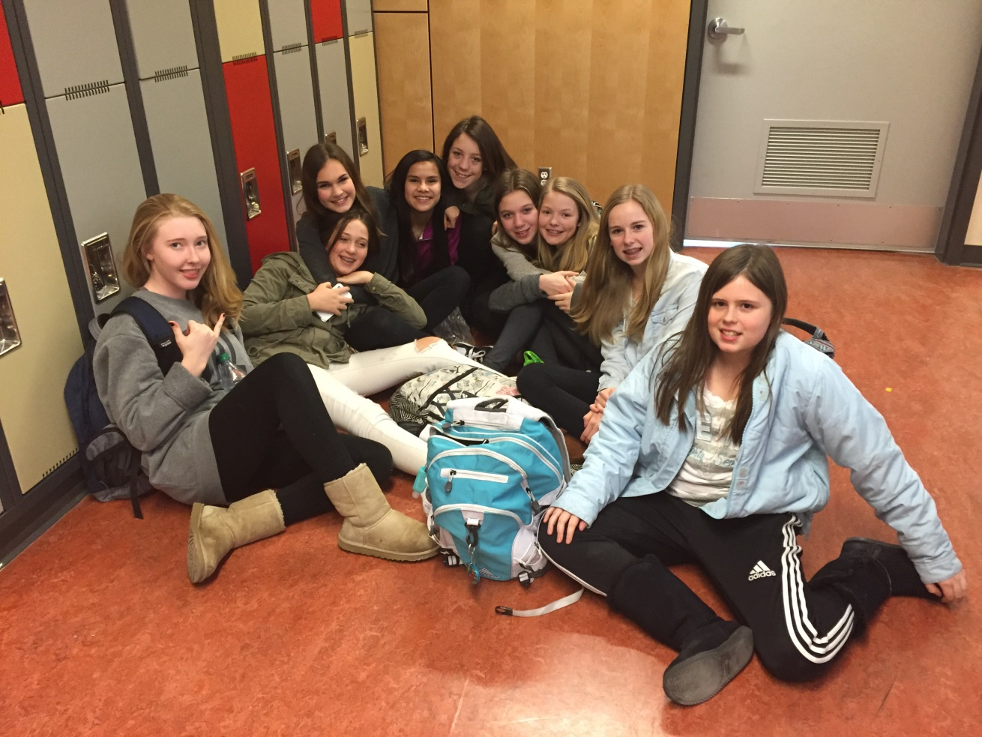
Time to eat…..
Cafeteria
or
brown bag it?

Slide 12
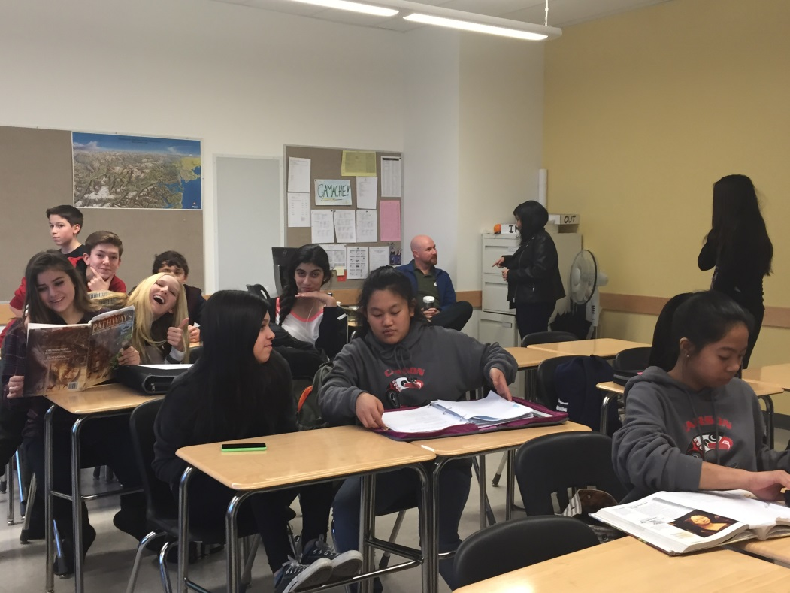
How is high school different
8 teachers
8 courses 8 classrooms
Individual lockers
More homework
More accountability
More responsibility
More extra curricular activities
MORE FUN!!!!

Slide 13
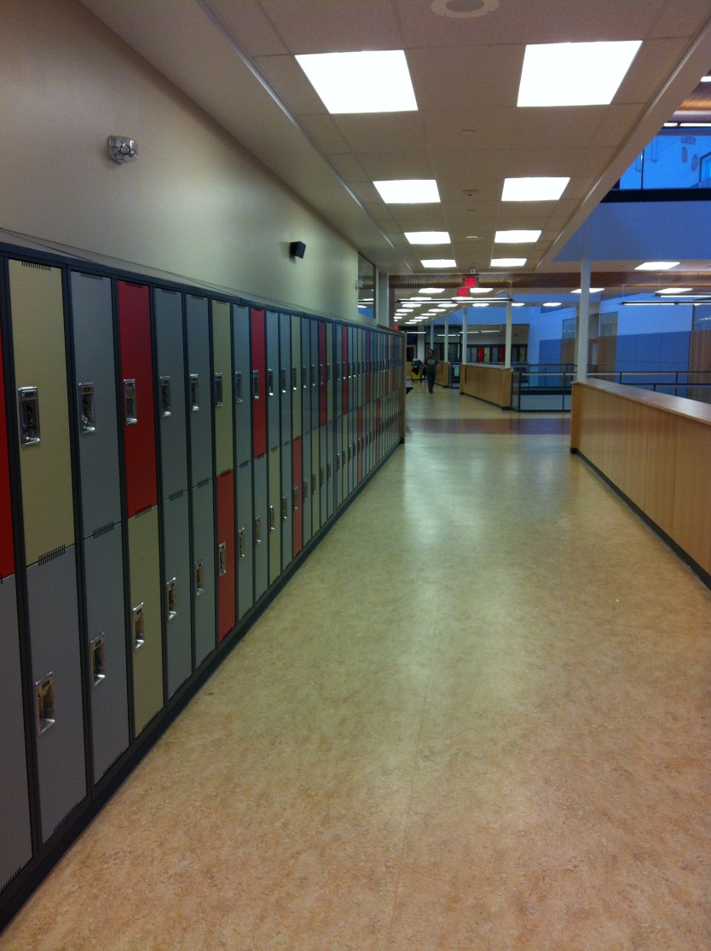
What does a typical day look like
8:35 am start
80 min class (Period 1)
15 min break
80 min class (Period 2)
80 min class (Period 3)
40 min lunch
80 min class (Period 4)
3:00 pm finish

Slide 14
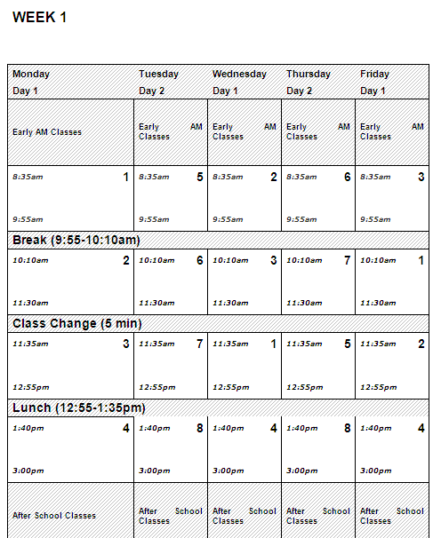
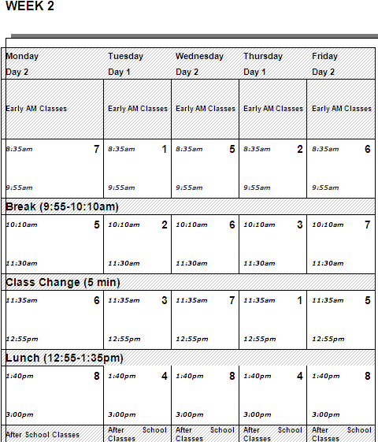
The Weekly Timetable
Regular schedule 8:35 a.m. – 3:00 p.m.
Wednesday IB/ Staff Development Late Start 9:55am

Slide 15
Course Selections for Grade 8
MYP Year 3 – Gr. 8:
Required Courses
1. Language & Literature
2. Individuals & Societies
3. Sciences
4. Mathematics
5. Physical & Health Ed
Language Acquisition French/Spanish/Squamish
Electives (inside the timetable)
Design rotation
- Info Tech, Wood, Sewing
Fine Arts rotation
- Art, Drama, Music
Concert Band
  - Takes place of either Design or Fine Arts
Electives (outside the timetable):
Concert Choir
Vocal Jazz Choir (must taken with Concert Choir)
Beginner Band
Jazz Band (must taken with Concert Band)

Slide 16
Language Acquisition
FRENCH
(MYP) French 8, 9, 10
French DP
11 & 12 11 & 12
SPANISH
(MYP) Spanish 8, 9, 10
Spanish 11&12 DP 11& 12
Beg Spanish 11
Spanish 11
SQUAMISH
(MYP) Squamish 8, 9, 10
Squamish 11 & 12
Will not be used for univ. language credit
Students are required to commit to their language of choice for all 3 MYP years.
Language 11 required for UBC, Beg. Level Lang. OK for SFU

Slide 17
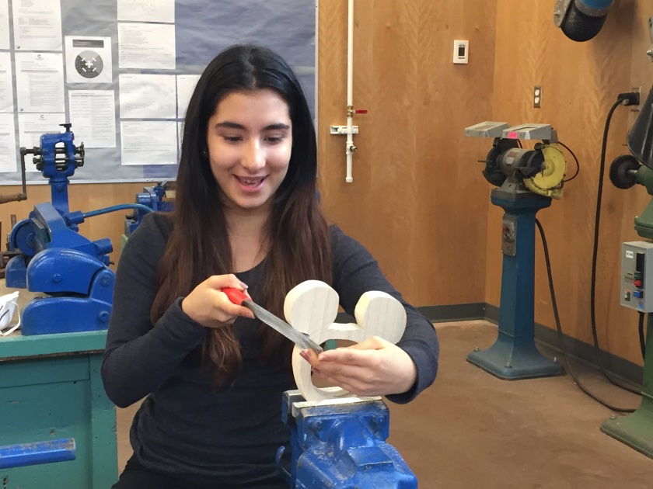

Design Year 3
Info Tech
Woodwork
Sewing

Slide 18
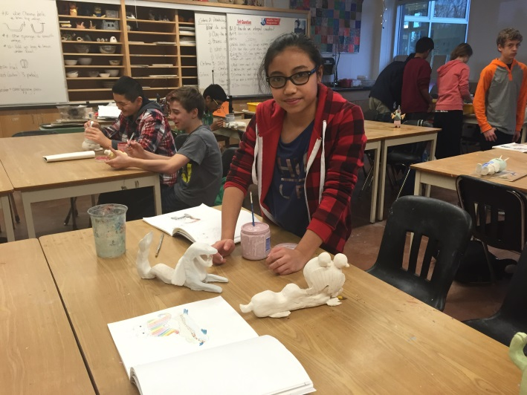


Fine Arts Year 3
Art
Drama
Music

Slide 19
Carson Graham Website
http://www4.nvsd44.bc.ca/school/carson/Pages/default.aspx

Slide 20
Other Options…
Learning Assistance 8
    for designated and referred students
English Language Learner (ELL) 8
    for referred students
Choices 8
    for referred students
Peak Performance
    minimum 15 hours/week of training
NV District Enhanced Programs
    see NVSD website for opportunities

Slide 21


Slide 22
EPIC WEDNESDAY’S
Grade 8 Inquiry Groups
Small groups to:
Encourage Leadership
School Connectness
Sense of Belonging
Skill Building
ATL Skills

Slide 23
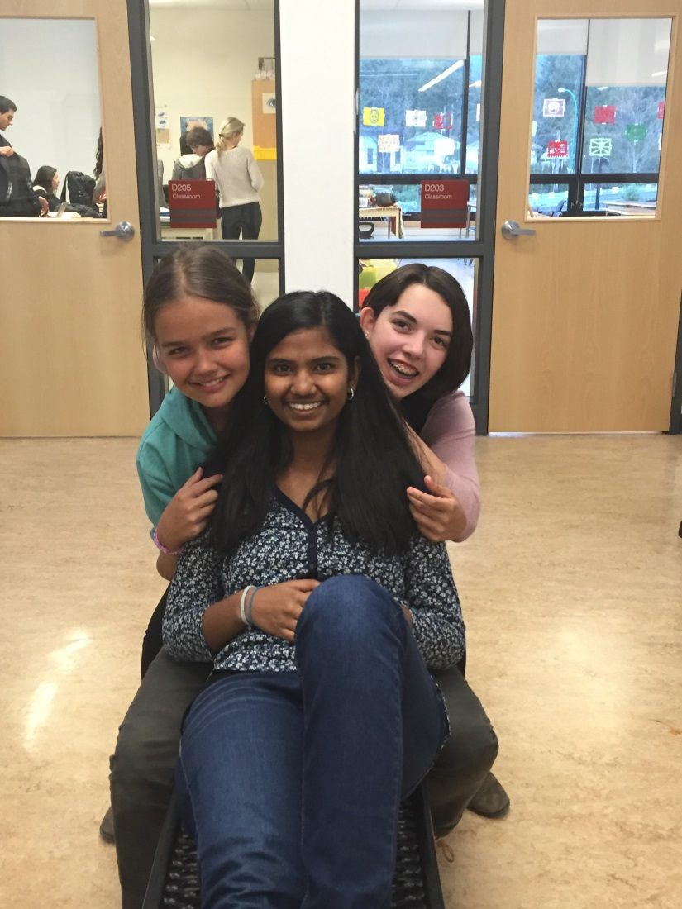
Focus for Grade 8 students
Take responsibility for your actions
Keep organized-use your agenda
Attend regularly
Be committed
Engage in all your classes
Get Involved

Slide 24
What you as a parent can do –
Be informed…
Check the school website www.carsongraham.ca
Help set up regular homework time
Keep in contact with teachers – all located on school website
Keep tabs on your child’s agenda book
Attend Parent – Teacher Conferences
Create reasonable restrictions
Enforce timelines

Slide 25
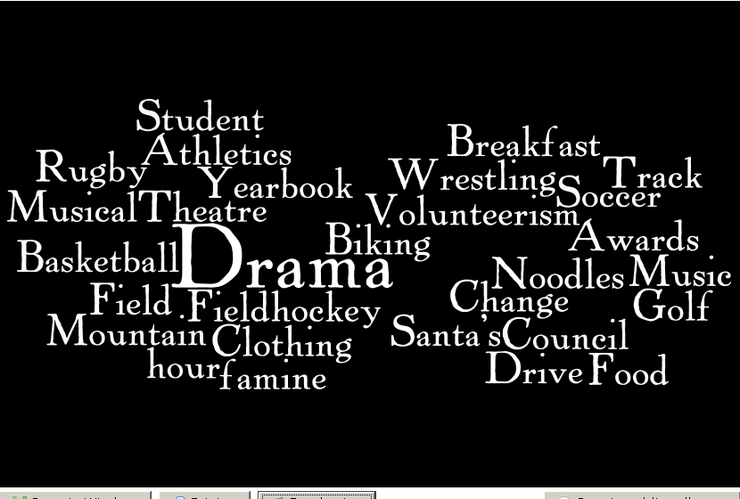
Get Involved!!!

Slide 26
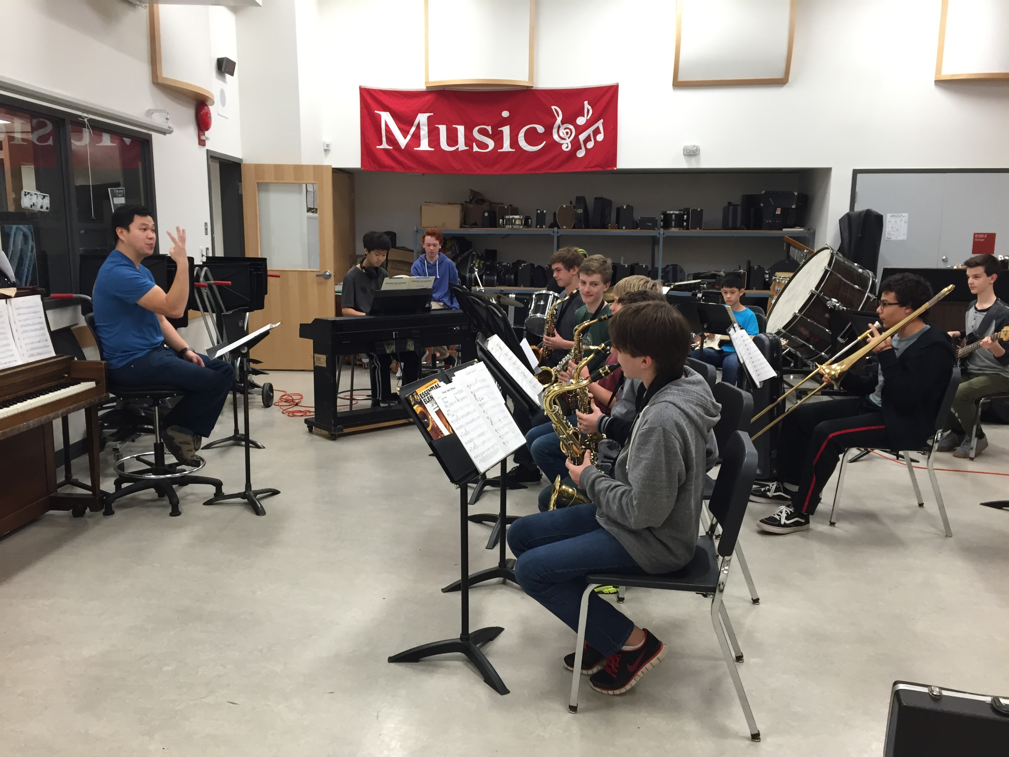
Concert Band 8

Slide 27
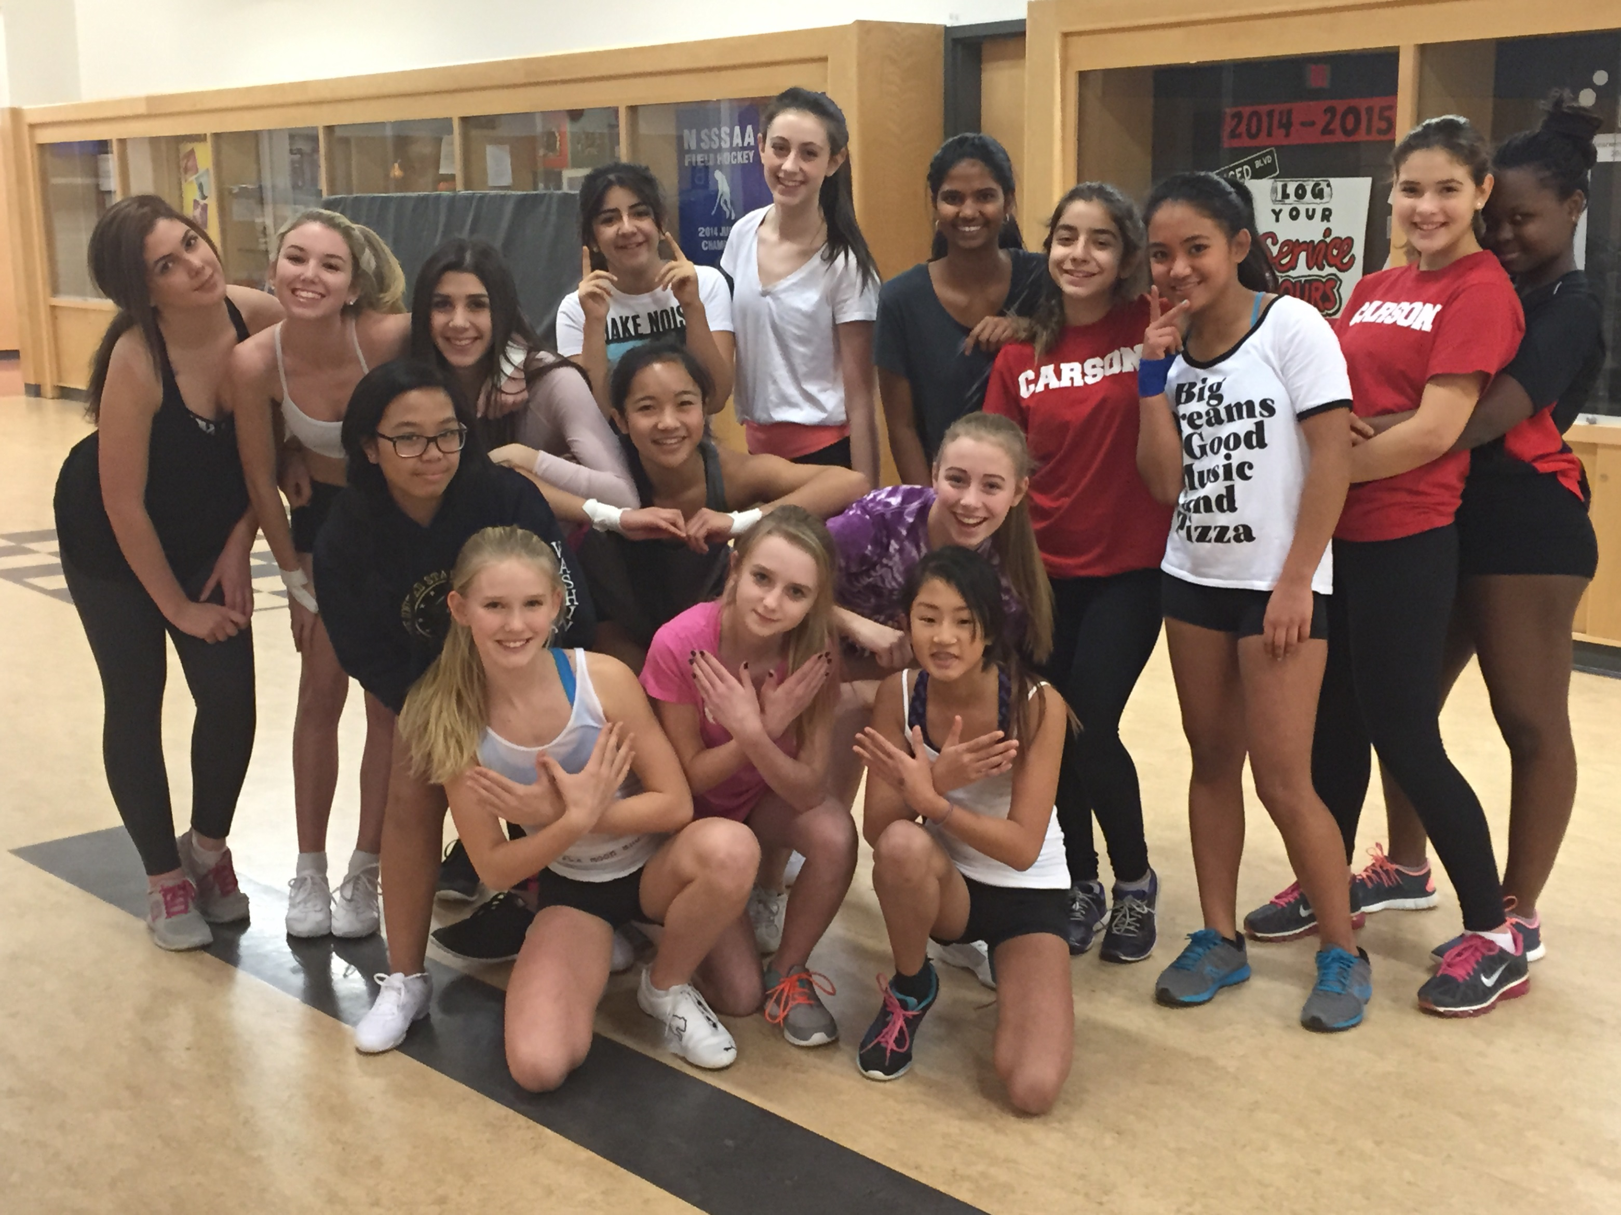

Slide 28
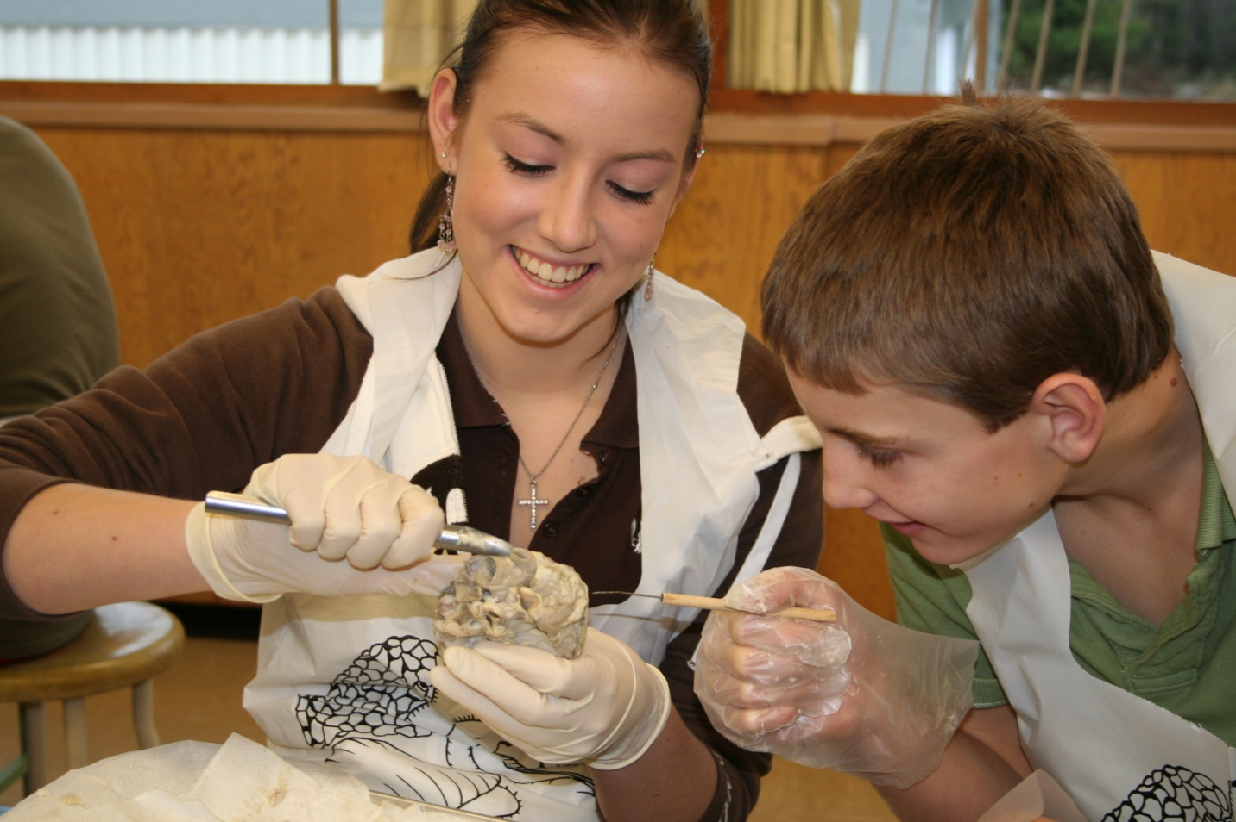
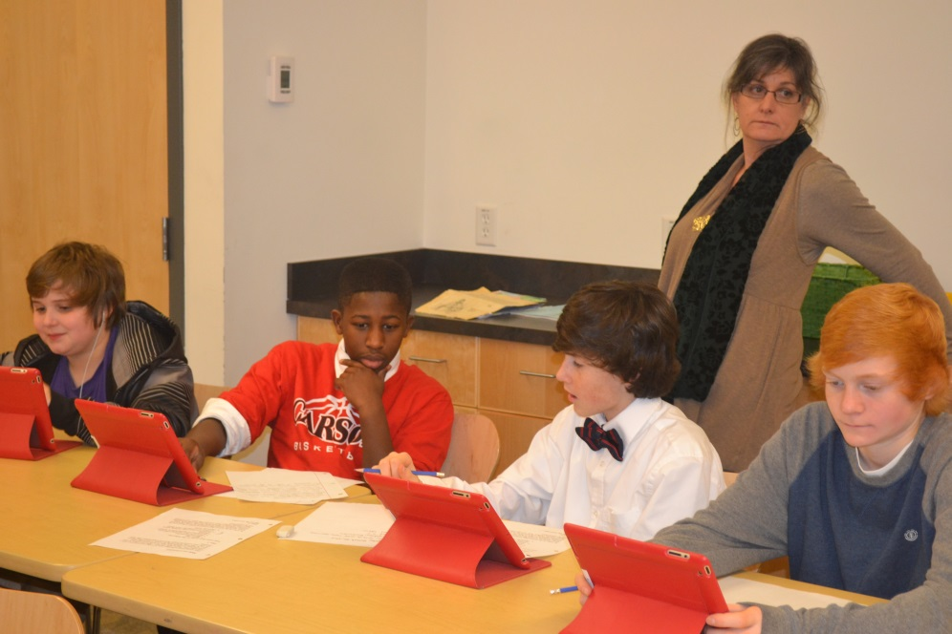
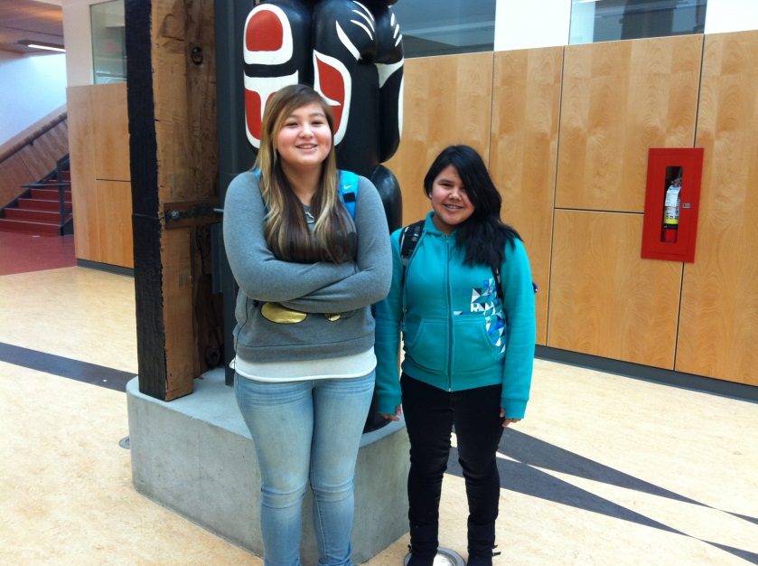
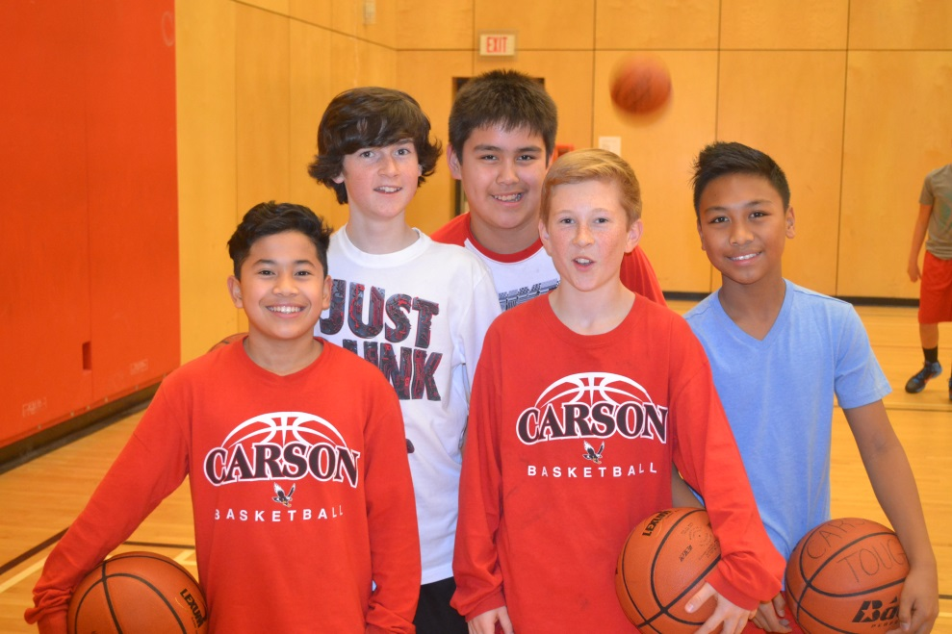

Striving for Excellence
Pursuing Our Goals
Celebrating Successes Together
Notes:
28

Slide 29
Grade 7 to 8
Transition Activities 2017
  Jan. 23 to Gr. 7 Programming Visits
  Feb. 1 Carson FOS Feeder Schools
  Feb 16 Gr. 7 MYP Personal Project Visit
  March 3 Cross Boundary Transfer Deadline
  April 25 Gr. 8 Buddies visit Gr. 7’s
  May 15-26 Articulation of Carson FOS begins
  June 1 & 2 Gr. 7 Tours at Carson

Slide 30
Carson 7 – 8 Buddy Program
Grade 7 paired with Grade 8 student
Buddies attended the same elementary school
Mentorship Program
Increased sense of belonging
Learn from the Pros

Slide 31
NVSD Gr. 7-8 Transition Course
Summer School
NVSD 44 Summer School at Carson
Focus includes:
Curriculum preview
Time management
Organizational skills
Stress management
Guest speakers

Slide 32
Questions
Refer to the Carson website for course descriptions www.carsongraham.ca
Ask Gr. 7 teacher for recommendations
Contact Gayle Weyell

Slide 33
Contact Information
Mrs. Gayle Weyell - Gr. 8 Counsellor
Ms. Lindsay McDowell - ELL / International
Mr. Ryan Kerluck - Athletic Director
Mrs. Jen Teiche - MYP Coordinators Mrs. Liz Thornhill

Slide 34
Carson School Tour
Interested in a brief School Tour by a current Gr. 8?
Please stay behind…..
Thank you all for coming tonight!

Slide 35
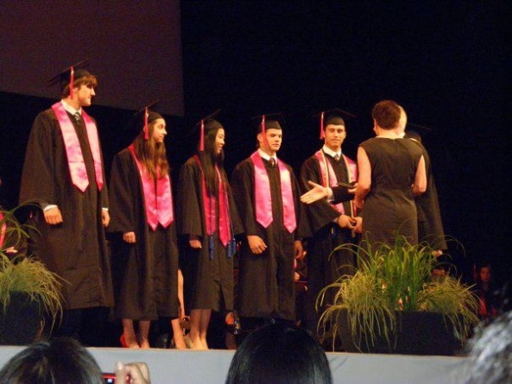
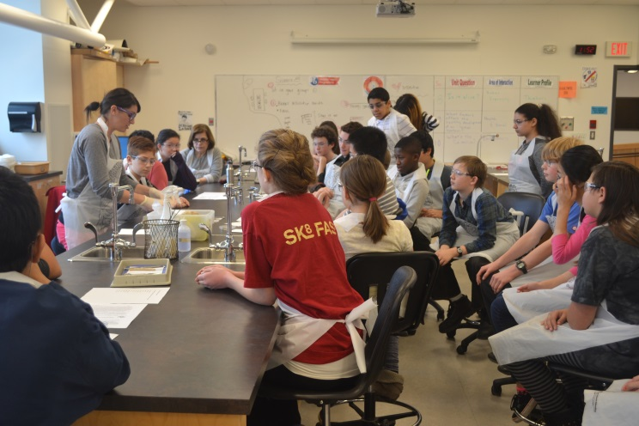
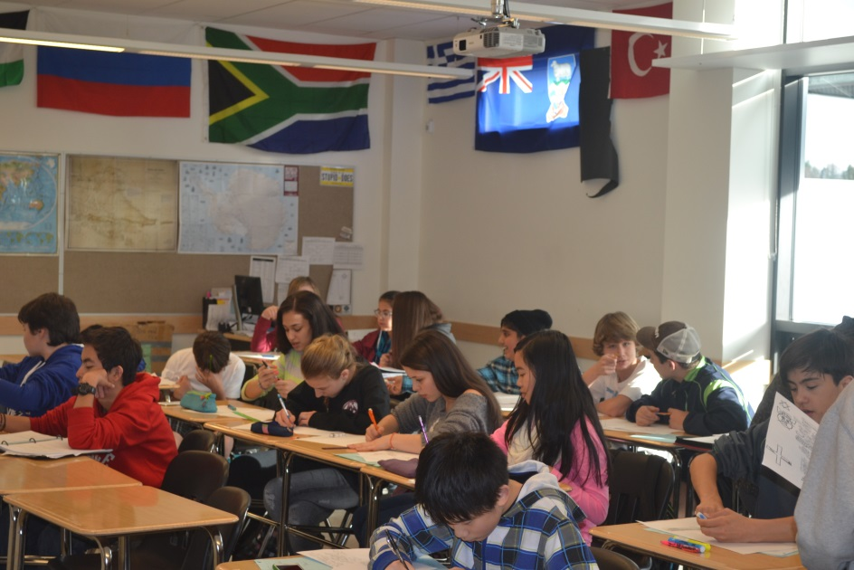
Life at High School…
Grade 12 and beyond
Grade 11
Grade 10
Grade 9
Grade 8
Notes:
35

Slide 36
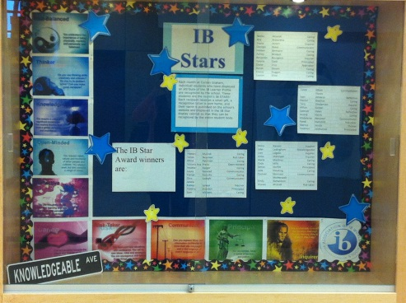
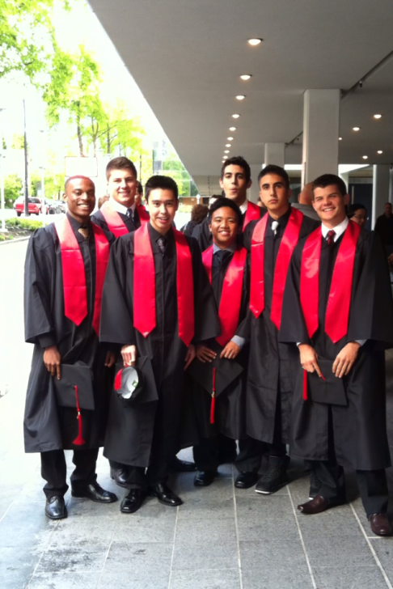
SCHOOL CAREER
K 7 8 9 10 11 12
ONLY 5 YEARS TO GO......
COLLEGE
UNIVERSITY
APPRENTICESHIP
TRAVEL
WORK

Slide 37
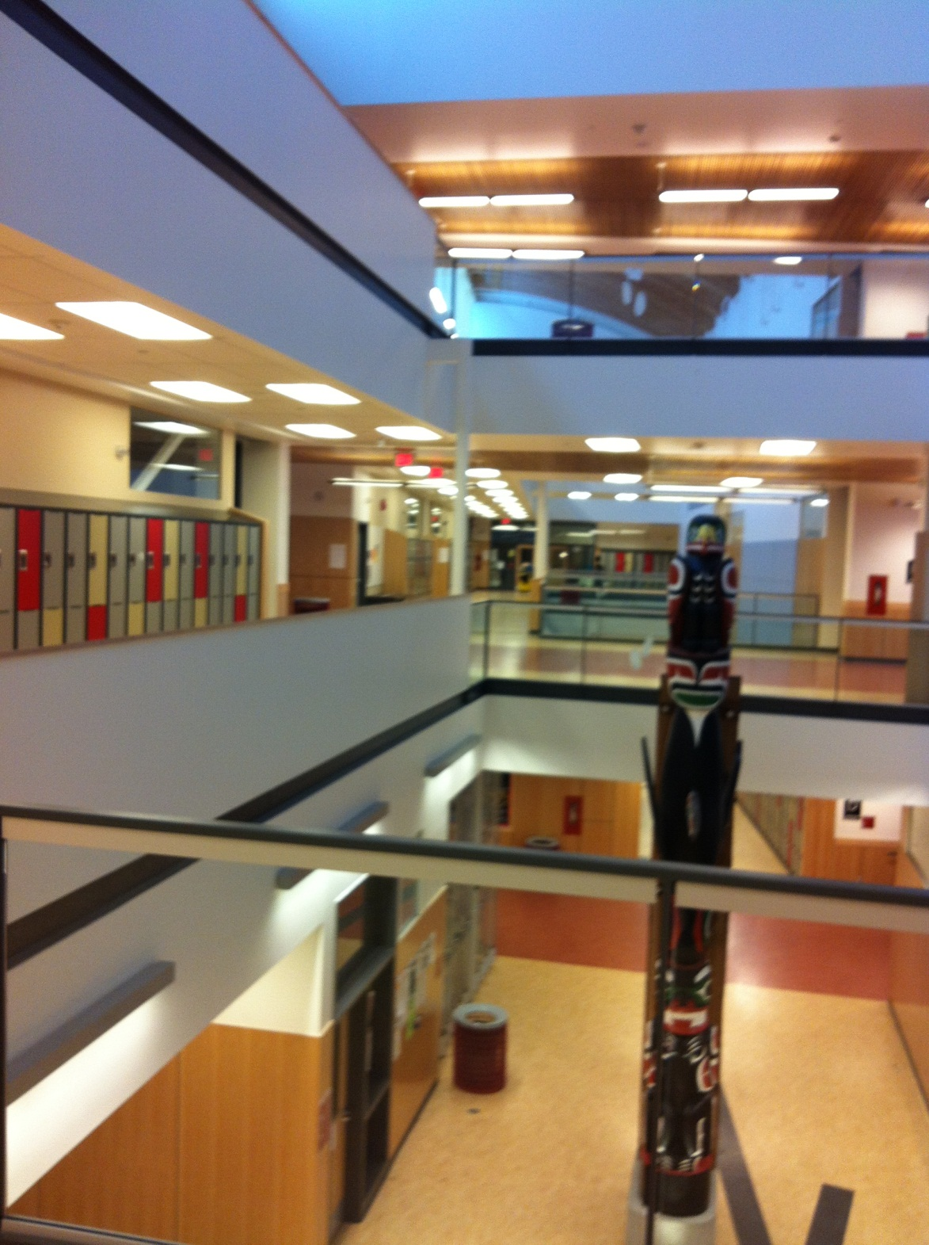

Slide 38
In order to graduate
Need 80 credits
Begin earning credits in Grade 10
Pass all courses
    if you fail a course you may have to take summer school or repeat the class

Slide 39



Slide 40



