Slide 1


Course Programming Year 5
Gr. 10 - 2018 - 2019

Slide 2


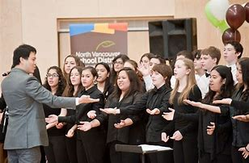
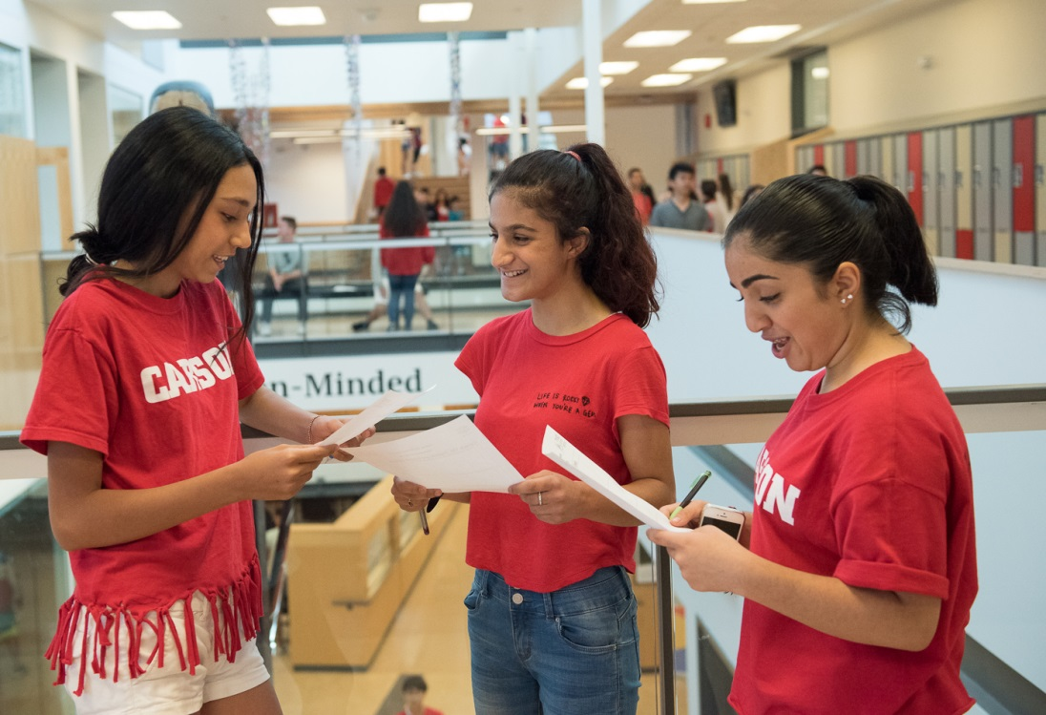

Life in High School…
GET INVOLVED!

Slide 3

How does the MYP affect course programming?
All students must:
Take a Fine Arts OR a Design Skills course
Take a Second Language course
Complete the MYP Personal Project
Complete 10 hours of service each year

Slide 4

Graduation Program

Slide 5

The Grad Planner
Keep up to date with current information from the Ministry of Education
Review of all programming
information in The Grad
Planner 2018/2019

Slide 6
In order to earn a BC Dogwood Graduation Diploma:
Students must have 80 credits
Students begin earning credits in Grade 10

Slide 7
Graduation Program:
80 Credits over Three Years
52 required credits (13 courses)
28 elective credits (7 courses)

Slide 8
Dogwood Graduation Requirements
Students must earn a minimum of 80 credits 52 required credits + 28 elective credits
Each course earns 4 credits
Literacy Studies 10 (New Media or Composition)
English 11 or Communications 11
English 12 or Communications 12
Social Studies 10
Social Studies 11 or 12
Science 10
A Science 11 or 12
A Mathematics 10
A Mathematics 11 or 12
Career Life Ed 10 (formerly Planning 10)
Physical Education 10
A Fine Art or Applied Skill 10, 11 or 12
Career Connects 12 (formerly GradTrans 12) 52 CREDITS
REQUIRED
ELECTIVES
28 CREDITS
80 CREDITS

Slide 9
Dogwood Graduation Requirements
Students must earn a minimum of 80 credits 52 required credits + 28 elective credits
Each course earns 4 credits
English 10
English 11 or Communications 11
English 12 or Communications 12
Social Studies 10
Social Studies 11 or 12
Science 10
A Science 11 or 12
A Mathematics 10
A Mathematics 11 or 12
Career Life Ed 10 (formerly Planning 10)
Physical Education 10
A Fine Art or Applied Skill 10, 11 or 12
Graduation Transitions / Careers 52 CREDITS
REQUIRED
ELECTIVES
28 CREDITS

Slide 10
Dogwood Graduation Requirements
Students must earn a minimum of 80 credits 52 required credits + 28 elective credits
Each course earns 4 credits
English 10
English 11 or Communications 11
English 12 or Communications 12
Social Studies 10
Social Studies 11 or 12
Science 10
A Science 11 or 12
A Mathematics 10
A Mathematics 11 or 12
Planning 10
Physical Education 10
A Fine Art or Applied Skill 10, 11 or 12
Graduation Transitions / Careers 52 CREDITS
REQUIRED
ELECTIVES
28 CREDITS

Slide 11
Dogwood Graduation Requirements
Students must earn a minimum of 80 credits 52 required credits + 28 elective credits
Each course earns 4 credits
English 10
English 11 or Communications 11
English 12 or Communications 12
Social Studies 10
Social Studies 11 or 12
Science 10
A Science 11 or 12
A Mathematics 10
A Mathematics 11 or 12
Career Life Ed 10 (formerly Planning 10)
Physical Education 10
A Fine Art or Applied Skill 10, 11 or 12
Graduation Transitions / Careers 52 CREDITS
REQUIRED
ELECTIVES
28 CREDITS

Slide 12
Dogwood Graduation Requirements
Students must earn a minimum of 80 credits 52 required credits + 28 elective credits
Each course earns 4 credits
English 10
English 11 or Communications 11
English 12 or Communications 12
Social Studies 10
Social Studies 11 or 12
Science 10
A Science 11 or 12
A Mathematics 10
A Mathematics 11 or 12
Career Life Ed 10 (formerly Planning 10)
Physical Education 10
A Fine Art or Applied Skill 10, 11 or 12
Career Connects 12 (formerly Grad Trans) 52 CREDITS
REQUIRED
ELECTIVES
28 CREDITS

Slide 13
Dogwood Graduation Requirements
Students must earn a minimum of 80 credits 52 required credits + 28 elective credits
Each course earns 4 credits
English 10
English 11 or Communications 11
English 12 or Communications 12
Social Studies 10
Social Studies 11 or 12
Science 10
A Science 11 or 12
A Mathematics 10
A Mathematics 11 or 12
Career Life Ed 10 (formerly Planning 10)
Physical Education 10
A Fine Art or Applied Skill 10, 11 or 12
Career Connects 12 (formerly Grad Trans) 52 CREDITS
REQUIRED
ELECTIVES
28 CREDITS

Slide 14
Dogwood Graduation Requirements
Students must earn a minimum of 80 credits 52 required credits + 28 elective credits
Each course earns 4 credits
English 10
English 11 or Communications 11
English 12 or Communications 12
Social Studies 10
Social Studies 11 or 12
Science 10
A Science 11 or 12
A Mathematics 10
A Mathematics 11 or 12
Career Life Ed 10 (formerly Planning 10)
Physical Education 10
A Fine Art or Applied Skill 10, 11 or 12
Career Connects 12 (formerly Grad Trans) 52 CREDITS
REQUIRED
ELECTIVES
28 CREDITS

Slide 15
Dogwood Graduation Requirements
Students must earn a minimum of 80 credits 52 required credits + 28 elective credits
Each course earns 4 credits
English 10
English 11 or Communications 11
English 12 or Communications 12
Social Studies 10
Social Studies 11 or 12
Science 10
A Science 11 or 12
A Mathematics 10
A Mathematics 11 or 12
Career Life Ed 10 (formerly Planning 10)
Physical Education 10
A Fine Art or Applied Skill 10, 11 or 12
Career Connects 12 (formerly Grad Trans) 52 CREDITS
REQUIRED
ELECTIVES
28 CREDITS

Slide 16

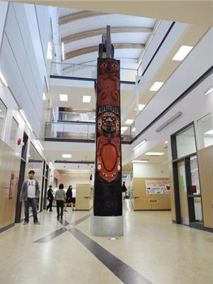
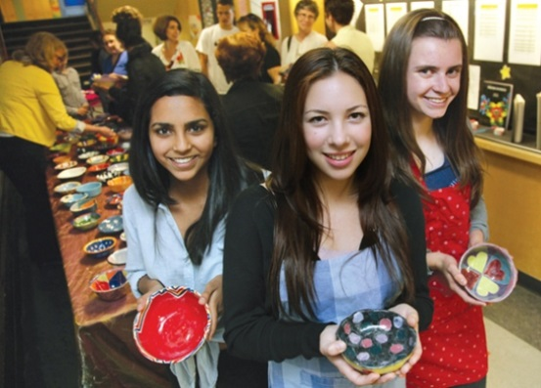
So, what should you take?!
You must consider the following:
Which electives do I want?
Which career directions interests me?
District Programs?
Which Math should I take?
What Work Experience should I get?

Slide 17
Language & Literature-New Media 10
Literary Studies 10 is designed for students who are interested in the literature of a particular era, geographical area, or theme, or in the study of literature in general. The course allows students to delve more deeply into literature as they explore specific themes, periods, authors, or areas of the world through literary works in a variety of media. Language & Literature - New Media 10 is a program of studies designed to reflect the changing role of technology in today’s society and the increasing importance of digital media in communicating and exchanging ideas.
This course is intended to allow students the flexibility to develop a program of study centred on students’ interests, needs, and abilities, while at the same time allowing for a range of local delivery methods. New Media 10 recognizes that digital literacy is an essential characteristic of the educated citizen. Coursework is aimed at providing students with a set of skills vital for success in an increasingly complex digital world by affording opportunities to demonstrate understanding and communicate ideas through a variety of digital and print media. New Media 10 explores tasks and texts designed to introduce students to the study of New Media.
.

Slide 18
Language & Literature-Composition 10
Designed for students who are interested in the literature of a particular era, geographical area, or theme, or in the study of literature in general. The course allows students to delve more deeply into literature as they explore specific themes, periods, authors, or areas of the world through literary works in a variety of media. Language & Literature - Composition 10 is designed to support students as they refine, clarify, and adjust their written communication through practice and revision. Students will read and study compositions by other writers and be exposed to a variety of styles as models for the development of their writing.
The course provides opportunities for students to, with increasing independence, study, create, and write original and authentic pieces for a range of purposes and real-world audiences. They will expand their competencies through processes of drafting, reflecting, and revising to build a body of work that demonstrates expanding breadth, depth, and evidence of writing for a range of situations. They will develop confidence in their abilities as they consolidate their writing craft.

Slide 19
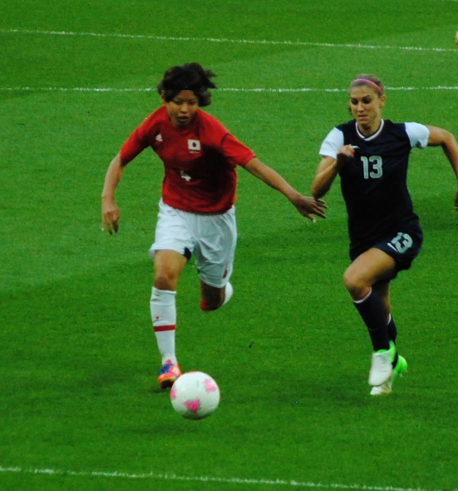

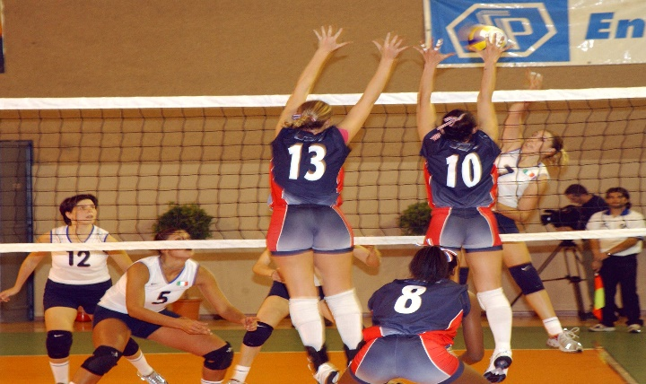
North Vancouver District Programs Available to all Grade 10 Students
Art Academy
Digital Media Academy
Dance Academy
Field Hockey Academy
Hockey Skills Academy
Basketball Academy
Outdoor Ed Academy(Feb 7)
Soccer Academy
Volleyball Academy
Lacrosse Academy
Distributed Learning
Peak Performance
Work Experience/Apprenticeship

Slide 20
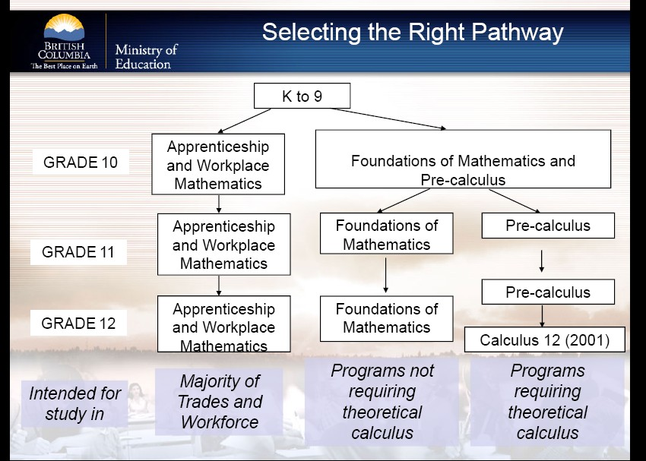

Slide 21
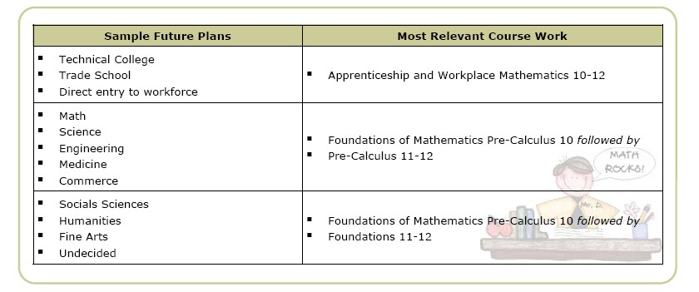


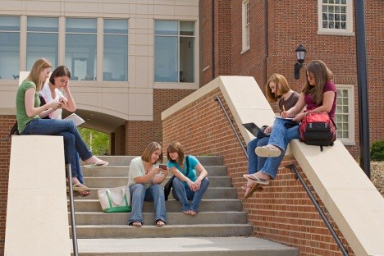


Slide 22
Gr. 10 Electives
Inside Timetable
Year long courses in Green – 4 credits
Semester courses in black – 2 credits
Design Electives
Design & Tech
Foods
Engineering
Info Tech
Textiles
Photography
Yearbook & Journalism
Fine Arts Electives
Art Design 2D
Art Design 3D
Theatre
Concert Band
Concert Choir
Chamber Choir
Guitar

Slide 23
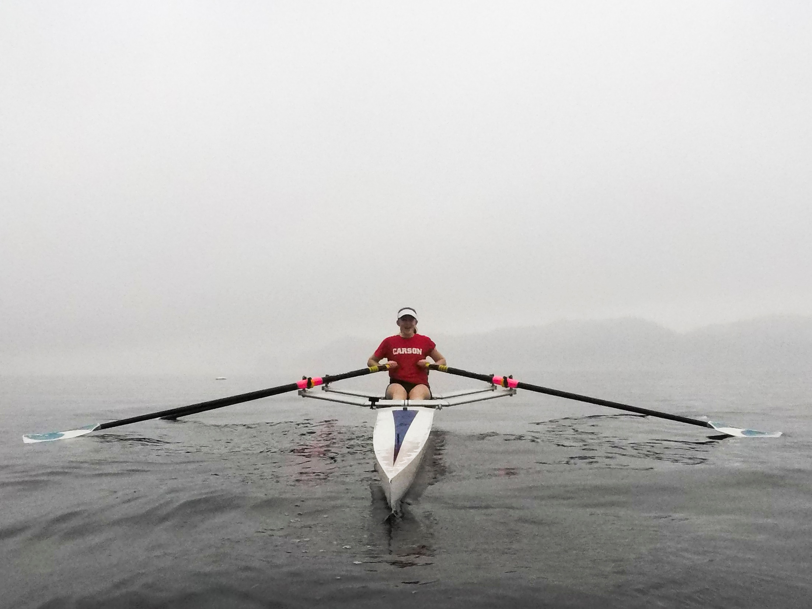
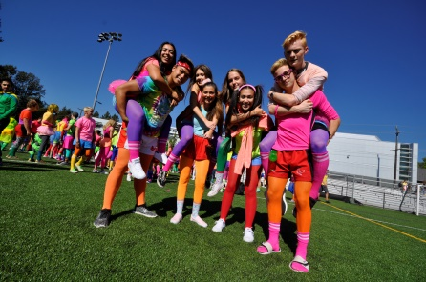
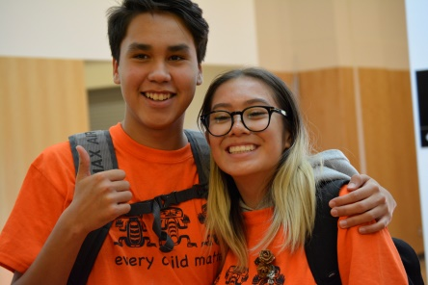
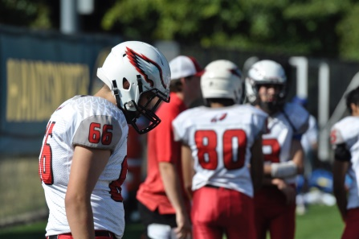
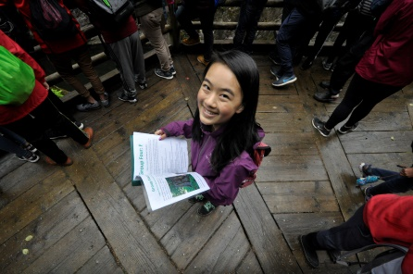
Yearbook Journalism 10/11/12
This course focuses on creating the school’s yearbook.
  Learn page design using InDesign
  Basic image manipulation using Photoshop
  Basic graphic design using Illustrator
  Journalism and creative writing
  Marketing skills
  Photography and photo journalism
Perks!
  Field trips to CBC Broadcasting studios
  Exclusive access to events, games, and shows
  Learn practical teamwork and leadership skills
  Produce an actual Book!

Slide 24


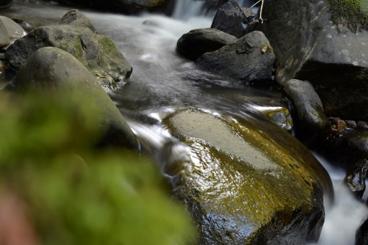

NEW! Photography 10!
This is a beginner course in digital photography.
  FUNdamentals of basic digital camera functions
  Image composition
  Basic Photoshop manipulation
Perks!
  Field trips (past Photography trips include, snowshoeing on Mt. Seymour, hiking to Quarry Rock, exploring Capilano Suspension Bridge, etc.)
  Getting outside!
  Having the best profile and Instagram pictures

Slide 25
Additional Courses
Outside the Timetable
Community Initiatives 10
Beginner Band
Vocal Jazz (must also be taking Concert Choir)
Jazz Band (must also be taking Concert Band)
Improv
Work Experience
Distributed Learning
These courses may be taken in addition to the EIGHT entries on your course selection sheet.
x
x

Slide 26

Summer Learning Details
Programs | Review & Completion Courses | ​Full Credit Courses | Elementary Summer Learning
 | 7/8 Transition: Regular, IB and French Immersion ELL Numeracy (Math 8 & 9) Literacy (English 8 & 9) | See next slide | Grade 4/5/6 Q or R Grade 5/6/7 G or D
Locations | Carson Graham Secondary | Carson Graham Secondary | Westview Elementary
Dates | July 4 - July 26 | July 4 - August 1 | July 3 - 11 August 20 - 29
Times | 8:30am - 11:15am | 8:30am - 12:30pm | 8:30am - 12:00pm

Slide 27
What we offer
Grade 10 | ​Grade 11 | Grade 12​​
​English | ​Biology | ​​​​​​Biology
Creative Writing and Literature Studies | ​​Chemistry | ​​​​Chemistry
Foundations of Math and Pre-Calculus | English | Creative Writing
​​Physical and Health Education | Foundations of Math | ​​​English
​​Science | Pre-Calculus​ | Foundations of Math
Social Studies | Physics | Pre-Calculus
 | Social Studies Exploration History, Human Geography and Philosophy | Physics
​​ | ​ | Human Geography
 | ​ | ​​Twentieth Century World History

Slide 28
Course offerings:
Fast Track
Enroll between May and July
Full access to teacher support/ DL Centre from May 1st to July 31st
Recommended completion date of July 31st
If not completed, can work in August into the fall term
Grade 10
Planning 10
PE 10
French 11

Slide 29
registration
Continuous Entry Courses
Registration form currently on the website
Register anytime up to July 5th
1 year to complete the course from date of registration
DL Centre access from September to July 31st
No DL Centre access or tracker support in August
Fast Track Courses
Registration forms will be on the DL website after Spring Break
Register between May 1st and July 5th
Recommended completion date is July 31st

Slide 30

Distributed Learning: What is It?
Alternate way to complete core academic courses and electives at the Grade 10, 11, and 12 levels – online
BC Ministry of Education approved courses
Teacher-student interaction is both online and blended
Continuous entry and self-paced
Learning with a technology focus;
using online tools

Slide 31
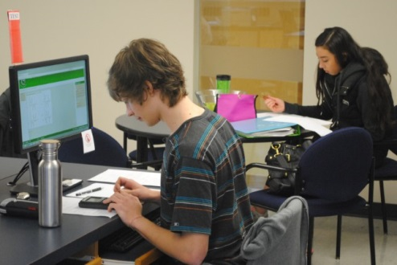
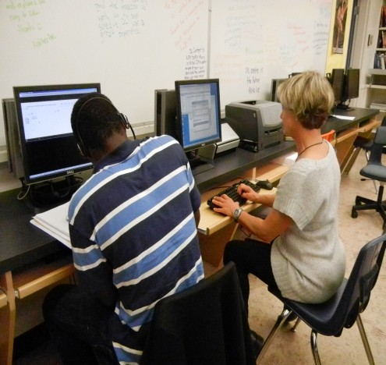
DL Centre Model
The DL Centre is a computer lab, classroom, or work space for students to meet with DL teachers for face to face interaction.
Main DL Centre: Mountainside Secondary
DL Centre opened daily
Test invigilation, tutorial support, tech support
Satellite DL Centres (at each Secondary School)
DL Centre hours posted on school website
Test invigilation, tutorial support, tech support

Slide 32
Distributed Learning: Who is it for?
You are a good candidate for DL if:
You are academically engaged
You are self-motivated
You are organized and have good time management skills
You have the ability to manage stress
You have the willingness to challenge yourself
You have the ability to present ideas and express yourself clearly

Slide 33

Interested in the IB Diploma Programme?
Although you still have a year to decide, it is never too early to consider your options!
https://www.sd44.ca/school/carson/ProgramsServices/IB/diplomaprogramme/Pages/default.aspx
Info session January 30th at 7pm at Carson if you’re interested in learning more!

Slide 34
Course Programming Sheets

Slide 35
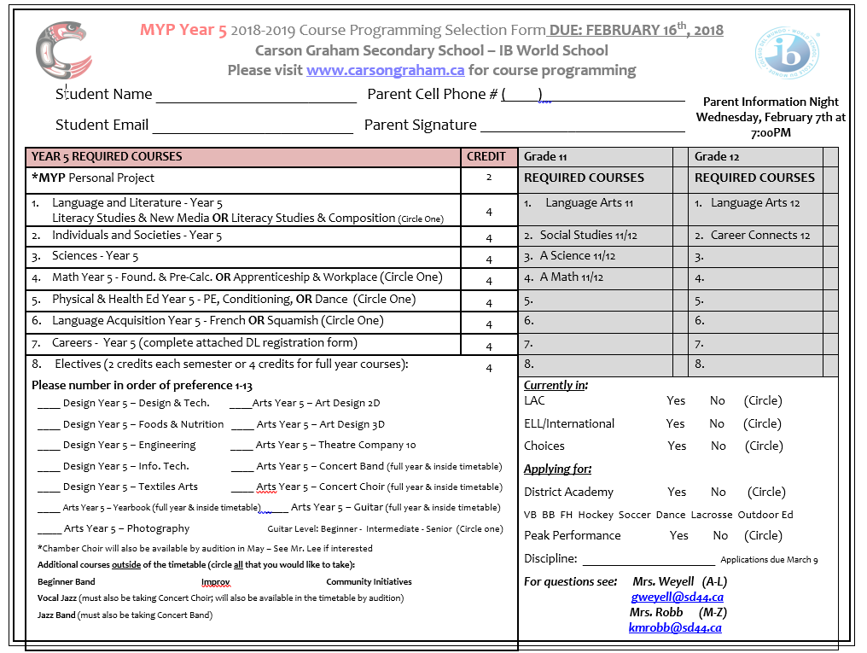

Slide 36
Gayle Weyell
604 903-3555
gweyell@sd44.ca
Gayle Weyell
9
8
3
10
7
4
5
6
12
1 & 2
11

Slide 37
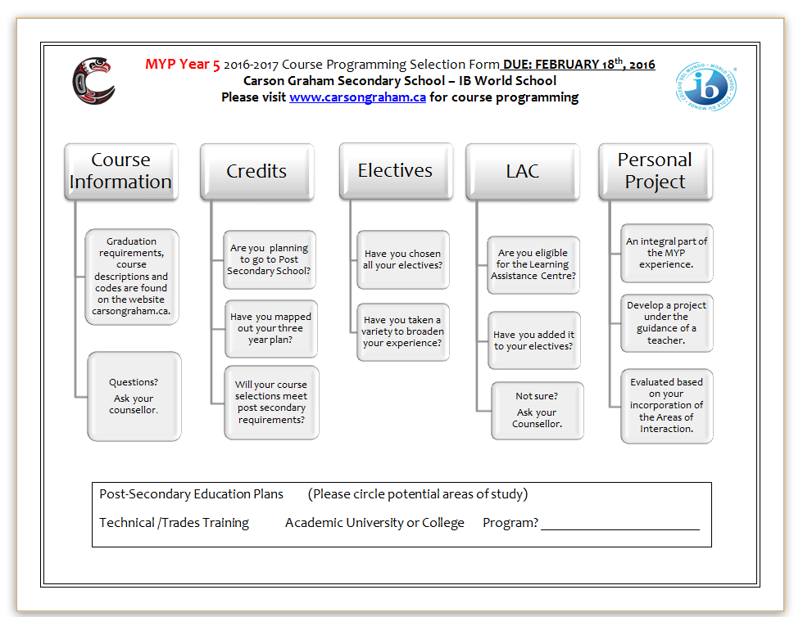

Slide 38

Submit your sheets as early as possible.
Where? Counselling Office
When? ASAP
Deadline to submit sheets: February 16th

Slide 39
Questions?
Visit: http://www.carsongraham.ca
Students
Course Programming
Course Descriptions
Speak with teachers for information and/or recommendations
See your counsellor
Talk to your parents

Slide 40
Current Grade Nine CounsellorS:
  Mrs. Weyell A – L
  Mrs. Robb M – Z
  Parent Night Feb 7, at 7:oopm

Slide 41

Questions?

